Slide 1
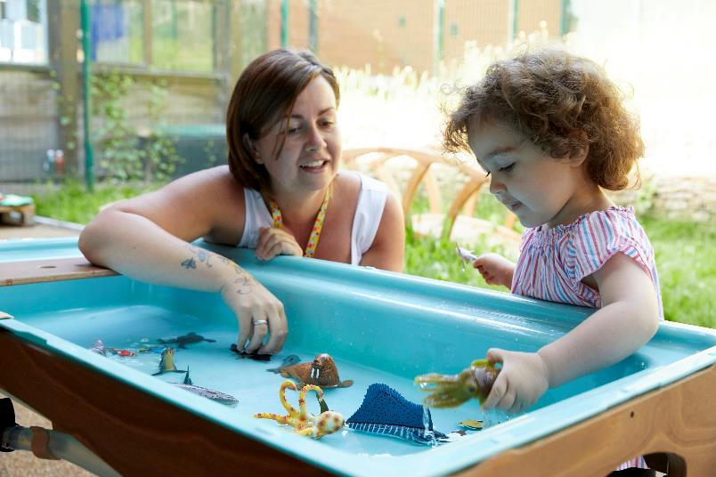
Creating innovative partnerships to break down barriers- the Sheffield Early Learning Community
Rachel Parkin, Save the Children UK
Dr Sally Pearse Sheffield Hallam University

Slide 2
Source: Waldfogel and Washbrook (2008)
Notes:
Why are we working in the Early Years? Firstly, because currently children growing up in poverty are much more likely to fall behind in the early years, and if they fall behind now then they are much more likely to continue to be behind in later life.
And we know that poverty in their early years affects children for the rest of their lives. Between two children – one from a high-income family, one from a low income-family, the differences in resources and environment those children have, the stresses their parents face and support they receive, all contribute to the poorer child learning less.
By age three, the average child from a low-income family is up to 17 months behind those from wealthier families.
At 16, only 24% of disadvantaged students get a good pass in English and Maths GCSE, compared with 49.9% of all other pupils.
And this gap gets wider and wider as these children age, affecting qualifications, employment, and ultimately entrenching inequalities across generations.
Child poverty has been rising for the past ten years and is accelerating with the pandemic, so this is a problem that has been and will continue to get worse. With lockdowns and school disruptions, it’s been the poorest children who’ve fallen the most behind, with many education experts warning about a 'partially lost generation’.

Slide 3
Early Learning Communities
The Early Learning Communities programme aims to improve early learning outcomes for children growing up in poverty in the UK
It builds on the evidence base and knowledge of local services, organisations and families in five communities across the UK: Feltham (West London), Margate, Bettws (Wales), Sheffield and East Belfast
In these communities we're exploring how working together through a whole system approach can fundamentally change the way children living in poverty are supported to learn and develop
Notes:
Part of our response is taking a place based systems change approach to try to tackle root causes, local to a community, based in evidence, and share what is learnt to help improve practice and policy change more broadly
We work together to test new approaches, in partnership with families, and develop local innovative solutions as well as embedding the ethos of adaptation

Slide 4
The Sheffield Partnership

Slide 5
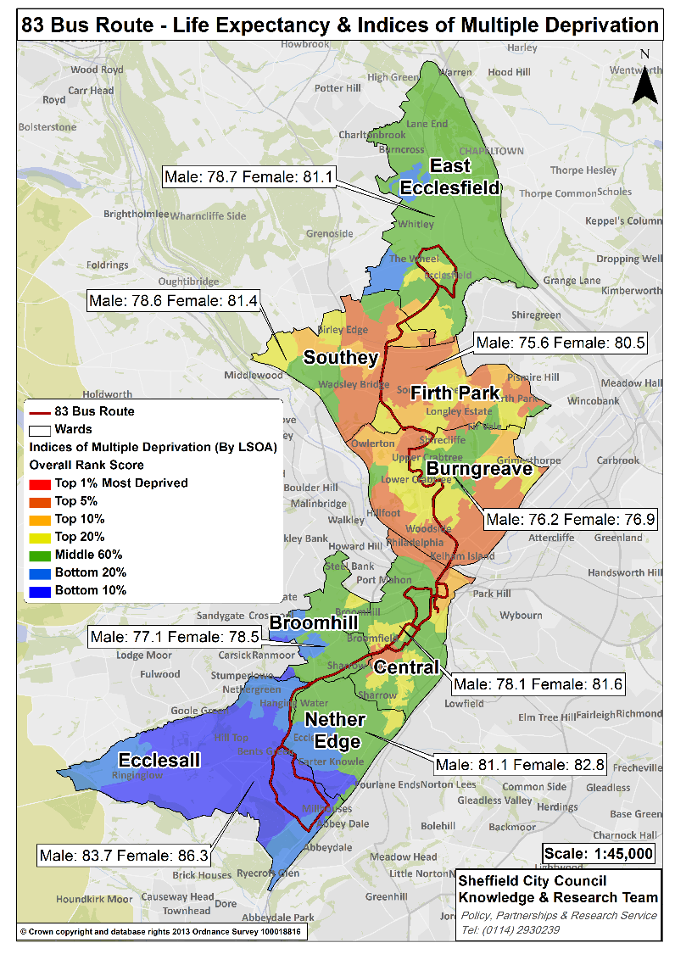
Health and Social inequalities
In Sheffield the 83 bus route, which showed an 8 year difference in male life expectancy of (83.7 years in Ecclesall to 75.6 years in Firth Park) in 2013 is used to illustrate the health inequalities in the city.
The Shirecliffe community sits in the central part of the route between Burngreave and Firth Park.
Shirecliffe is in the top 10% most deprived areas on the Indices of Multiple Deprivation
The work of Sir Michael Marmot’s Institute of Health Equity highlights the relationship between the experience of economic inequality and the likelihood of experiencing chronic ill health (with associated co-morbidities) at an earlier age. (www.sheffieldccg.nhs.uk)
Notes:
Why Area B?

Slide 6
Sheffield Early Learning Community Priorities
Overall outcomes for children aged 0-3
Speech, Language & Communication
Social & Emotional Development
ELC Workstreams
Building Community Aspirations
Community Cohesion
Systems Navigation
Workforce Development
Parents as Partners
Parental Mental Health
Principles
Working in Partnership
Innovation & testing
Family & child led
Common Language
Simple engaging communication
Asset based
Reflecting diversity

Slide 7
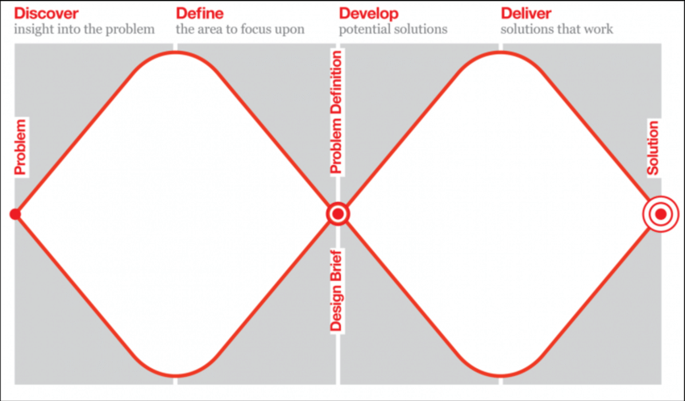
Co-design
Notes:
Single, standalone programmes are unlikely to change early learning outcomes for the most disadvantaged children. To create long-term change, we need joined-up, sustainable support for children and their families, which is shaped by the experiences of families and rooted in the specific challenges that individual communities face.
That’s why we’re working in communities to catalyse and support local partnerships to improve the early learning support available to families. In our Early Learning Communities (ELCs), we work alongside a range of local organisations and families to understand the specific issues they face and develop solutions that work locally. We bring together everyone in a community who influences young children’s learning, breaking down barriers between services and making sure that families play a key role in designing the support they get.
We design innovative new approaches and test whether and how they best support families. We use the rich learning that we gain from this work to influence policy and practice at the local, regional and national level. We host a learning network of partners and organisations around the UK to share learning about what works and we work with partners and families to campaign for policy change that better supports communities.

Slide 8
Co-design continues
Innovations start to be tested
Family Hub funding secured (SCC)
Nursery provision expands
Parental pathways developing
Cross organisational referrals increasing
Research projects grow
Timeline
Covid pandemic starts
Review of priorities
Emergency responses inc grants and home learning resources
Nursery & EYCRC development work continues
Joint funding bids submitted
2019
2020
2022
2021
The Meadows nursery & EYCRC opens April 2021
Funding secured
Pilot of Explore, Play, Learn
Pilot of extended FEL places starts
Secondment of team to the ELC
Co-design starts in Page Hall area
Strategy development using Early Years evidence and the ELC toolkit produced by Dartington Design Lab
Involvement of multiple stakeholders across the area including professionals and families

Slide 9
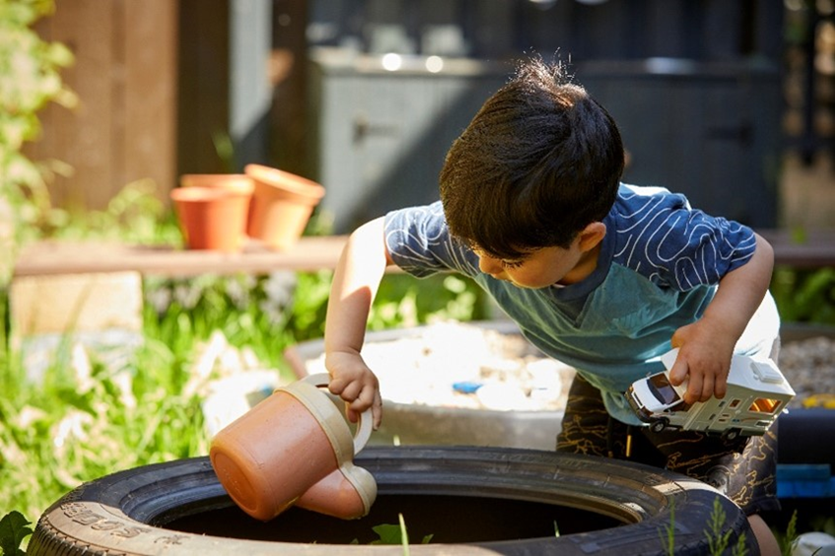
The EYCRC as an exemplar of the early learning community partnership......
The Early Years Community Research Centre (EYCRC), based alongside a primary school in Sheffield opened its doors in April 2021.
The Centre offers up to 40 full-time nursery places for children aged 2-5 and is a hub for innovative early years learning and inter-disciplinary research.
It is the result of a unique partnership between the School, Sheffield Hallam’s social mobility programme South Yorkshire Futures, Save the Children UK, and Sheffield City Council.

Slide 10
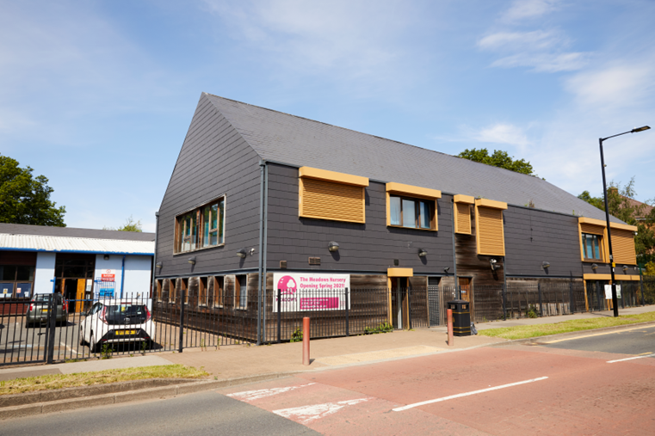
The Centre received a £345,000 grant from the Department for Education School Nurseries Capital Fund Innovation Pot to support the renovation of the physical space from 2018-2021.
The Nursery has also benefited from charitable donations from local businesses such as Henry Boot Construction and John Lewis to provide much-needed equipment.

Slide 11
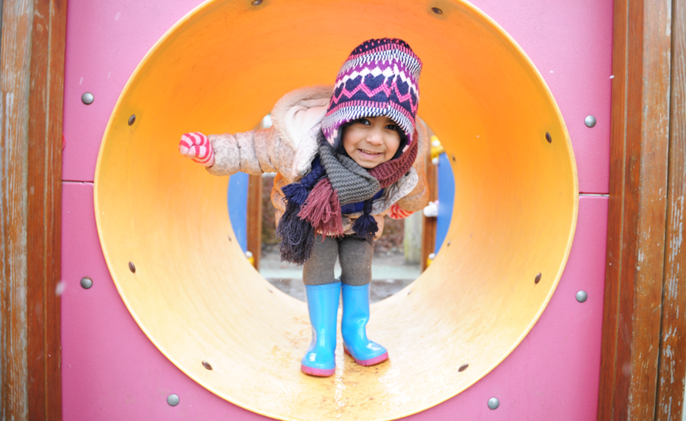
.
Hallam’s Civic Ambitions
As well as providing much-needed nursery places in a disadvantaged area in Sheffield, the Centre will also provide placement and research opportunities for University students. This also increases capacity for practical projects that partners cannot meet.
Students across the University, including those studying Architecture and Early Childhood Studies are supporting the design of an innovative outdoor space at the Centre.
Film Production graduates have completed internships to create marketing and promotional materials to help communicate the Centre’s offer to the community.

Slide 12
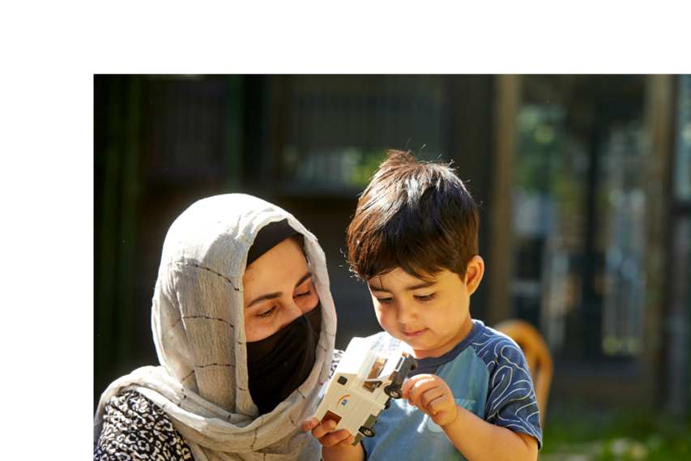
Meadows Nursery – Changing Lives Through Relationships
The benefits of relational approaches
Trust with children and families
Co-design
Co-location
Joint delivery of services
Parents accessing services
CPD on relational approaches

Slide 13
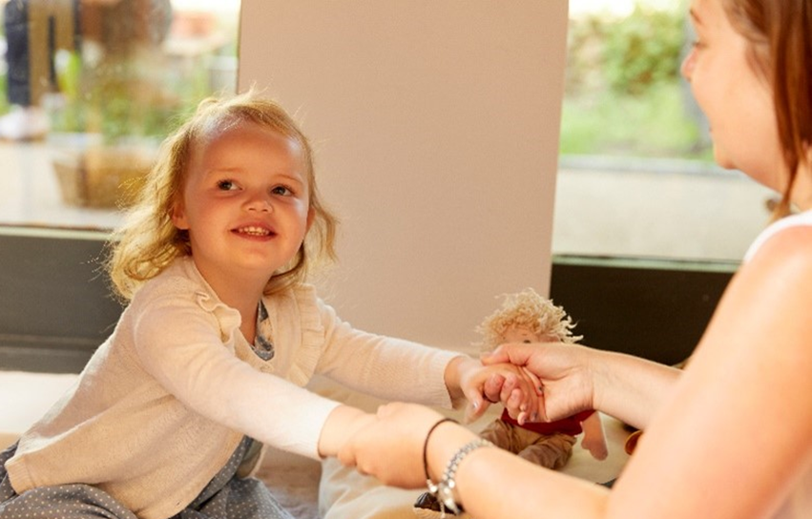
With funding secured through our collaboration with Save the Children UK, we can offer a child a place at the nursery as soon as they reach their second birthday.
Syrenna's daughter Willow was able to join the nursery early.
“The community really needed a nursery in the area, especially for little ones. Willow hasn’t had much interaction with other children, so I wanted her to be confident and social with others. After the year everyone has had I was worried that Willow wouldn’t enjoy nursery and being around others, but I think it was what she needed.
“I’ve noticed her speech is coming on, she is trying to put words together now. Also, she is wanting to be more independent and do things for herself. I am really pleased the nursery has been able to help her become confident and her own little person.”

Slide 14
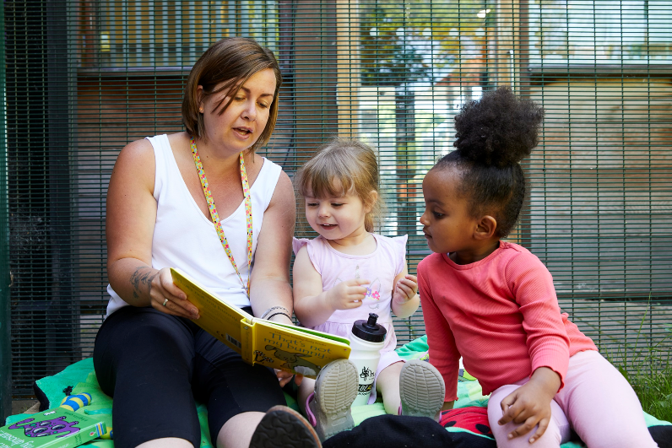
.Financial benefits of the partnership
The Early Learning Community has attracted additional funding for:
Nursery places
Early intervention through the Explore, Play, Learn group
Improved capacity within organisations so they can focus on co-construction of services with families from local communities.

Slide 15
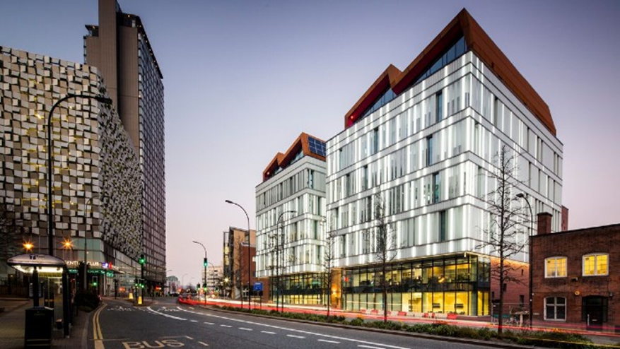
Research and innovation
Policy Influencing – Free Early Learning pilot project
Practice influence – Listening Rooms research with Meadows Practitioners
Service design – co-design tests
Piloting innovations and interventions - Explore, Play, Learn , TWiTCH
International collaboration

Slide 16
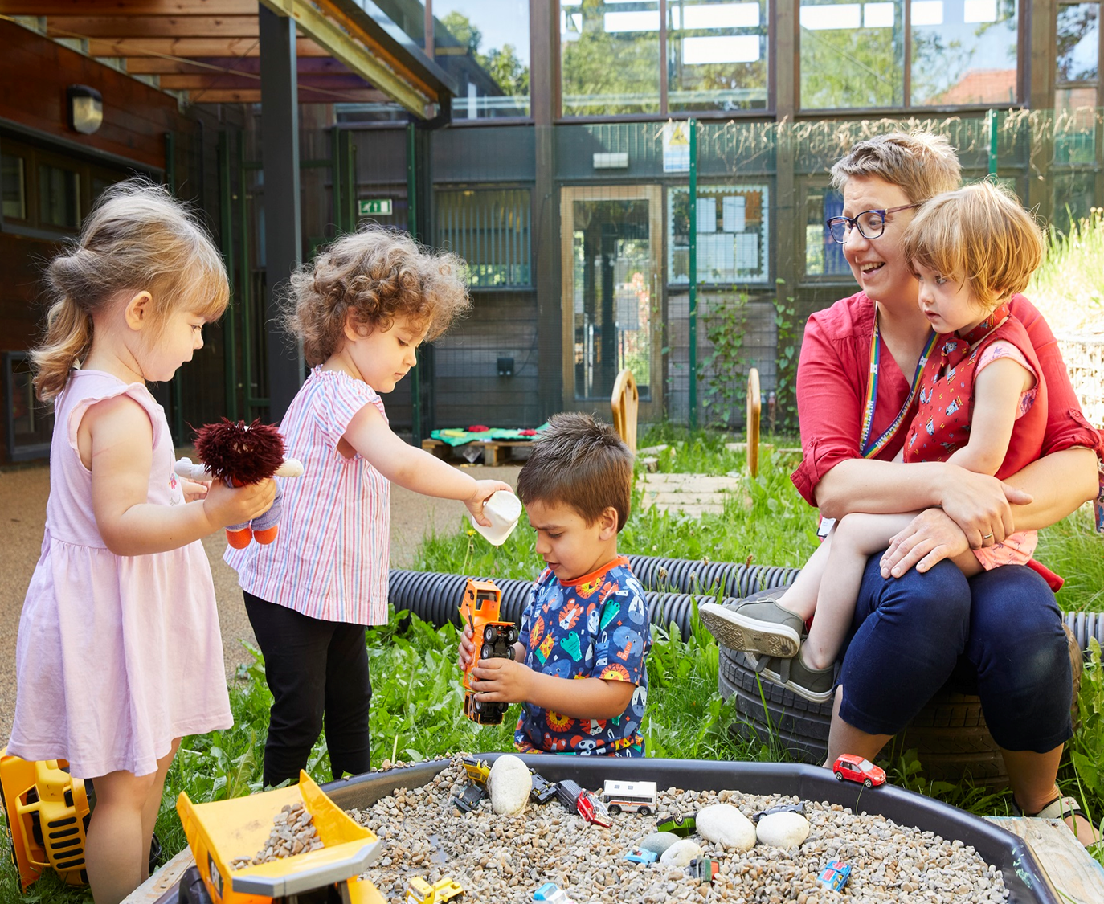
Next Steps
Long-term sustainability of the Early Learning Community including principle of parents as partners, co-designing services
Embedding within the Family Hubs Programme
Applying to become a Stronger Practice Hub
Passing the baton
Continuing to work with parents to identify gaps in services
Realising the potential of the university to provide capacity within the community

Slide 17
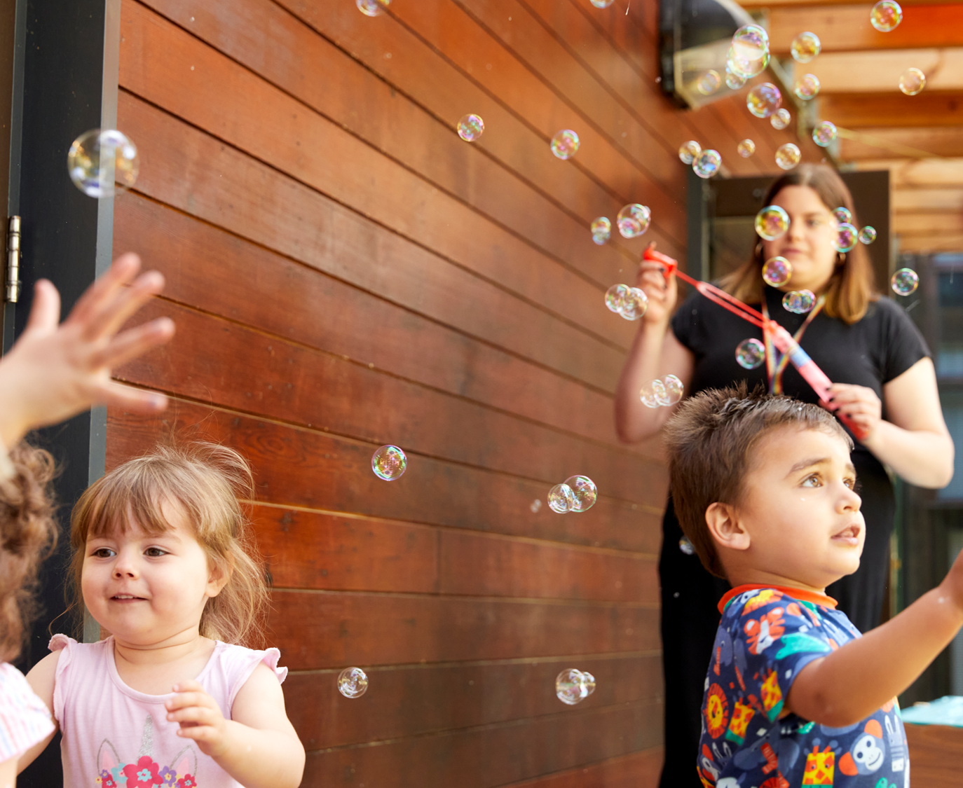
“
“I am incredibly proud of this project. It demonstrates the vital role universities play in tackling economic and social inequalities in the regions they serve.
It is an excellent example of the impact collaborative partnerships can have. It is at the heart of our commitment to providing young people with every opportunity to thrive.”
Professor sir Chris husbands
Vice-chancellor

