Slide 1
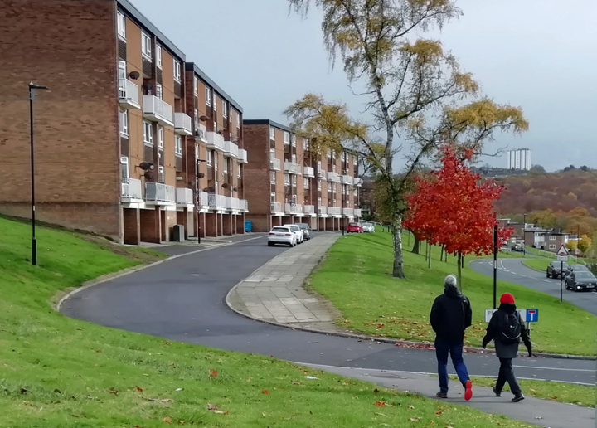
Listening to the local leadership at the neighbourhood level
Dr Jeni Vine
University of Sheffield
Urban Studies and Planning Department

Slide 2
Why do local leaders get overlooked?
Themes of history (the need to explore and understand what the experiences are of those in England’s original industrial revolution spaces - Nayak, 2019)
Themes of relationships (consultations as a form of cruel optimism - Berlant, 2011)
Themes of space (place-based effects of slow violence within communities that have been devastated over a prolonged period of time. In the North of England, this stems from deindustrialisation combined with austerity - Pain, 2019).
Themes of leadership (an emergent phenomenon that arises from interactions and events - Lichtenstein, 2006)

Slide 3
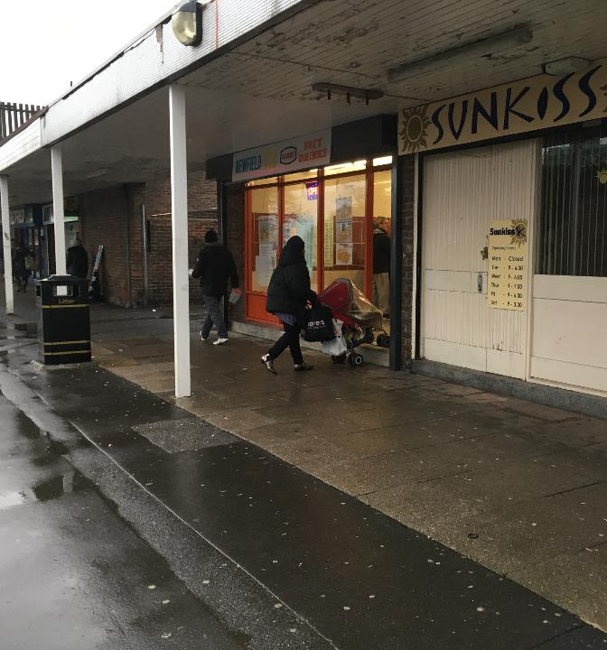
Research focused on
economically deprived neighbourhoods in Sheffield that have seen a demographic change from being almost entirely white and homogenous in culture at the millennium, to having around 15-20% minority ethnic populations.

Slide 4
History of dispossession
“I was 10 years old and on the 1st May 1935, I and my family moved on to M__ Road, on the AB. I thought it was lovely to have a bedroom on my own and a bathroom with hot and cold running water......All our old neighbours lived on our block and we used to leave our doors open whilst we went for a chat next door. In those days we never had to worry about anyone going in and stealing anything.......Today I keep my front door and back door locked all the time; some years ago we were burgled during the night, which was a terrible experience.”
Quote from Arbourthorne Views, Monteney Community Workshop Trust, 2003

Slide 5
Dispossession through demolition
“It is important that AB should offer a wide range of housing types and densities, to ensure a balanced community in a rich and varied urban environment.”
“Affordable housing will be pepper-potted throughout the whole of AB, so that it is virtually indistinguishable from market housing.”
Extract from Masterplan for the neighbourhood, completed 2005

Slide 6
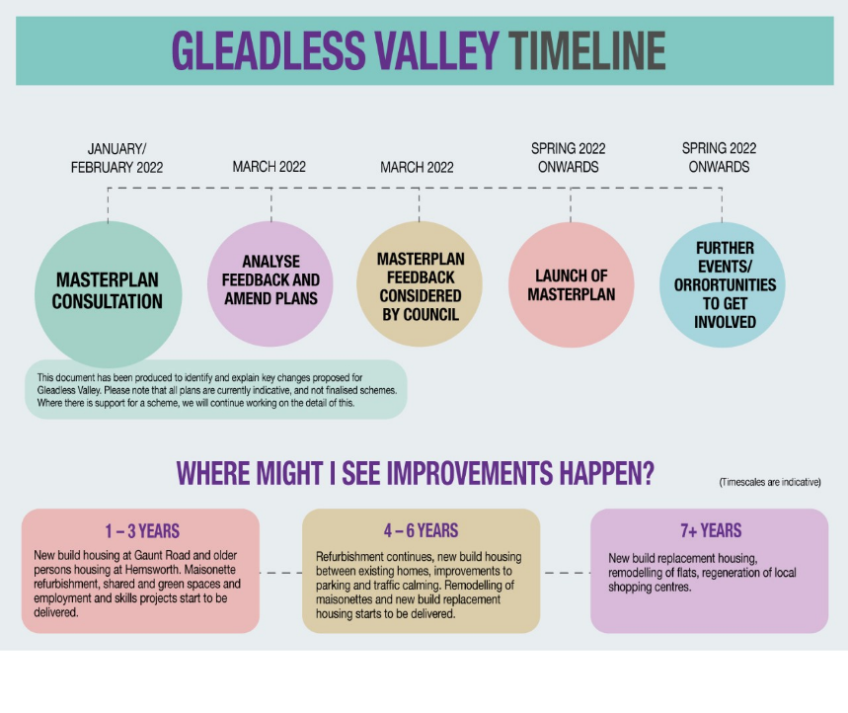

Slide 7
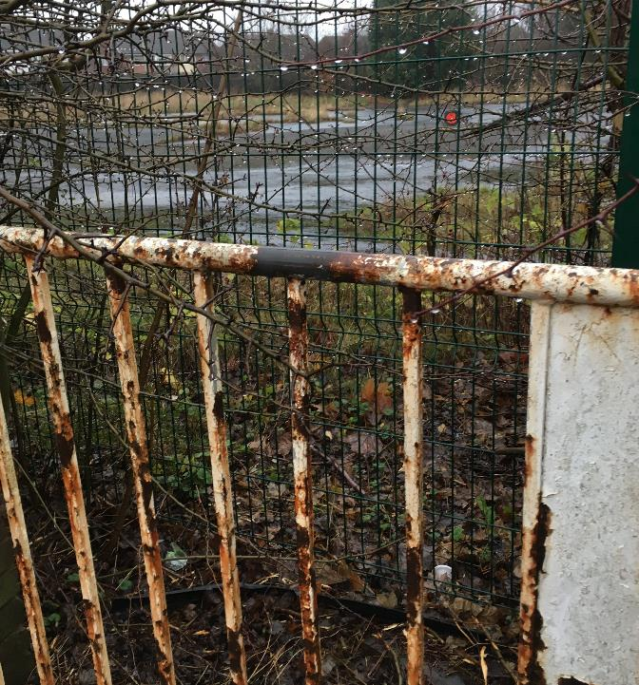
very little research has focused on those who have been dispossessed in the process of gentrification
gentrification might better be understood as a form of 'social harm' (Hillyard et al, 2004) or 'structural violence' (Galtung, 1969; Johnson, 2011).

Slide 8
Relationships
“There was an old couple that lived near mum and [the woman] passed away. The strange thing was, he was the one with the ill health and they expected him to die first. He didn't. She passed away, bless her, but he followed very quickly and people were mortified that it was, for want of a better word, a black family that got this house. "There's enough white people on the waiting list” they said.
Quote from Joan, local community leader

Slide 9
Asked what the gym is about, Spike replied:
“The community more than anything. We've got boxing. We’ve got all the facilities in the world, but it's the people here what make it, it's not the gym. We've got probably one of the best gyms in Sheffield. Floor space, better equipment and everything else but it's not that, we've got a Dream Team. Everybody helps, nobody judges. Everybody wants to help. I work 50 hours a week. I love my job. I see people's lives change every day.”
(Spike, volunteer, community gym)

Slide 10
“All the time, they're going on about anti-social behaviour. Most of that behaviour in't anti-social, it's social. It’s kids meeting together hanging about at shops, hanging about around estate. Where are they going to go if there's nowhere for them to go? Herdings Youth Centre when I was a kid, six days a week that were open……… All they provide now is two nights a week and all that is for is eleven plus. It's not good enough. There’s nought there for younger ones.” (Shep, pub landlord and community activist)

Slide 11
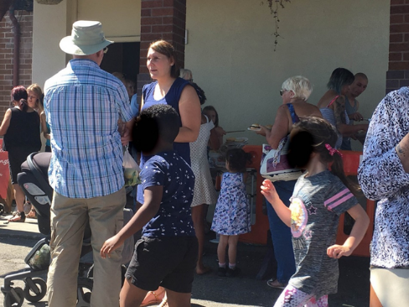
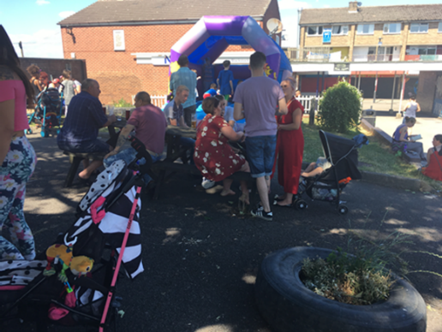

Slide 12
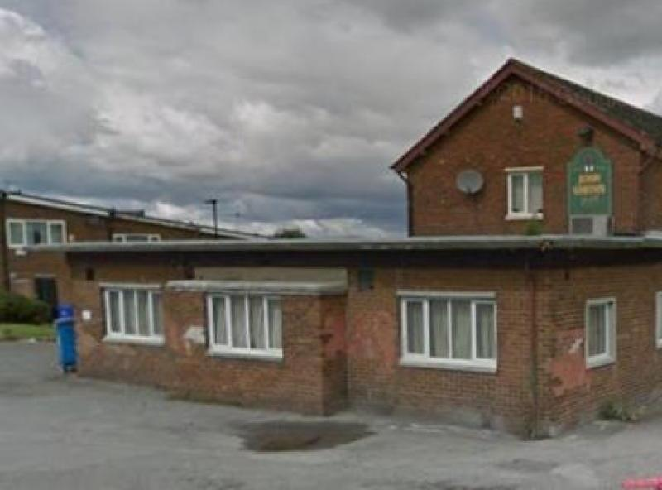

Slide 13
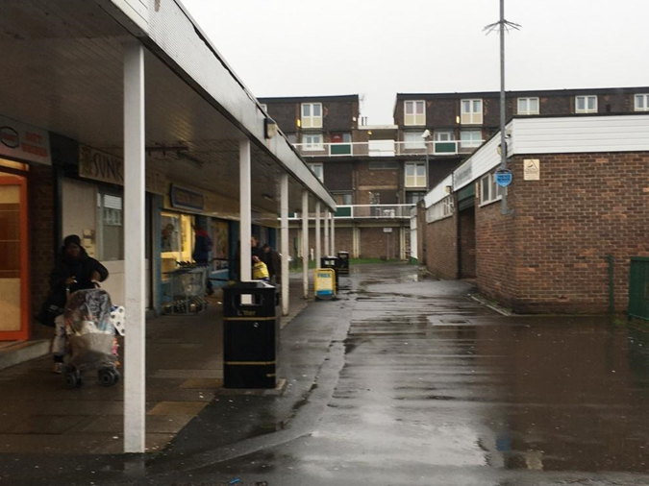
Space/place
“Somewhere I've got a letter saying nothing will change. But we have no lights on the walkway. The lights now that light up the shopping centre at night, the council installed some at the front and the community centre. And now they're not turned on. They'll be turned on tonight because of the …. meeting tonight, the general meeting, yes, they'll be turned on tonight. And I get sent outrageous bills for electricity. And that's been sold on, somebody in London who is trying to screw every penny out of there because it's a long-term investment.” (Liz, local resident)

Slide 14
Hidden transcripts and action research
It is possible to understand what appears as inaction as a refusal, by indirect means, in the way that Scott (1990) articulated through his concept of ‘hidden transcripts’. Through this lens, the local leadership understands that to directly refuse any offer may not be in their interests, so there is the appearance of encouragement and acceptance, while at the same time knowing that what is offered is of no interest to them. To accept that I was not sufficiently in tune with the neighbourhood’s ‘hidden transcripts’ offers the possibility of extending dignity and respect towards the emergent leadership and their wise handling of yet another person telling them what might be good for them. By appearing to support the workshops, but then not encouraging any of the people they have influence with to attend, becomes understood to be a positive act. Dignity is maintained without confrontation. In Walkerdine’s words:
“in failing both to recognize and to support the understanding of community past and present affects and meanings, not simply at an individual level, but at the level of the relationally produced communing itself, we deny crucial support to those communities struggling in the face of huge economic changes” (Walkerdine, 2016:703).

Slide 15
"Well, who’s the mug here, I get my repairs done for you, but you got a mortgage and you've got to pay for your repairs [laughter] No, that kind of thing. There is a big thing about class coming into it; who lives in social housing, who doesn't. There seems to be this thing that if you live in social housing then you've not got any modicum of intelligence.” (Joan, local community eader)

Slide 16
As Lauren Berlant points out, it is a deeply political project to influence the affect in a neighbourhood and this presentation has been an attempt toward “explaining crisis-shaped subjectivity amid the ongoingness of adjudication, adaptation, and improvisation” (2011:54).

