Slide 1
Neighborhoods and Youth Voice: A Qualitative Exploration of Local Institutions and Young Person’s Well-being
Brenda Mathias
University of California, Berkeley
Spring 2022

Slide 2
Introduction
“Going there I’ve met a lot of good people and good friends that I’ve been friends with for 5 plus years already. And it’s just a good way to build working skills, community skills, social skills”
- M.X., 16 year-old self-identified Latinx female

Slide 3
Neighborhoods and Local Institutions

Slide 4
Well-being
Photo credit: Chapter 510

Slide 5
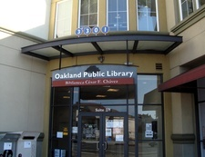
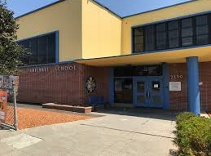
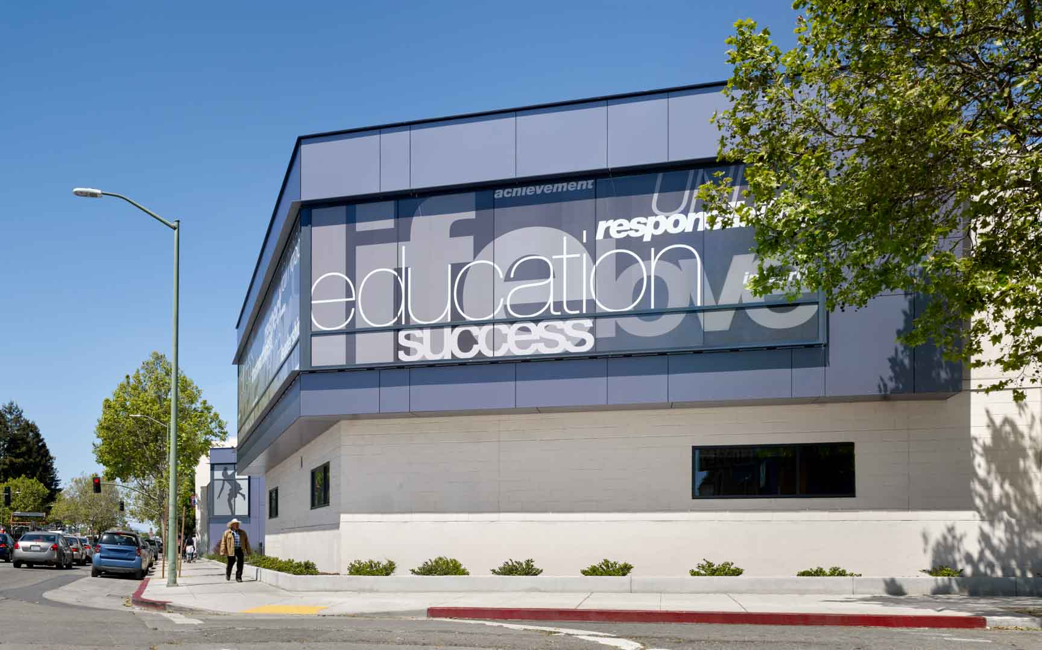
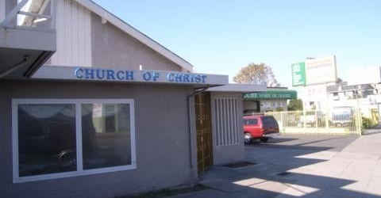
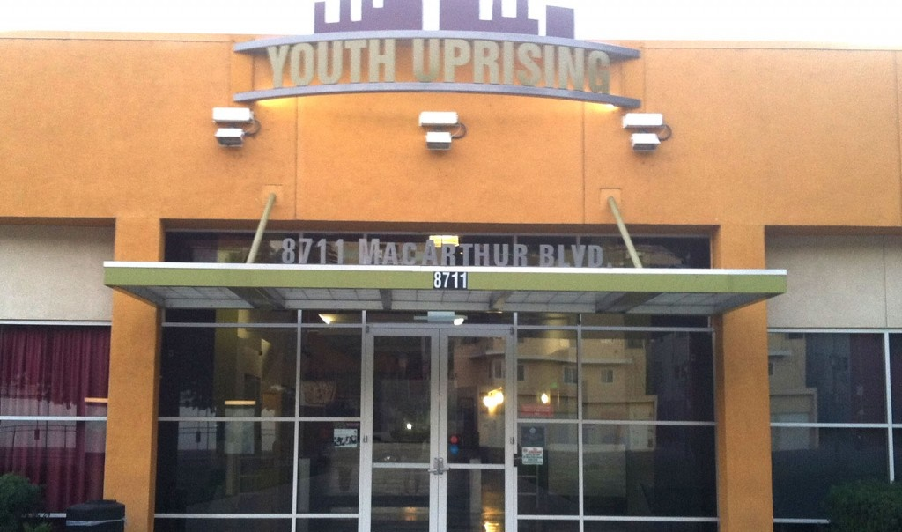
Neighborhood Institutions
Photo credits: City of Oakland, East Oakland Youth Development Center, Youth Uprising

Slide 6
Theoretical Framing: Community Youth Development
Individual strengths,
Decision making, Awareness opportunities
Adult & peer relationships, Program activities, resources
Young person participation
Young person well-being
Institutions
Source: Perkins, 2009

Slide 7
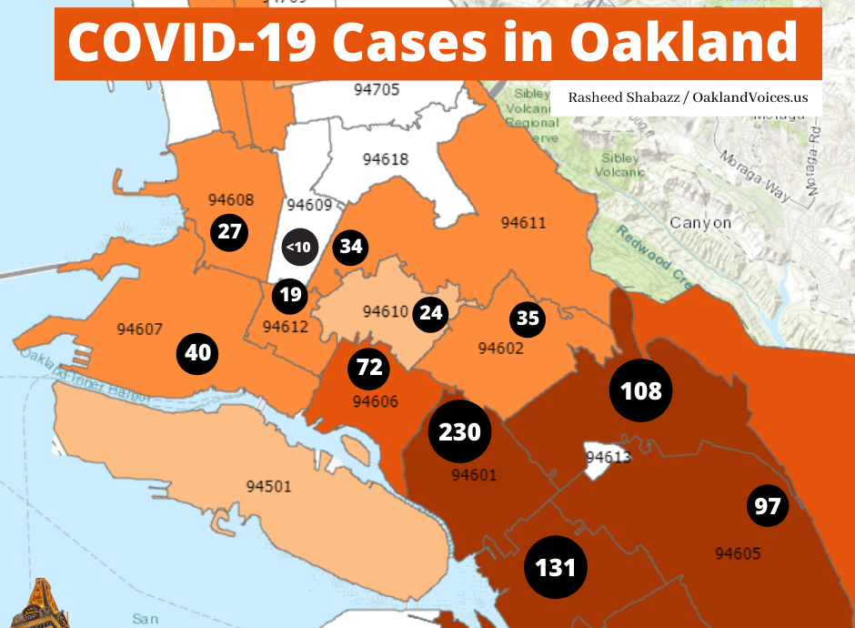
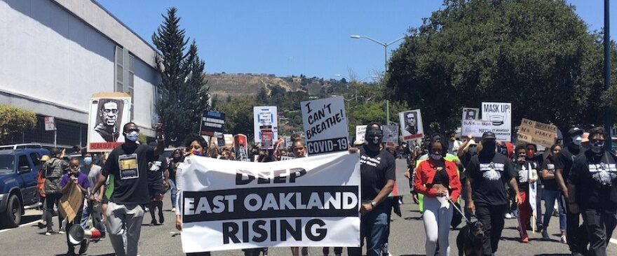
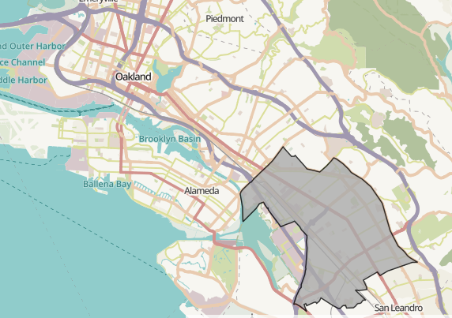
Study context: East Oakland
Photo credits: California Endowment, KALW news, Oakland Voices

Slide 8
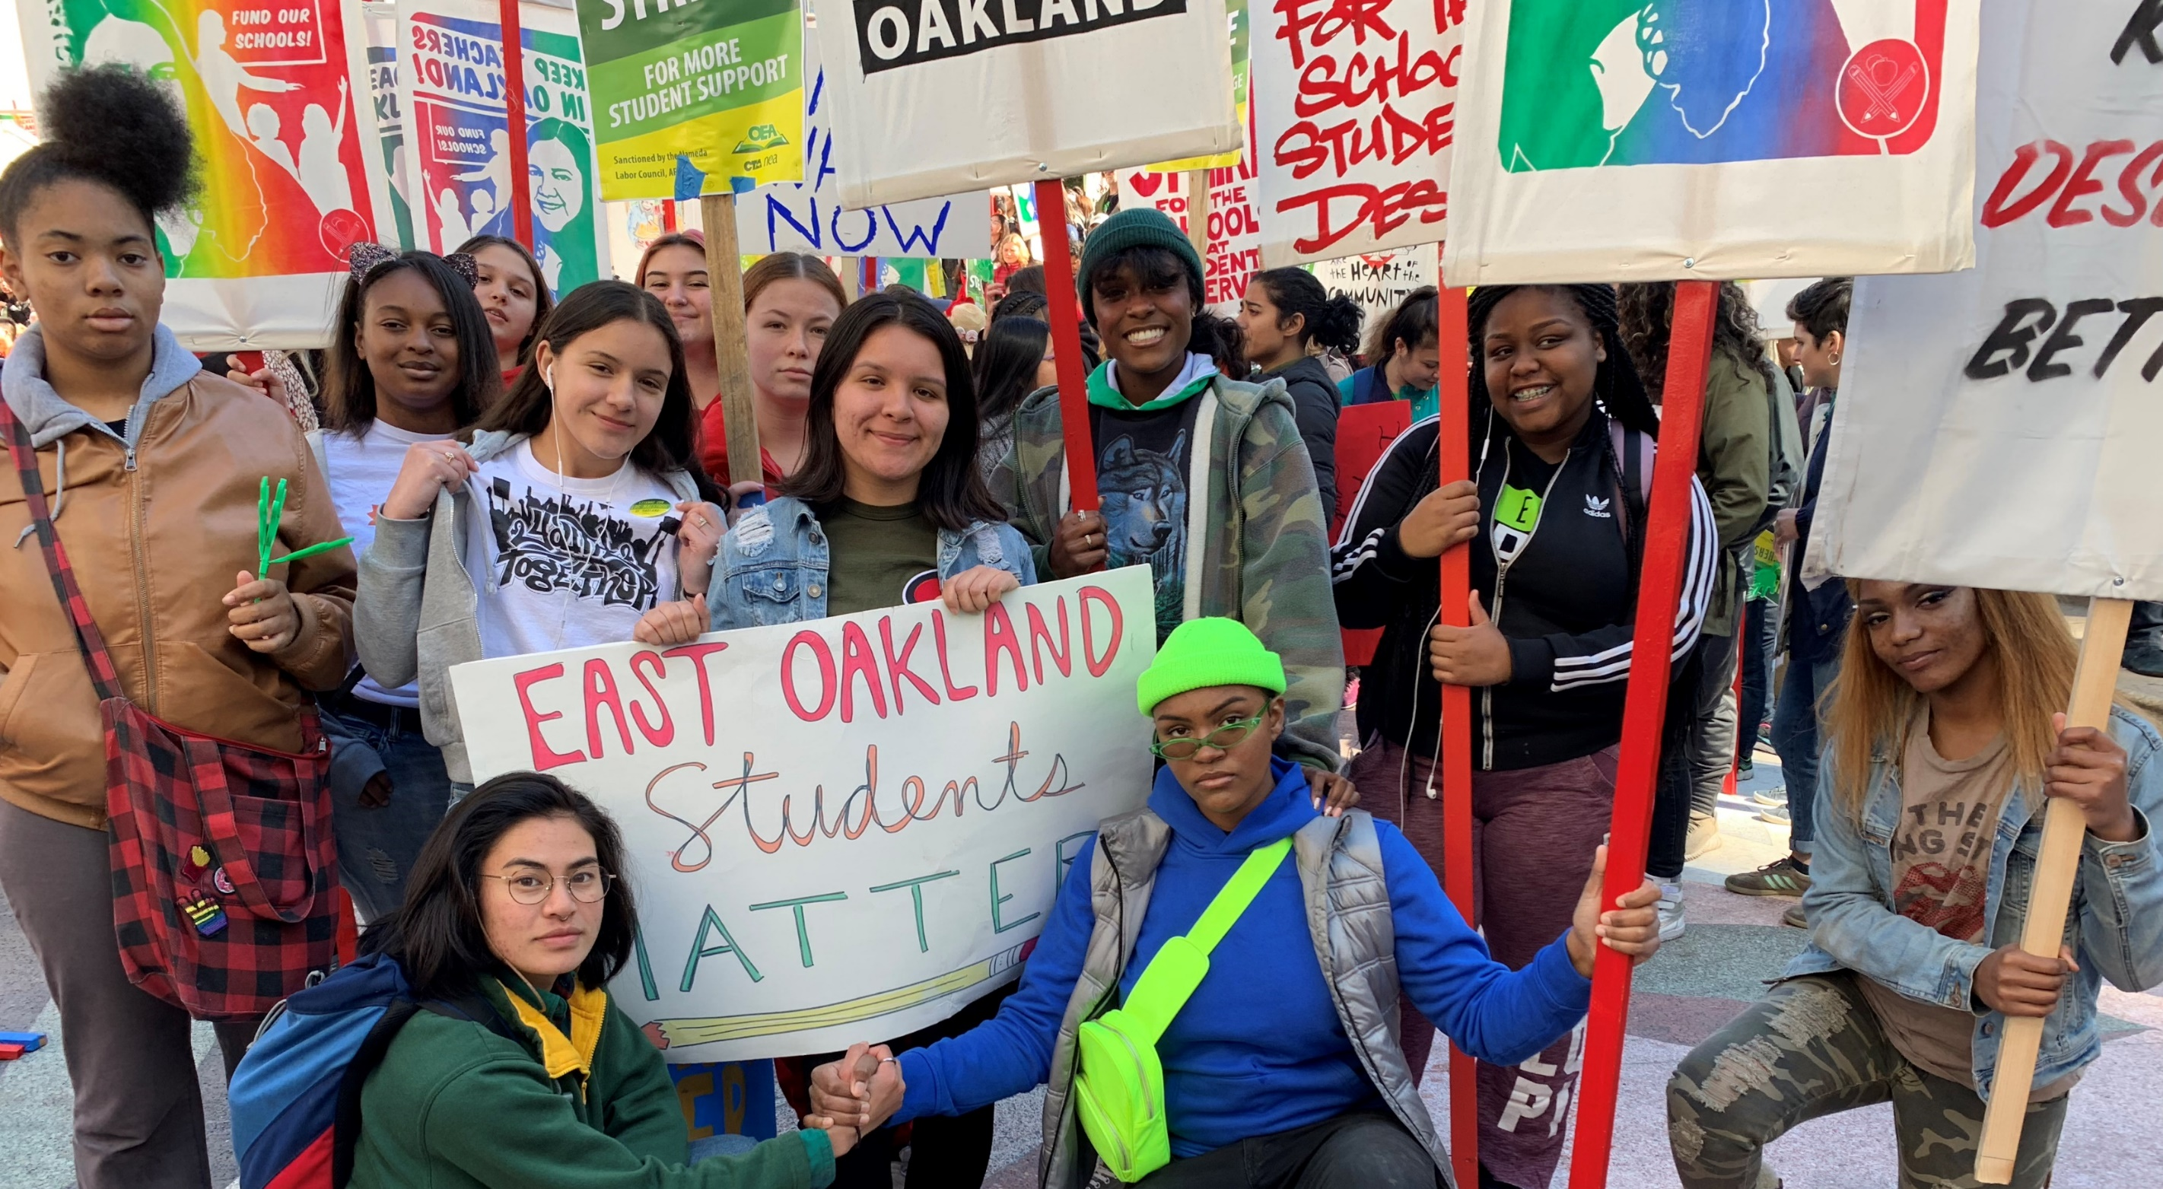
Methods and Analysis
Photo credit: The San Francisco Foundation

Slide 9
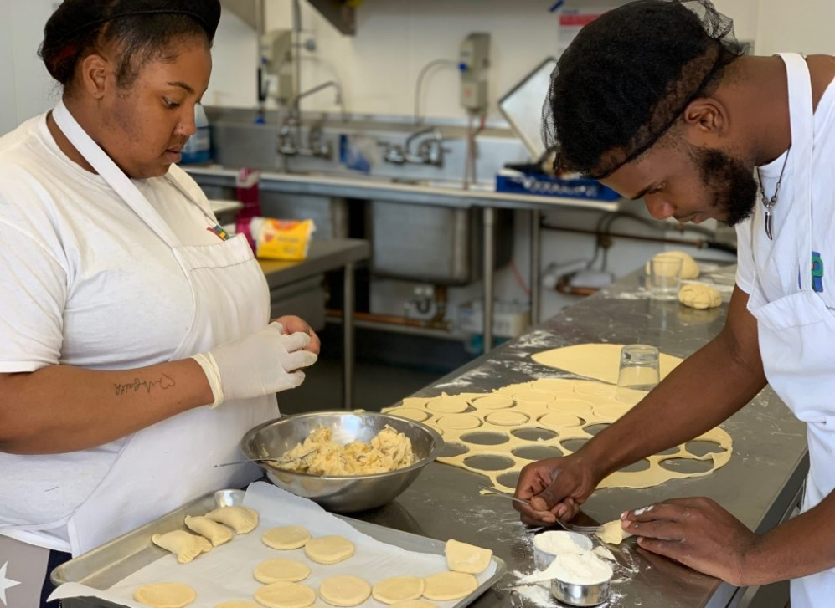
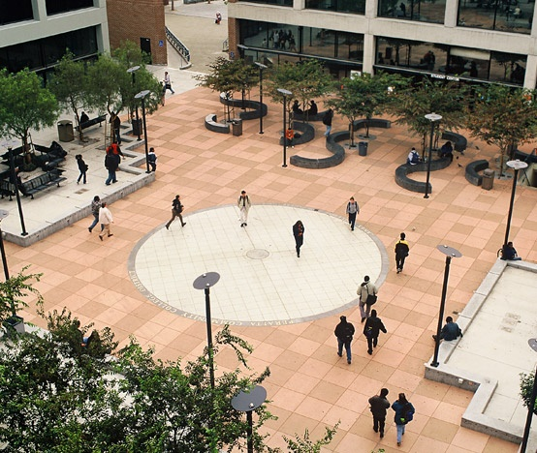
Findings: Types of neighborhood institutions
Photo credits: Youth Uprising, City of Oakland

Slide 10
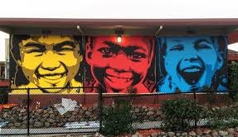
Schools
“I would say I like my old high school. One of the high schools I went to, Patten Academy. I just loved being there because you know, that's when I started getting into sports and playing basketball. So, after school I would be there a lot, just spending my time playing basketball. I didn't know what else to do. And even after high school like we even go just hop over the fence and we just go shoot at the courts over there. Because it's like, it's somewhere where me and all my friends went to high school; so, we all been there before.”
- Participant B.B. an 18 year-old Latinx male

Slide 11
Youth-Serving Organizations
“This is another thing about the EOYDC I liked too. Because they gave young people job opportunities that's hard to come across. Just in general, but especially in Oakland or in East Oakland. So I get paid and get paid a reasonable amount. ‘Cuz I was working for a program that would only pay $100 a month. That's a total ripoff. But the EOYDC didn't do that. They actually will pay reasonable amounts”
- Participant J.D. an 18 year old AA female

Slide 12
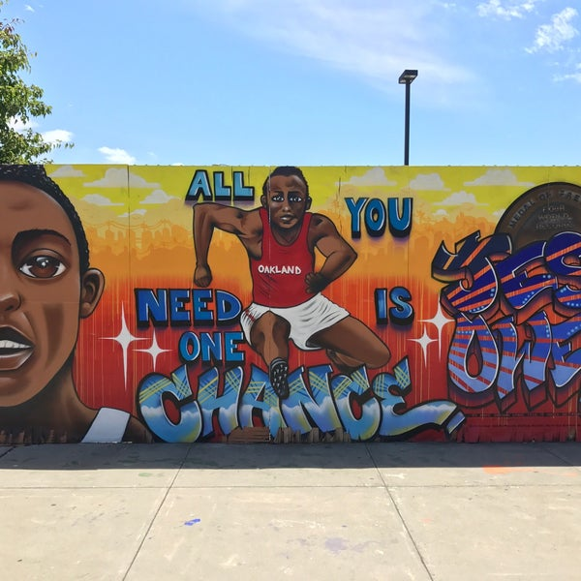
“One of the main opportunities that they give to the workers, as far as like teenagers and preteens is their Pathway to College Program the PTC. Through that program depending on your age group, you get different support on things that matter for whatever grade you're in. For example, junior year you get SAT prep and senior year you get help with applying to colleges, scholarships, and just matching you with the College that works for you. And then the other grades, you get homework help, any support for anything you're going through at the moment. You also get college tours. I’ve been on the College tour to New York, and we visited three different schools out there. And you also get support through career exploration. Like you don't really get that in typical high schools where it’s more about just taking your classes to graduate so you don't get to really explore hobbies and interests. You have to just pick a career”
- Participant A.R, 17 year-old Latinx female

Slide 13
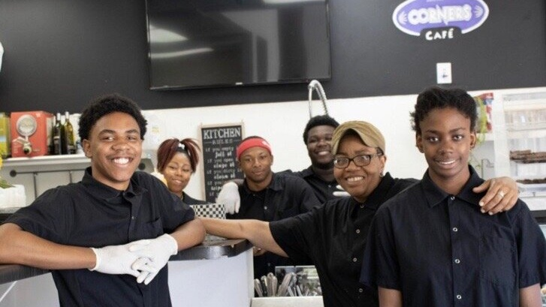
Findings: Young Person Well-being
Autonomy (the ability to learn and make independent choices);
Connectedness (the presence, maintenance, and development of positive relationships),
Competency (Developing and building skills that allow young people to make choices about different areas of their life including careers, education and abstract aspects such as spirituality and psychological beliefs),
Optimism (maintaining a positive perspective on life, even when faced with unknown circumstances)

Slide 14
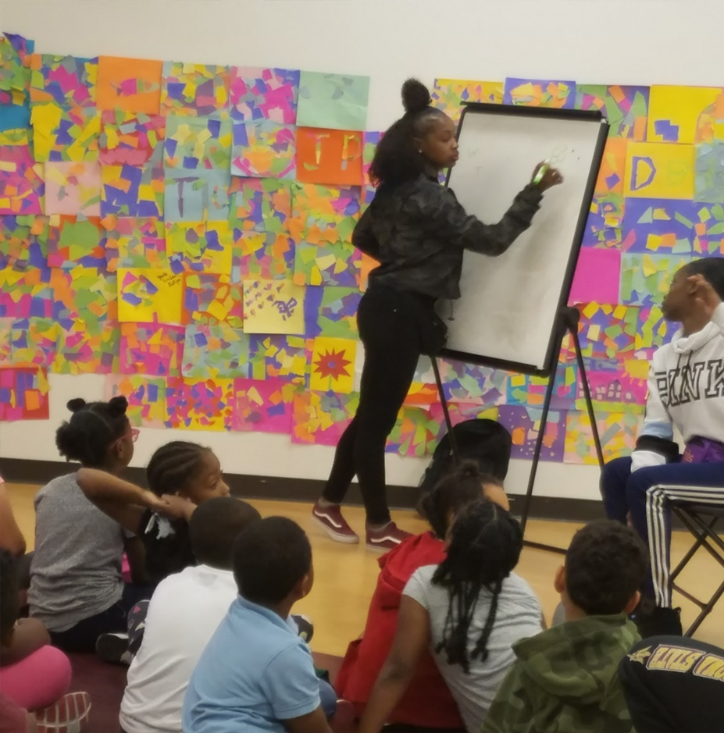
Autonomy and youth decision-making
“It’s [the program] ran by youth. That's the thing that I like about it. That it's run by youth. So, me right now I’m 15, and I’m a youth leader right? To kids from ages five to like 12-13. So, it's like it's not really like, Oh it's adults telling me, ‘You gotta do this,’ you feel me? It’s better. It's like a youth telling you, “Hey look.” You feel me? From a youth perspective, you know?”
- Participant M.B., 15 year-old AA Male

Slide 15
Competency and Responsibility
“I monitor kids, you know, help them. Basically just help them. ‘Cuz like again it is based off of East Oakland, so it's a lot of stuff that goes on out here, you know, during the day at night, a lot of stuff happens. So, we're just trying to help them be bet- not be. I'm trying to think of the word. Like I don't want to say, be better because they are good as it is, but like we help them [young children] too… We just want to put them in the right direction. Basically, we want to keep them in the right direction and to make sure that they go to school, you know that they're learning ok and all that.”
- Participant M.B.

Slide 16
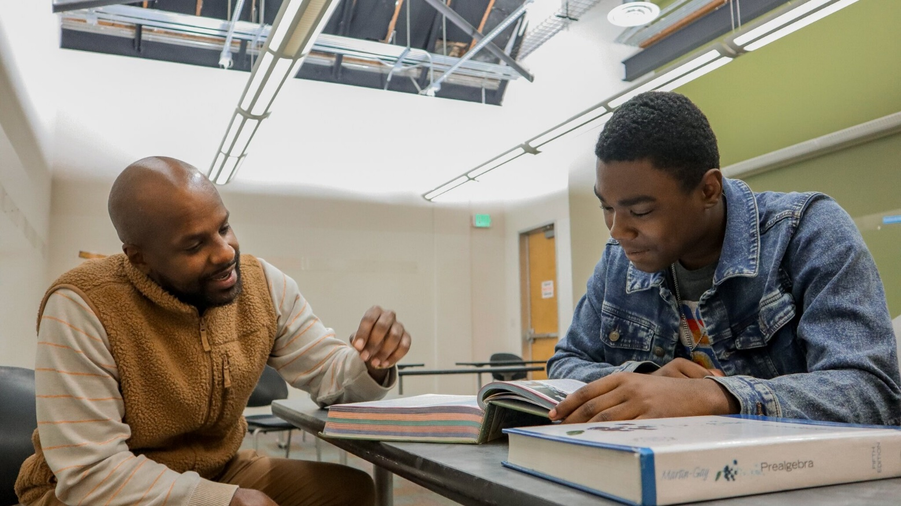
Connectedness and Relationships
“Oakland is not one of the major crime ridden cities, but it is a city with a lot of crime, and everyone knows that. And I’ve also directly seen a lot of things just growing up in Oakland. There's a lot of gang activity, a lot of like I said, crime. And so there's a lot of things you can get into when you grow up here, especially when you're connected to other people that grew up here. They'll introduce you to things that aren't good for you to do. However, it's something that they found themselves getting into. So being somewhere where you’re around mentors who are pulling you in a direction, but it's a positive direction is helpful”.
- Participant A.R.
Photo credit: Youth Uprising

Slide 17
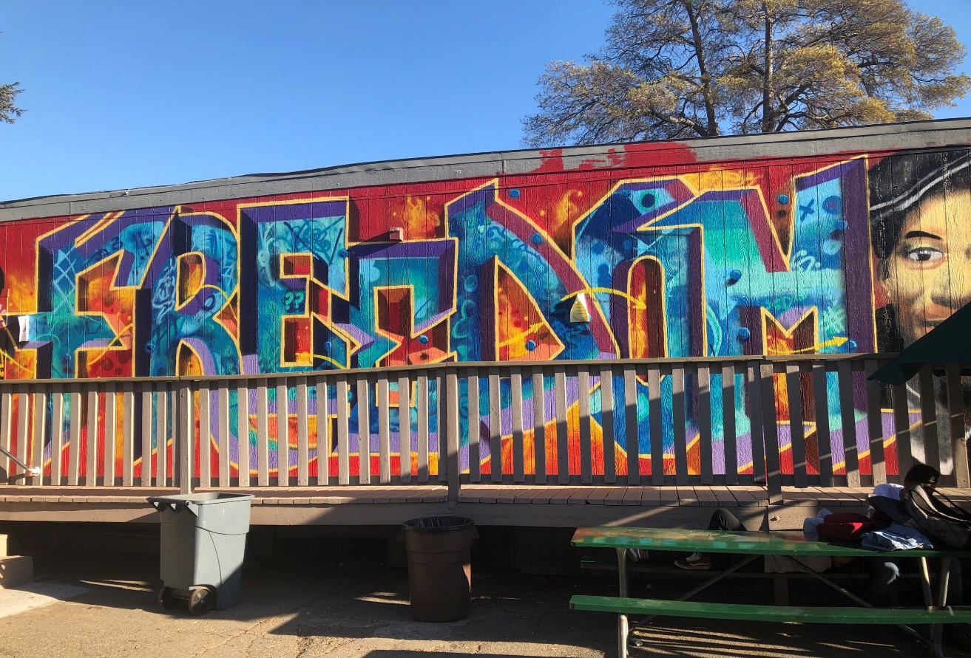
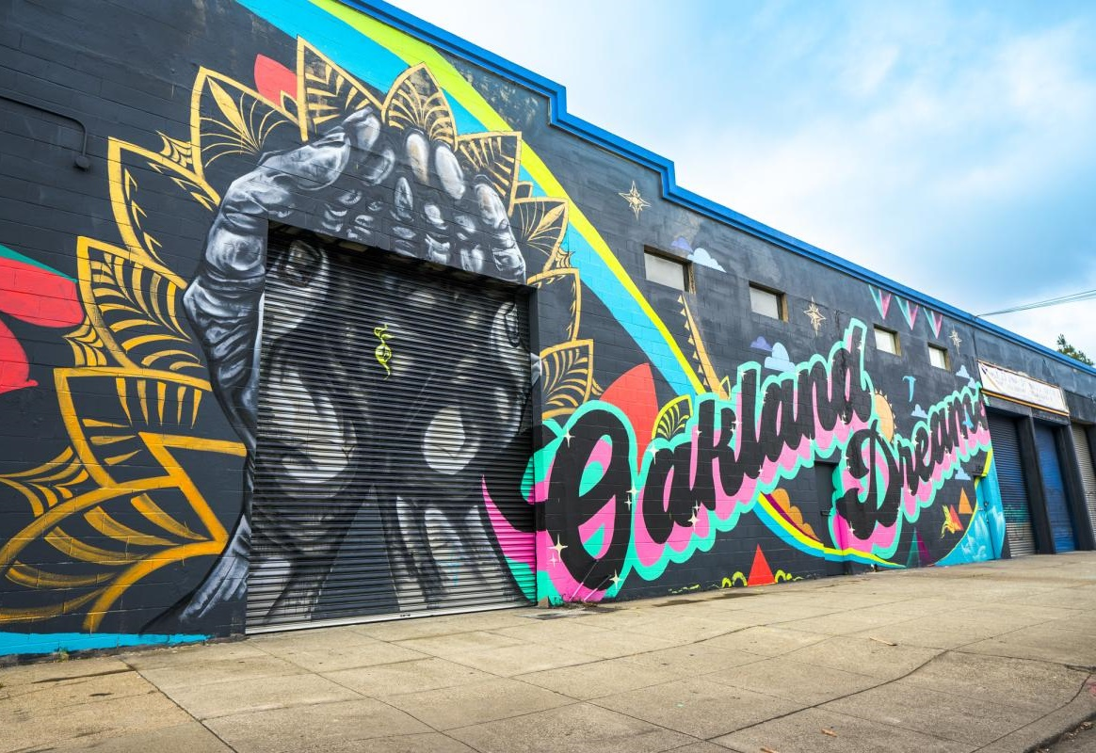
Discussion
Photo credit: City of Oakland

Slide 18
Conclusion
Neighborhood institutions provide important spaces and opportunities for young people to build and strengthen their well-being
Key programmatic components include strong mentorship, academic support, decision making power within the program, college preparedness workshops, payment for the time young people are participating in programs, safe spaces, and staff who also have ties to the community.

