Slide 1
Opening slide
Public Spaces Protection Orders: Consultations with marginalised groups and recommendations for greater inclusivity
Ben Archer @BenjaminArcher_
SIPS/DTA PhD student & Lecturer in Law
b.archer@shu.ac.uk

Slide 2
Text with main image to the right
Context 1
What are Public Spaces Protection Orders (PSPOs)?
Introduced by local authorities against a designated public space, for an initial period of up to three years.
Contains prohibitions (preventing consumption of alcohol) and requirements (requiring a dog to be kept on a lead etc.).
Two statutory punishments, with tiered approach in guidance (Local Government Association, 2018).
Approximately 15 introduced each month (Appleton, 2021), with little oversight by central government (Heap & Dickinson, 2018).

Slide 3
Text with main image to the right
Context 2
Street-sleeping homeless people and PSPOs
In 2018, 32 local authorities (out of a sample of 125) had at least one PSPO prohibiting begging, aggressive begging, or behaviour associated with street-sleeping homeless people (Brown, 2020).
Home Office (2022) guidance: PSPOs should not directly target street-sleeping homeless people.
Setting local authorities as examples: 80,000 signatures against PSPO in Hackney (Osborne, 2015).
The continuing impact of the Vagrancy Act 1824 (Roberts & Archer, 2022).

Slide 4
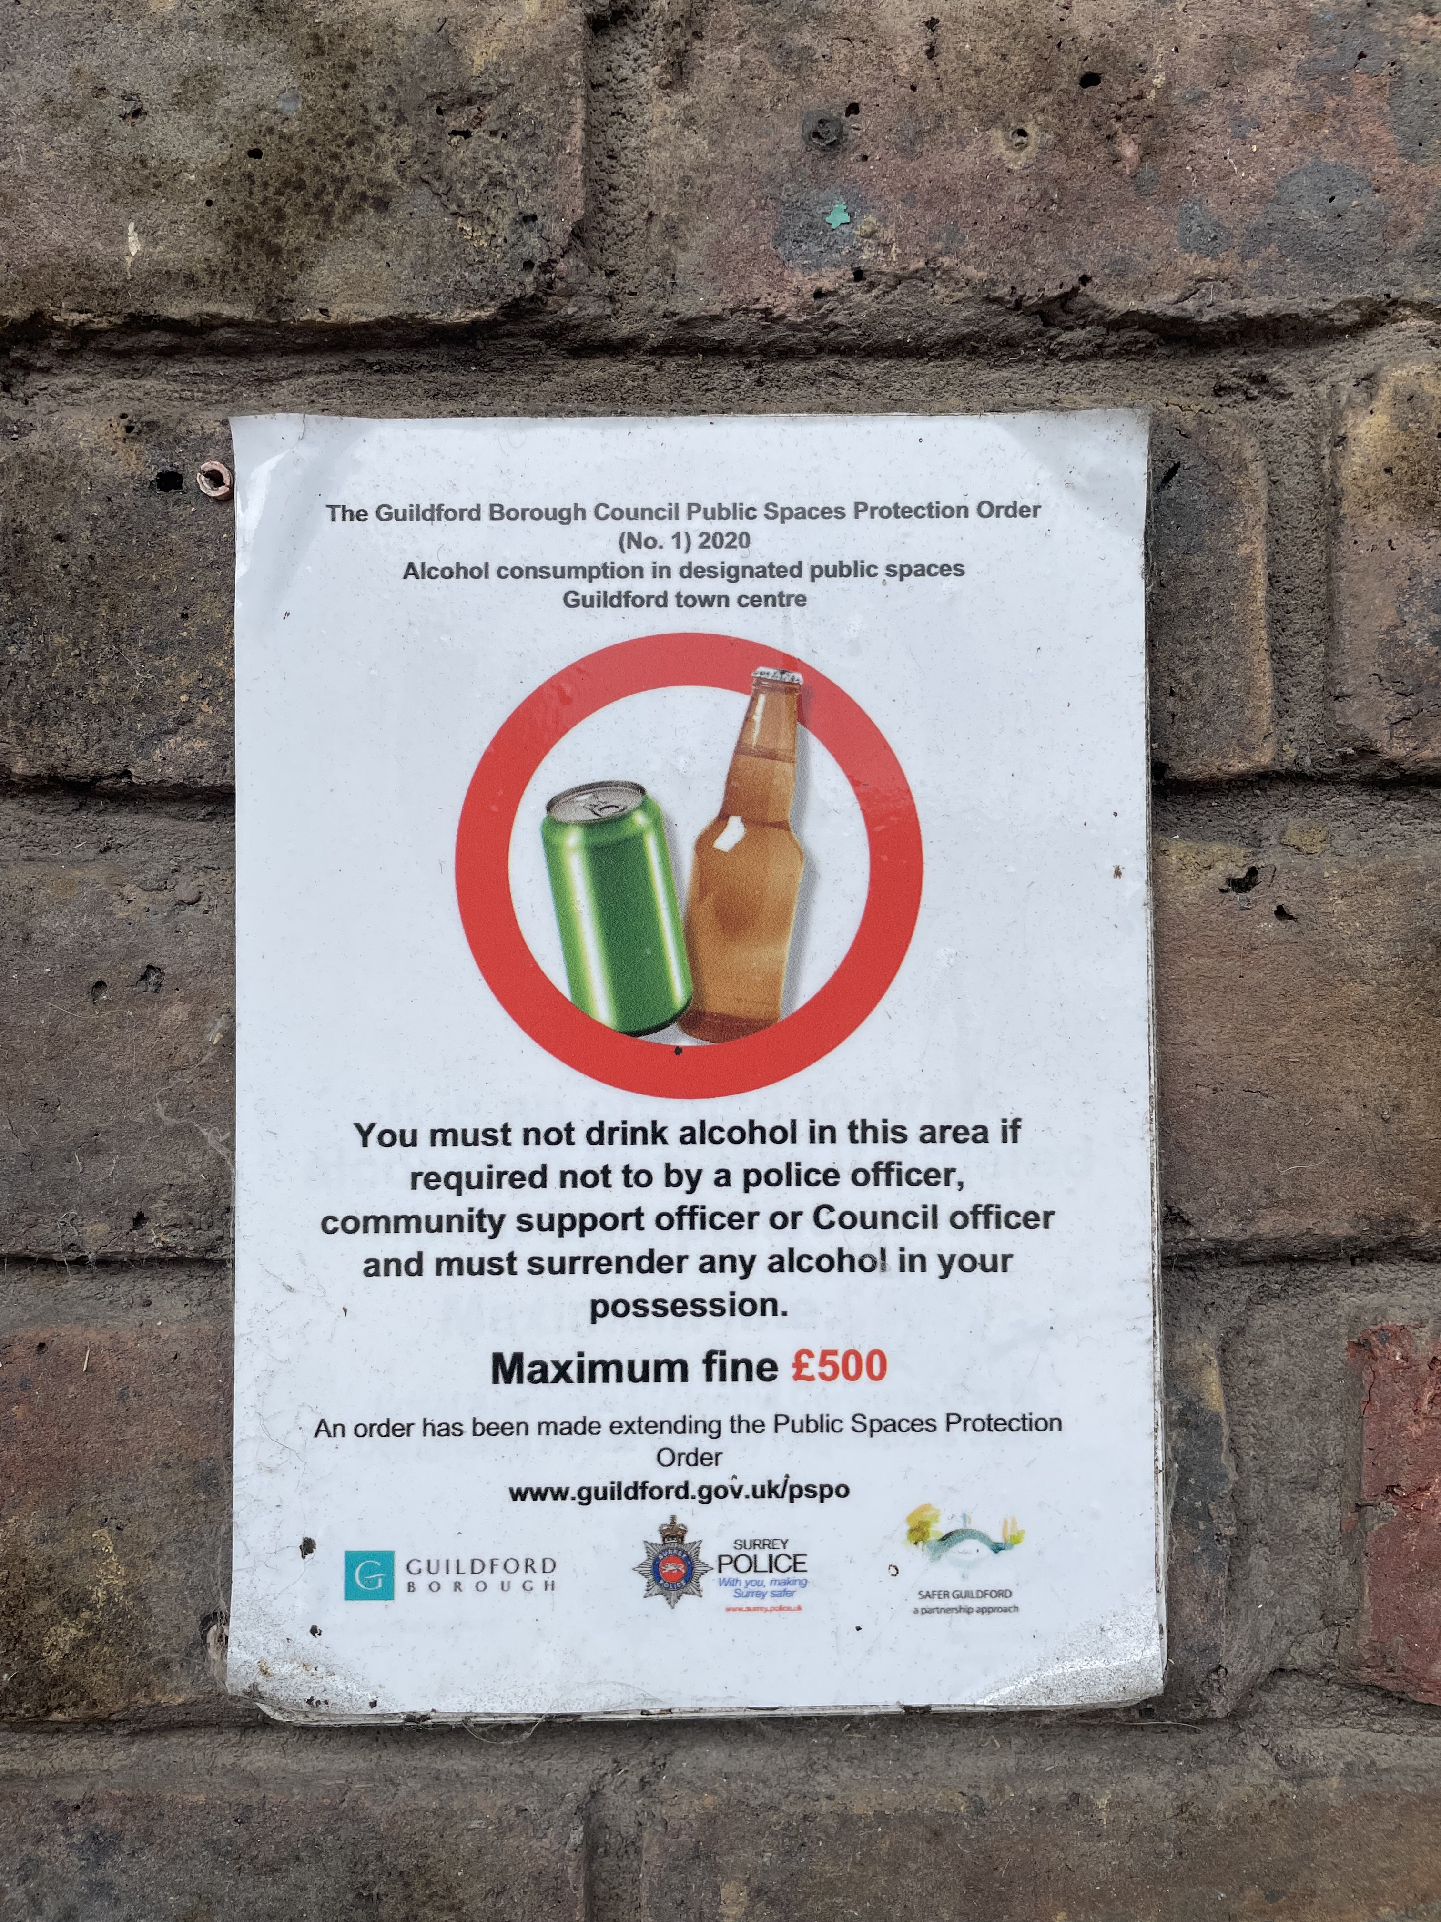
Text with main image to the right
Context 3
Statutory requirements for PSPO consultations
ASB, Crime and Policing Act 2014, S72(4):
The Chief Officer of Police, and the local policing body for the police area that includes the restricted area;
Whatever community representatives the local authority thinks it appropriate to consult; and
The owner or occupier of land within the restricted area, if, or to the extent that it is reasonably practicable to consult with the owner.
Home Office (2022) guidance.
‘Invite-only’ consultations (The Kennel Club, n.d.). and closed questioning (Appleton, 2016).

Slide 5
Left image and text to the right
Methodology
Addressing these gaps in knowledge
Research aim: To examine the interpretation of the statutory mechanisms for consultations by local authorities seeking to implement a PSPO against a designated public space
Qualitative multiple-case study approach, allowing for examination of different cases of similar instances (Bryman, 2016; Yin, 2018).
4 case study areas, 5 supplementary research areas: 32 participants.
Analysis using thematic analysis (Braun & Clarke, 2006).

Slide 6
Text, image and quote
Theme 1: Consultation mechanisms
"… just about anyone who would've had an interest would've had a chance to either answer a website consultation or to do a paper one or to, you know, come into the council offices and complete one there."
Participant 28, safer community manager.
Consensus on the use of online survey platforms to conduct PSPO consultations across the local authorities studied, with few examples of in-person consultations in the designated public space itself.
Positives of such consultation mechanisms (Firmstone & Coleman, 2015; Hong, 2015; Lui, 2017).
Concerns regarding availability of internet platform access for vulnerable population groups (Dyce, 2019; Eyrich-Garg, 2011; Lowndes et al., 2001), such as street-sleeping homeless people.
Impact of self-selection in consultations (Bobbio, 2019).
"So, it's lot of places set, so when we start the consultation, although it gets publicised and it's available to everybody, and it's available on the website and everything else, we have got a lot of groups that we can push it out to."
Participant 21, community safety officer.

Slide 7
Text, image and quote
"… for those that were potentially begging, we used a lot of our partners around engaging with people with lived experience."
Participant 29, community safety lead.
Theme 2: Population groups
Street-sleeping homeless people: Limited direct consultation with those experiencing homelessness, unless already engaging with service providers.
Diverse communities: Concerns raised in one case study area by service provider over lack of inclusion and subsequent negative responses to PSPO consultations.
Young people: Situated largely within schools on a limited basis in only a few case study areas.
"So, even some of the community organisations were saying, 'Well, you're not talking to the people we're working with.' So, we're giving them the papers and saying, 'Would you want to do some of the consultation with them and feed it back to us?’”
Participant 10, community safety officer.
"… we did consult with schools on that, where we are at [PSPO 3], there's a secondary school very close by, and [PP5] did a lot of work with the secondary school about the impact that it would have on young people."
Participant 3, legal professional.

Slide 8
Text with main image to the right
Conclusion
Policy recommendations for future PSPO implementation
The ASB, Crime and Policing Act 2014 should be amended to establish a consultation framework with vulnerable population groups particularly impacted by the implementation of PSPOs.
Where insufficient consultation results are obtained from such population groups, PSPOs should not be pursued further by local authorities.
Thinking to the future, E-PSPOs?

Slide 9
Opening slide
Thank you!
Ben Archer
@benjaminarcher_
b.archer@shu.ac.uk

