Slide 1
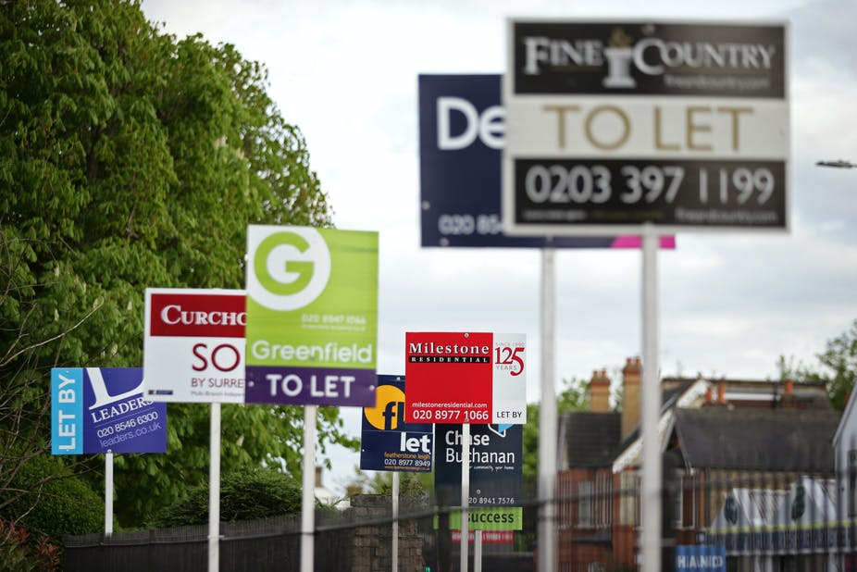
York Law School
Professionals only please:
Discrimination against housing benefit recipients on online platforms
Jed Meers

Slide 2
York Law School

Slide 3
York Law School
01
02
03
Equality law and online rental platforms
Analysis of SpareRoom.co.uk
The Problem
!

Slide 4
York Law School
The Problem

Slide 5
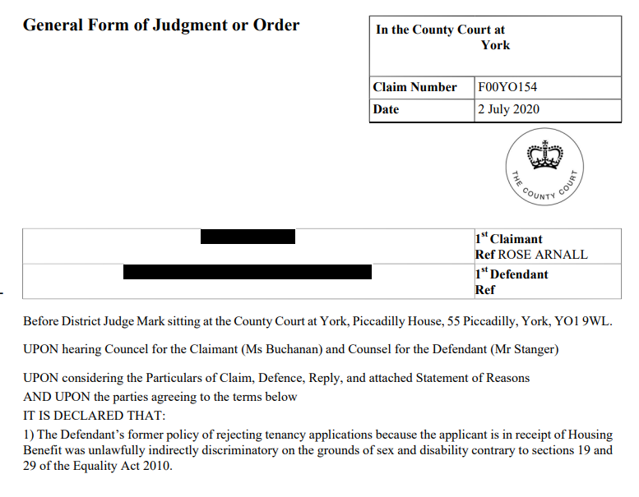
York Law School

Slide 6
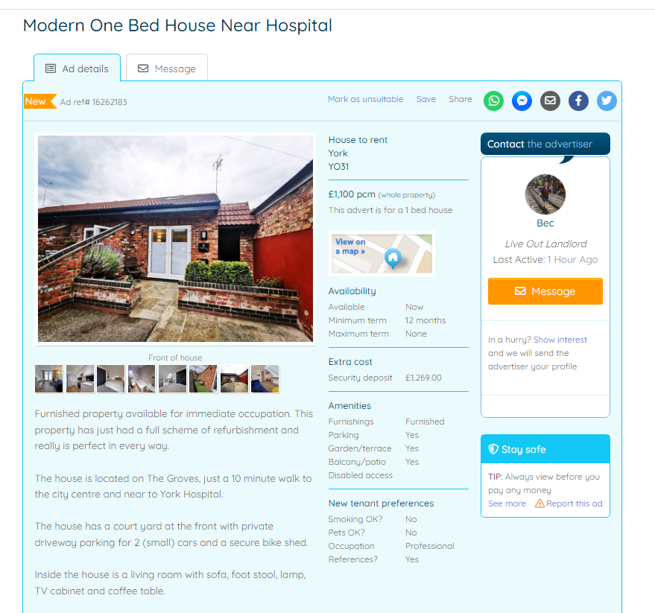
York Law School

Slide 7
York Law School

Slide 8
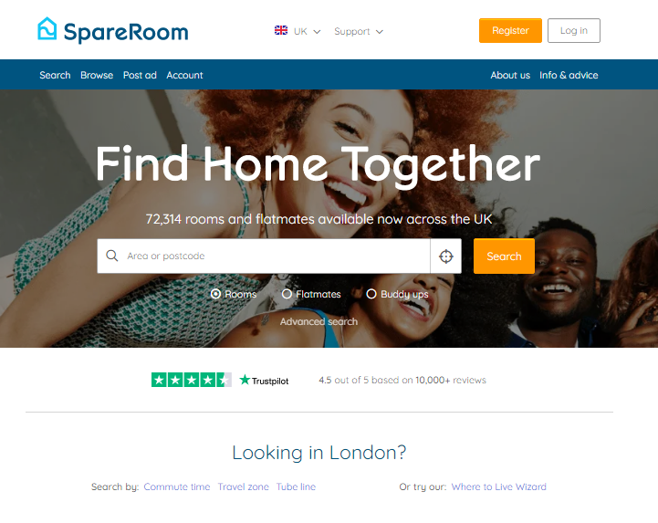
York Law School
Analysis of 31,909 listings on SpareRoom.co.uk
19%
Excluding in both the advert and the preferences box
19%
Excludes just in the preferences tool
18%
Excludes just in the advert
Over half
Inaccessible to non-professionals
Notes:
Of the adverts in the sample, 12,120 chose “professionals” from this housemate preferences box, 1,591 chose “students”, and the rest (a total of 18,144) expressed no preference. A breakdown of these is provided in Table 2.

Slide 9
York Law School
The legal obligations bite on lettings agents: what about these online platforms?
How does the Equality Act 2010 work for online platforms – what duties to do they owe?
Precis: Definitely bites – I argue no different to physical lettings agents in terms of legal obligations…
What happens when platforms change: can it make it a difference to the extent of exclusion?
In response to the “No DSS” rulings, many UK-based platforms changed their structural design: does it make a difference?
Precis: Comparing sample of 1.6k pages from 2016 and 2021…seems like it does make a difference…!
Notes:
Of the adverts in the sample, 12,120 chose “professionals” from this housemate preferences box, 1,591 chose “students”, and the rest (a total of 18,144) expressed no preference. A breakdown of these is provided in Table 2.

Slide 10
York Law School
Why the Equality Act matters:
Relevant legal duties

Slide 11
York Law School
the UK is “the jurisdiction with the clearest legislative position on the coverage of anti-discrimination laws over digital spaces”
Paul Harpur, Discrimination, Copyright and Equality (CUP 2017) 188.
Part 3 and Schedule 25 Equality Act 2010
Obligations on service providers
What’s in:
anyone providing services to the public (including facilities and goods)
What’s out:
Very narrow “online information society services provider” exemptions (email servers, hosting, caching)

Slide 12
York Law School
Section 19 Equality Act 2010
(2) For the purposes of subsection (1), a provision, criterion or practice is discriminatory in relation to a relevant protected characteristic of B's if—
(a) A applies, or would apply, it to persons with whom B does not share the characteristic,
(b) it puts, or would put, persons with whom B shares the characteristic at a particular disadvantage when compared with persons with whom B does not share it,
(c) it puts, or would put, B at that disadvantage, and
(d) A cannot show it to be a proportionate means of achieving a legitimate aim.
…should be construed widely so as to include, for example, any formal or informal policies, rules, practices, arrangements, or qualifications including one-off decisions and actions.
the way “things generally are or will be done”

Slide 13
York Law School
I think the scope of PCPs is considerable…
Policies, provision and criteria in platform design
 | Capturing data | Prompting and priming | Designing out
User-generated content | Monitoring user-generated content. | Structuring the input of content through web-design tools. | Preventing or removing types of user-generated content.
User processing of existing content | Monitoring user search behaviour. | Structuring the filtering and search of content. | Preventing and limiting search functions.
Managing interactions | Monitoring interactions between users. | Structuring interactions between users. | Preventing or limiting interactions.

Slide 14
York Law School
Data on how platform structure can change…

Slide 15
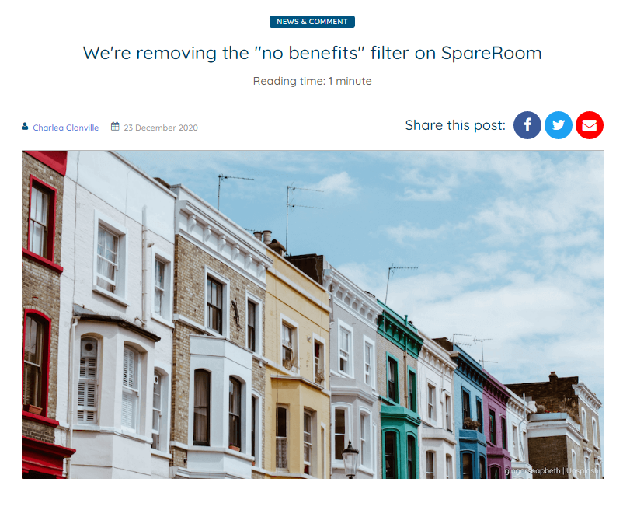
York Law School

Slide 16
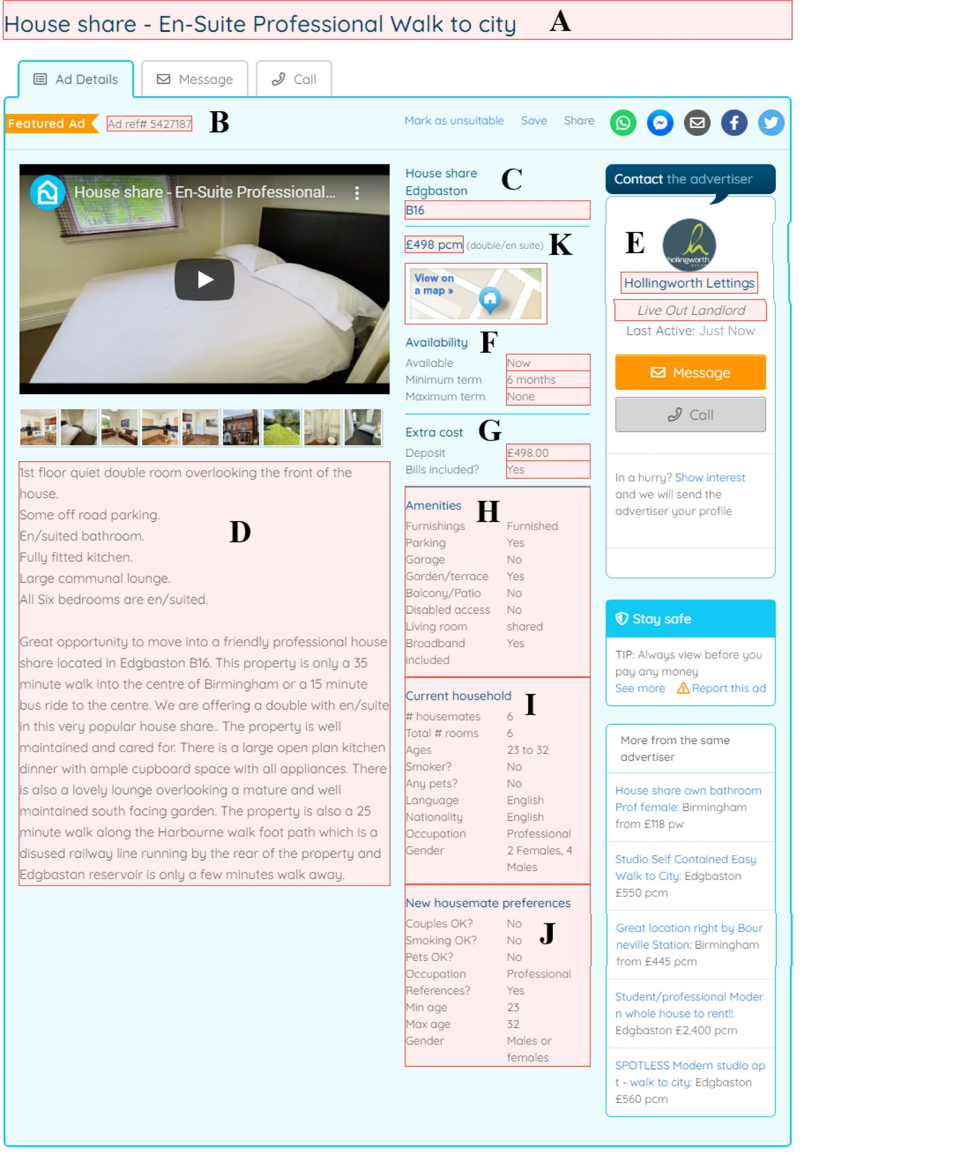
York Law School

Slide 17
York Law School
2016 data
1.7k individual listings
2021 data
31k listings
Matched by same outward postcode
(e.g. YO10)
Final sample of 1.7k pre-DSS change, and 1.7k tied post-DSS change

Slide 18
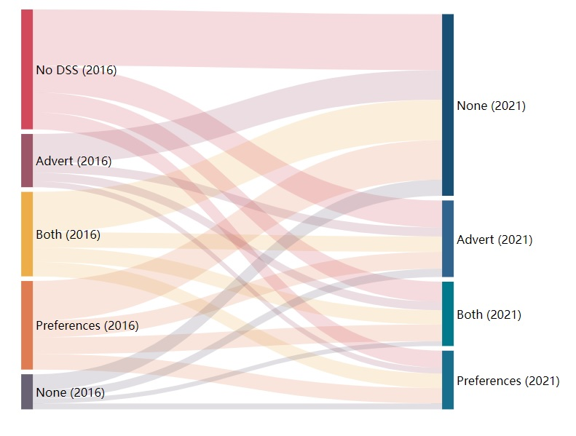
York Law School
529
Total excluded:
From 91% to 52%...
“Professionals only”:
From 59% to 52%
802
235
373
338
391
284
155
259

Slide 19
York Law School
Conclusions (?)

Slide 20
York Law School
As property search cements online, there are clear legal obligations under the EA 2010: platforms should recognize these (and should be challenged)
01
02
Changing platform design can (seemingly) make a difference
Interrogating online platform design is not confined to algorithms: we should interrogate platform design too
03
Am thinking about where to go next… have got some dosh for a tenant survey but not sure if that would offer any colour on this…?
…

Slide 21
York Law School

