Slide 1
A minimum digital living standard
6 July 2022
Abigail Davis, Matt Padley, Katherine Hill, CHLOE BLACKWELL
Centre for Research in Social Policy

Slide 2
The Minimum Income Standard
How much is enough?

Slide 3
The MIS process
Orientation groups
Task groups
Checkback groups
Final groups
Notes:
3

Slide 4
MIS Definition
A minimum standard of living in the UK today includes, but is more than, just food, clothes and shelter. It is about having what you need in order to have the opportunities and choices necessary to participate in society.

Slide 5
A minimum digital living standard
Adapting the MIS methodology
Building on established public consensus
Focusing on what it means to live in a digital world

Slide 6
The MDLS process
Groups with young people
Orientation groups
Task groups
Task groups
Checkback groups
Final groups
Notes:
6

Slide 7
‘Orientation’ phase
Exploratory first stage – to get a sense of the issues + develop the MDLS definition
4 groups
Working age adults without dependent children (Southampton)
Pensioners (Leicester)
Parents of 0-18 year old children (Edinburgh)
Mix of all three categories (Swansea)

Slide 8
Living in a digital world
Inevitable and unavoidable, no going back
Across all aspects of life – work, education, leisure, services
Accelerated by Covid
Parental exclusion can lead to children’s exclusion
Pace of change
Feel ‘forced’ to go online. Would prefer to retain choice
Can be overwhelming, hard to keep up.
Technical obsolescence involves cost and learning new things
Diversity of experiences and multifaceted attitudes

Slide 9
Benefits
Convenience and efficiency
Fast, easy online shopping
Being in two places at once
Access to information
Extending choice
Navigation and tracking
Communication, connection
With family, friends, professionally
Expanded horizons
Accountability
Environmental advantages

Slide 10
Concerns
Potential risks
Increased consumption
Pressure of 24/7 access
Effects on family life
Effects on physical and mental health
Loss of human contact in services / job losses
Navigating systems could be frustrating, time consuming
Online harms
Security, scams, identity theft
Misinformation,
Trolling –anonymity – lack of accountability

Slide 11
Parents’ concerns for children
Cyber bullying
Knowing who they are talking to online
Knowing what they are accessing, age appropriateness of content
In-app purchases
Sharing content, messages – that will always be out there
Implications –eg on mental health, body image and concentration
Finding a balance between setting limits and their child’s independence and trust

Slide 12
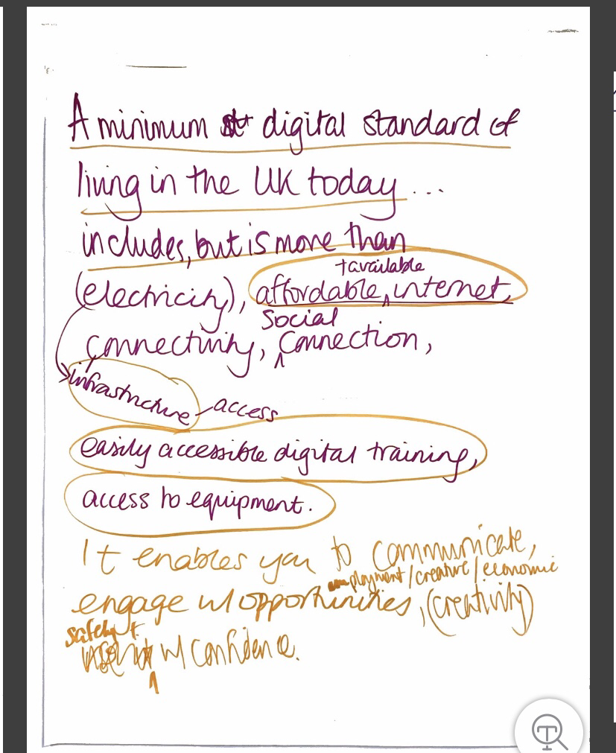
Drafting a definition
A minimum digital standard of living includes, but is more than, having accessible internet, adequate equipment, and the skills, knowledge and support people need. It is about being able to communicate, connect and engage with opportunities safely and with confidence.

Slide 13
Progress and next steps
Drawing on MIS as a starting point
Deciding on the content - what families with children need to meet the definition
First stages of groups with parents and first group with young people completed
Further groups in September
Survey and mapping exercise in 2023

Slide 14
CENTRE FOR RESEARCH IN SOCIAL POLICY
LOUGHBOROUGH UNIVERSITY

