Slide 1
Digitalisation without detriment A research agenda for digital inclusion in the future energy system
Joseph Chambers (Lewisham Borough Council)
Caitlin Robinson (University of Bristol)
Matthew Scott (National Energy Action)

Slide 2
Structure of today’s talk
Wider context
Digital exclusion and fuel poverty
Benefits and drawbacks of digitalisation
Current policy landscape
Our research
Aims of our research
Social relations framework
Stakeholder workshop
A research agenda
Affordability and assets
Time and temporality
Trust
Language, literacy and communication
Specific social groups
Key recommendations

Slide 3
Wider context

Slide 4
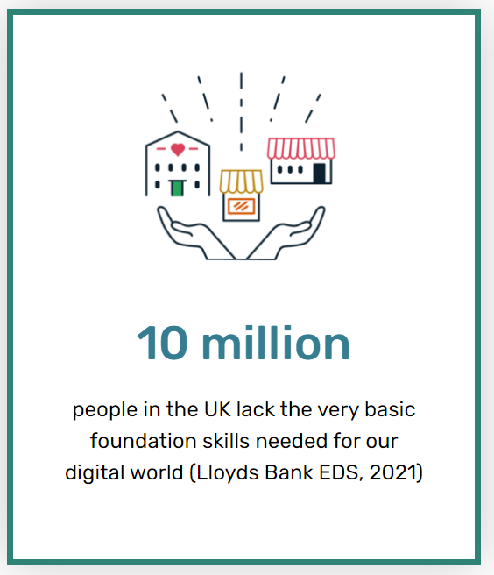
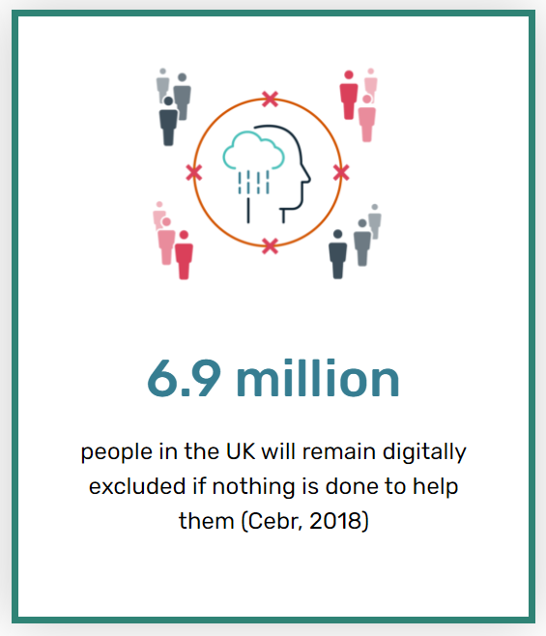
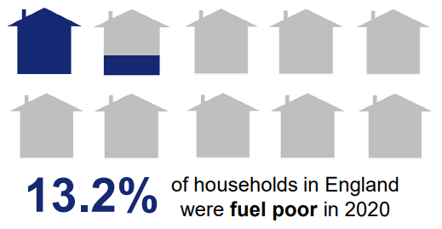
Digital and energy inequalities
Digital inequality: Gaps that exist between different social groups or societies in digital skills, knowledge or infrastructures
Digital inclusion: The extent to which people can take part in (or not) increasingly digitalised systems
Fuel poverty: The inability of households to access sufficient energy services to ensure that they can participate meaningfully in the society in which they live
(Bouzarovski and Petrova 2015)
(Good Things Foundation 2021a; BEIS 2022)
Notes:
Wider framing
On the one hand a drive towards digitalisation in the energy sector
On the other hand – stark digital divides, and energy inequalities

Slide 5
Digitalisation of the energy system
Benefits and drawbacks
Digitalisation is the integration of digital technologies into the energy system, to support decarbonization and enable flexibility
Digitalisation provides a greater degree of control over household electricity use, costs, and bills
(Hillerbrand et al. 2021)
Consumers can play active role in smart technology adoption to reduce energy demand
(Calver and Simcocock 2021)
Focus on digitalization can detract from deep-seated structural inequalities embedded within the energy system
Negative impacts of energy inequalities compounded for those who can’t access internet, or are digitally excluded in other ways
(Zheng and Walsham 2021)
Shift consumption away from times of high network constraint or low renewable generation, and even store electricity at the household scale
Digitally excluded miss out on best energy deals, and face digital barriers to accessing support services in energy market
(Ofgem 2019)

Slide 6
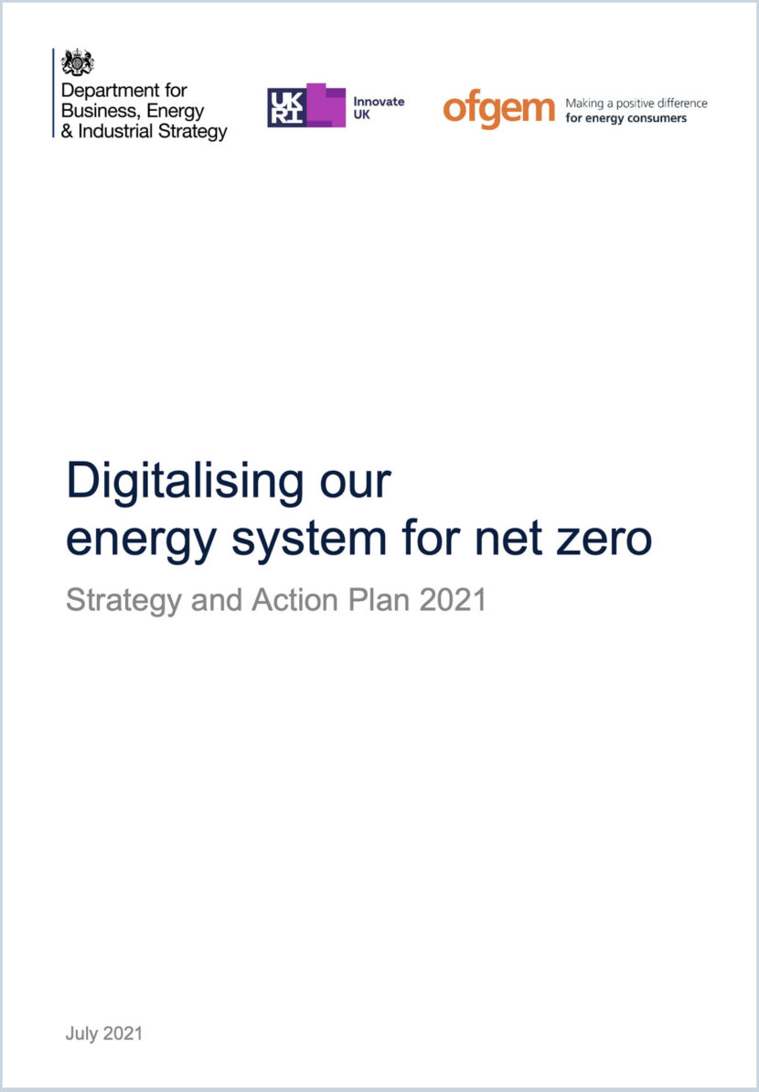
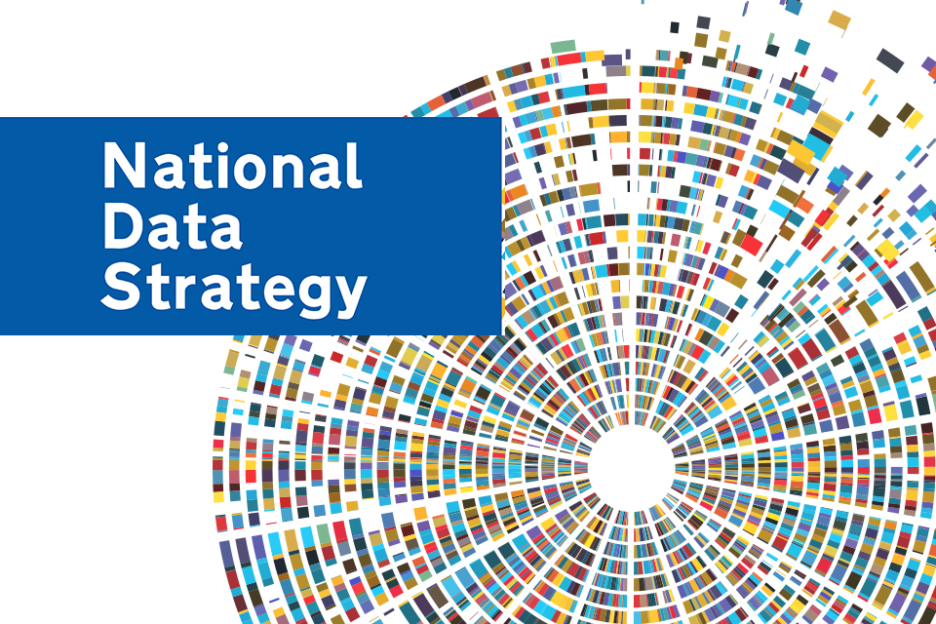
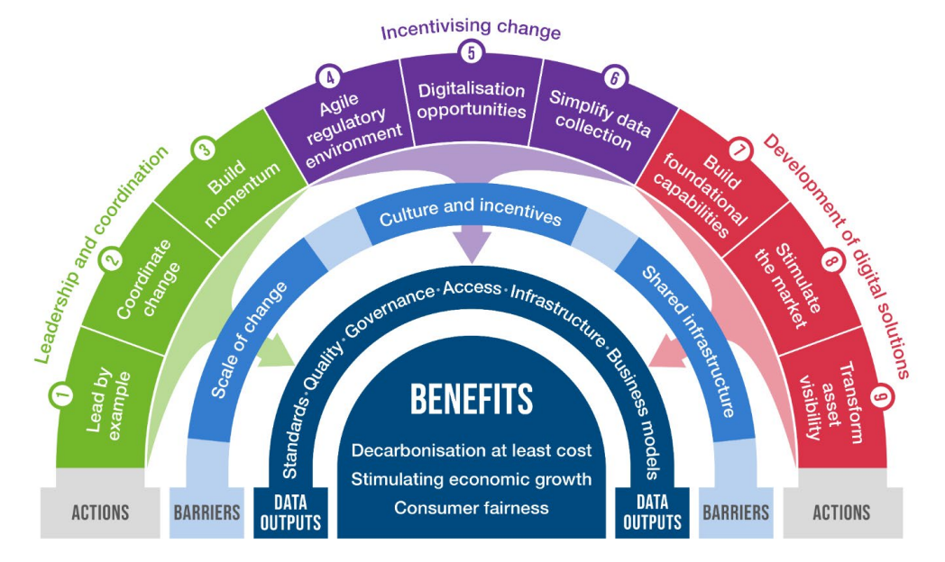
Digitalisation of the energy system
A new policy landscape
.2021.
The first strategy to digitalise energy system in Great Britain to encourage innovation, reduce bills and drive decarbonisation
.2020.
Recognise the value of data for “aiding decarbonisation through smarter energy grids”
.2020.
Digitalisation as a key pillar of effort to modernize and optimize the energy system as a whole in the EU
Need to “assess [how to ensure that] digitalisation, as a process at the core of smart energy transitions, is people-centric and inclusive” (Sareen 2021)

Slide 7
Our research

Slide 8
Digitalisation without detriment
Aims of the research
Sketch out agenda
for understanding the risks, opportunities, and inequalities latent within the transition to a digitalised energy system
To explore the links between energy system digitalisation, digital exclusion, and energy poverty

Slide 9
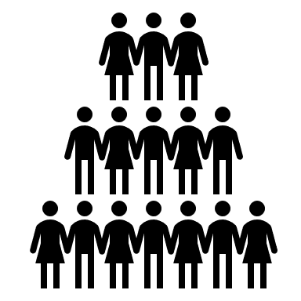
Framing the research
A social relations framework
Current frameworks for understanding energy demand often overlook how “energy use occurs in places such as homes, workplaces and communities in which complex webs of social relations already exist”
Hargreaves and Middlemiss (2020: 196)
Social relations framing useful for thinking about digital-energy inequalities
Family & friends
Communities & agencies
(landlords; energy companies; community groups)
Identity
(age, race, gender, class, disability)
Infrastructure & technology
(digital systems, energy systems)

Slide 10
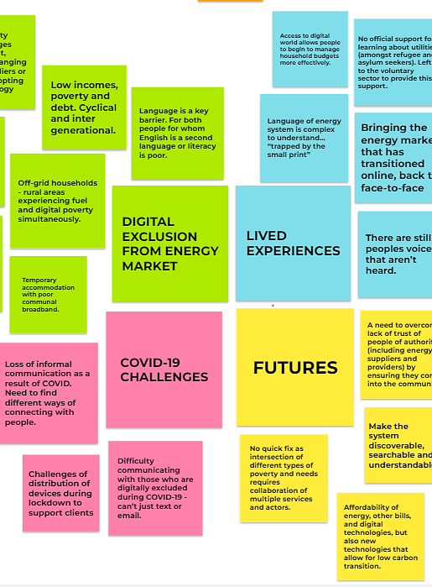
Stakeholder workshop
Thematic analysis
Online workshop on “Exploring the challenges and opportunities of digitalization in the UK energy system
Held in May 2021 therefore the COVID-19 pandemic played a significant role in discussions
Key themes identified based on workshop discussions
2
Thematic sessions
Practice and policy focused
90
Online attendees
From diverse sectors
12
Organizational perspectives
Insight into challenges faced

Slide 11
A research agenda for digital inclusion in the future energy system

Slide 12
Financial exclusion and affordability of assets
Digitalisation of the energy system
Specific social groups
Language, literacy and communication
Time and temporality
Trust
Future research themes
The five themes overlap and are not intended to be definitive or exhaustive, but rather to act as a starting point for further conversation.

Slide 13
Financial exclusion and affordability of assets
Financial exclusion and affordability of assets
The most disadvantaged people are missing out on benefits that the digitisation of the energy system should be providing them with
New technologies are often perceived to be non-essential luxuries, despite the potential benefits for managing bills (Sovacool et al. 2021)
Covering the cost of other essentials is likely to take precedence over the digital with some exceptions (Petrova 2018)
Digitalisation is reconfiguring the relations between households and energy companies, providing a new way to ensure compliance
Lack of assets is a key driver of digital exclusion, with lack of internet access the biggest barrier to switching supplier

Slide 14
Ability to synchronise activities increasingly valued in digitalised energy systems, especially flexible to use electricity at cheap times
Time and temporality
Price signals are likely to be communicated via digital technologies (e.g. in-home displays, smartphone apps, or energy consuming devices)
Response to signals will depend not only on whether households can afford digital technologies, and their wider digital skills and engagement
Those with less “flexibility capital” less able to shift use than affluent households, missing out on financial benefits (Powells and Fell 2020)
Social relations with suppliers often defined by forms of waiting, anticipation, and frustration that vary across digital technologies

Slide 15
Multiple forms of trust matter: in technologies, in quality of online information, and in different actors
Trust
People who are digitally excluded are less likely to trust and are placed at a significant disadvantage (Ramsetty & Adams 2020)
Whilst people may trust technologies, there is often less trust in large scale actors such as energy providers and governments (Cotton 2016)
Low levels of trust in how companies will use data result in it not being volunteered, and switch off of devices (Grünewald and Resich 2020)
Digital excluded people turn to friends and family to carry out online tasks, a crucial relationship shaping energy demand (Richardson 2018)

Slide 16
Digitally excluded people often face range of language barriers to getting online (e.g. migrants and refugees whose first language is not English)
Language, literacy and communication
Energy companies increasingly use digital forms of communication to engage with customers (e.g. online billing, chatbot functions)
Transition online was intensified as a result of COVID-19 when companies were not able to use traditional forms of communication
To actively engage in the energy system people required to be able to understand the language in which documents (i.e. energy literacy)
Additional challenges of overly technical and complicated vocabulary associated with using digital tools (Holgersson and Söderström 2019)

Slide 17
Specific social groups
Certain segments of society are more likely to experience digital exclusion and energy inequality than others
Relations of identity associated with different groups shape relations with friends, family and agencies to exacerbate digital inequalities
For refugees, oppressive relations (e.g., suspicion or mistrust) with other actors exacerbate ability to engage digitally with the energy market
Poor broadband in temporary accommodation and unwillingness of landlords to offer advice with online energy accounts to refugees
Positive social relations can be developed with trusted mediators, to reverse some of the digital exclusion experienced in the energy market

Slide 18
Digitalisation of the energy system
How do we embed digital inclusion?
Involve locally embedded, trusted community groups, who provide digital support and energy advice, in research and evaluation process
(Butler2021)
Smart energy services often developed without vulnerable consumers, whose needs should be “included by design” via a human-centred innovation process
(Chard, Lipson and Fleck 2021)
Research should examine the lived experience of digitally excluded households in the energy market, to ensure needs are met
Emphasise need to consider social, financial, and digital inequalities that will be entrenched if the digitalisation continues on current course
Evidence of what works for different groups of people, to inform policy and regulation (e.g. where is engagement most challenging?)
Critically analyse technocentric discourses from government and industry on digitalisation of the energy system
Existing Energy Digital Strategy makes no attempt to define digital inclusion or set out how it can be achieved

Slide 19
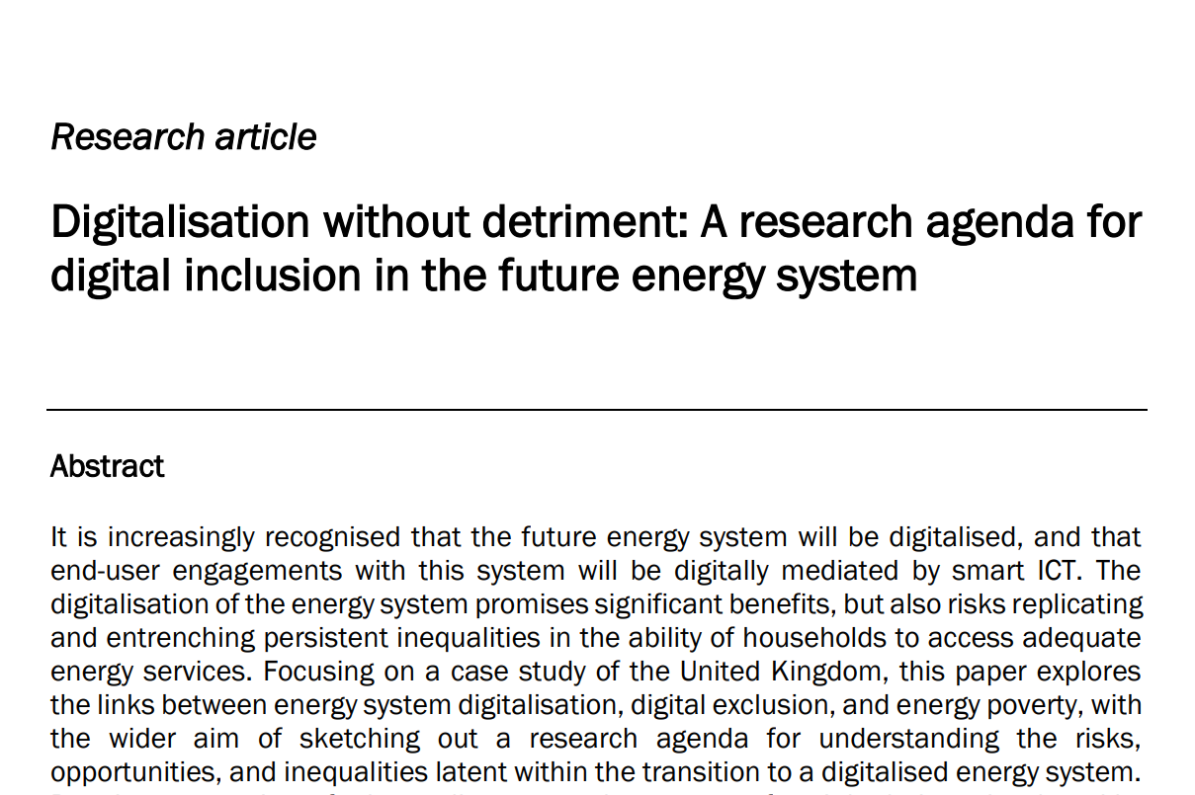
Want to find out more?

Slide 20
Thank you for listening
Caitlin Robinson (University of Bristol) @caithrobin caitlin.robinson@bristol.ac.uk
Matthew Scott (National Energy Action) @CaroKanny matthew.scott@nea.org.uk

