Slide 1
Breaking down barriers or putting them up? Festivals, events and the inclusivity of urban parks.
Andrew Smith, University of Westminster
Didem Ertem, University of Westminster
Goran Vodicka, Sheffield Hallam University

Slide 2
Research question and background
RQ: How do festivals and events affect the inclusivity of parks?
Urban public parks – symbolic and material significance
Programming – used to achieve greater inclusion, but can exclude
Notes:
Our work is an ongoing project which began in 2019
HERA funded FESTPACE project + QHT funded PhD

Slide 3
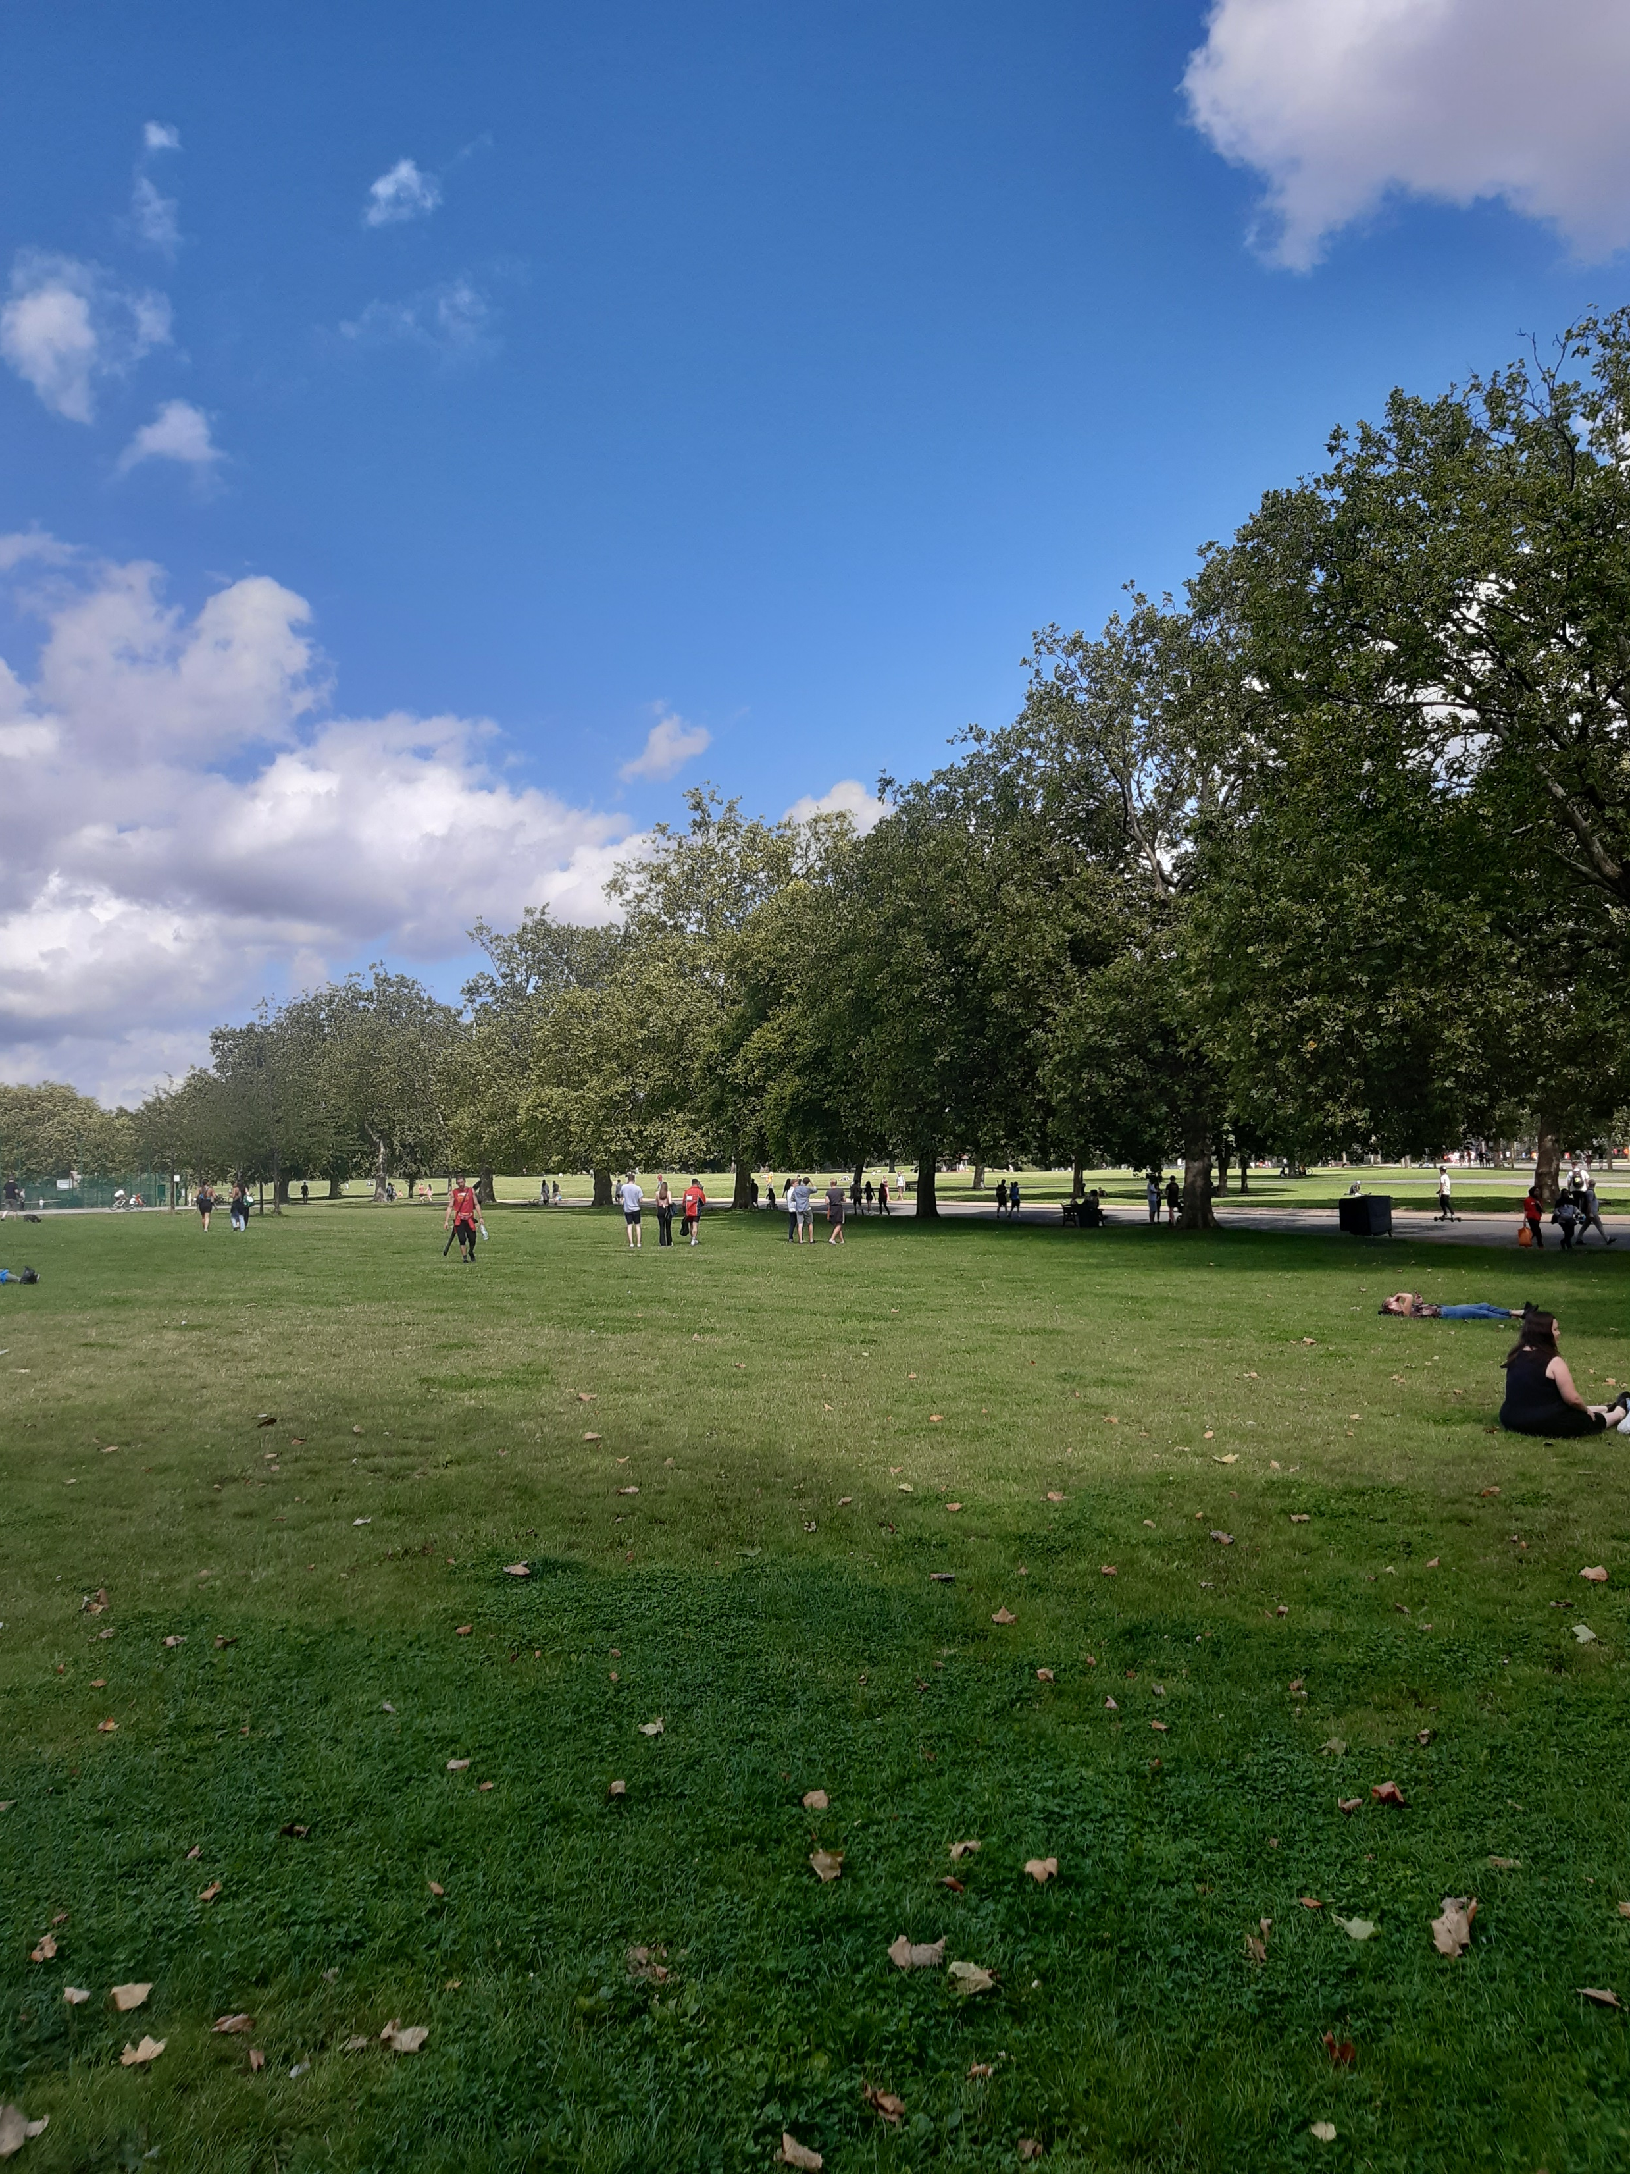
Finsbury Park
A large (46ha) municipal park
4 miles north of the centre of London
Stages a wide variety of events, some of which are highly contested
Surrounded by densely populated and super-diverse communities.

Slide 4
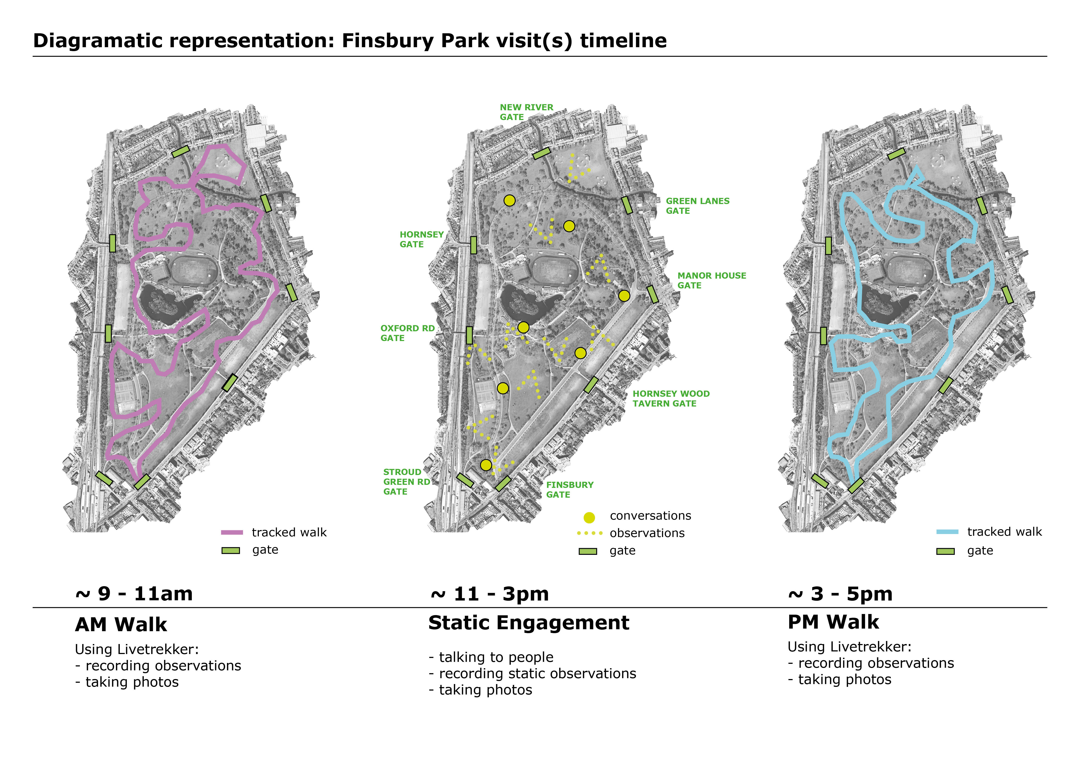
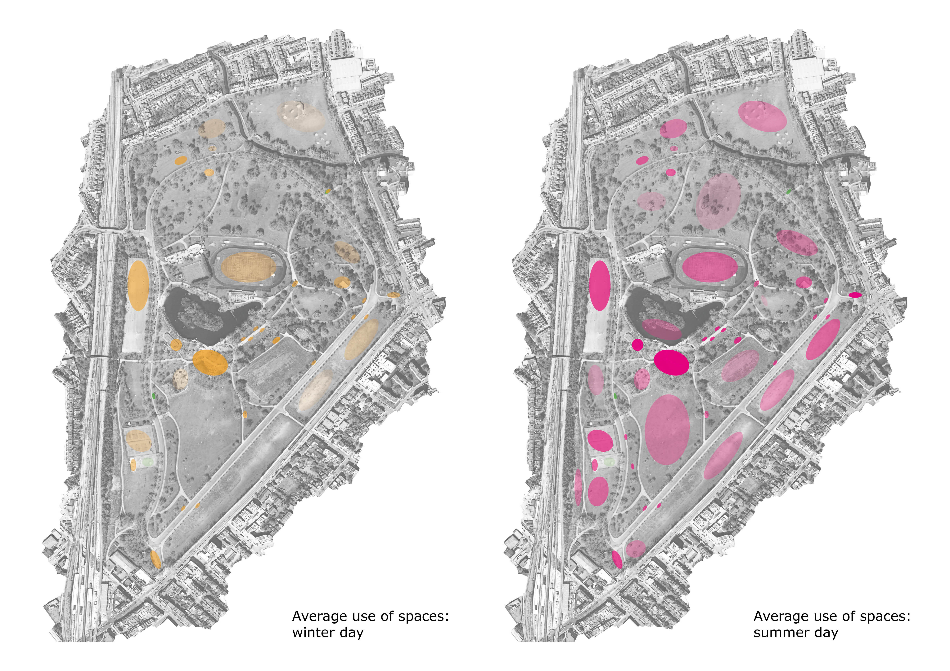
Main research method used
Observations at times when events were & weren’t happening
Weekly observations for six months 2019-20 (pre-pandemic)
Regular observations 2021-22 (once restrictions had eased)

Slide 5
Conceptual framework
Amalgamates ideas on park inclusivity and effects of park events
Accessibility – physical and financial barriers
Flexibility – how determined are functions and uses?
Sociability – esp. interactions between groups
Relatability – are spaces relevant to disadvantaged groups?
Draws on work by Franck & Stevens (2007); Low (2013); Allport (1954)

Slide 6
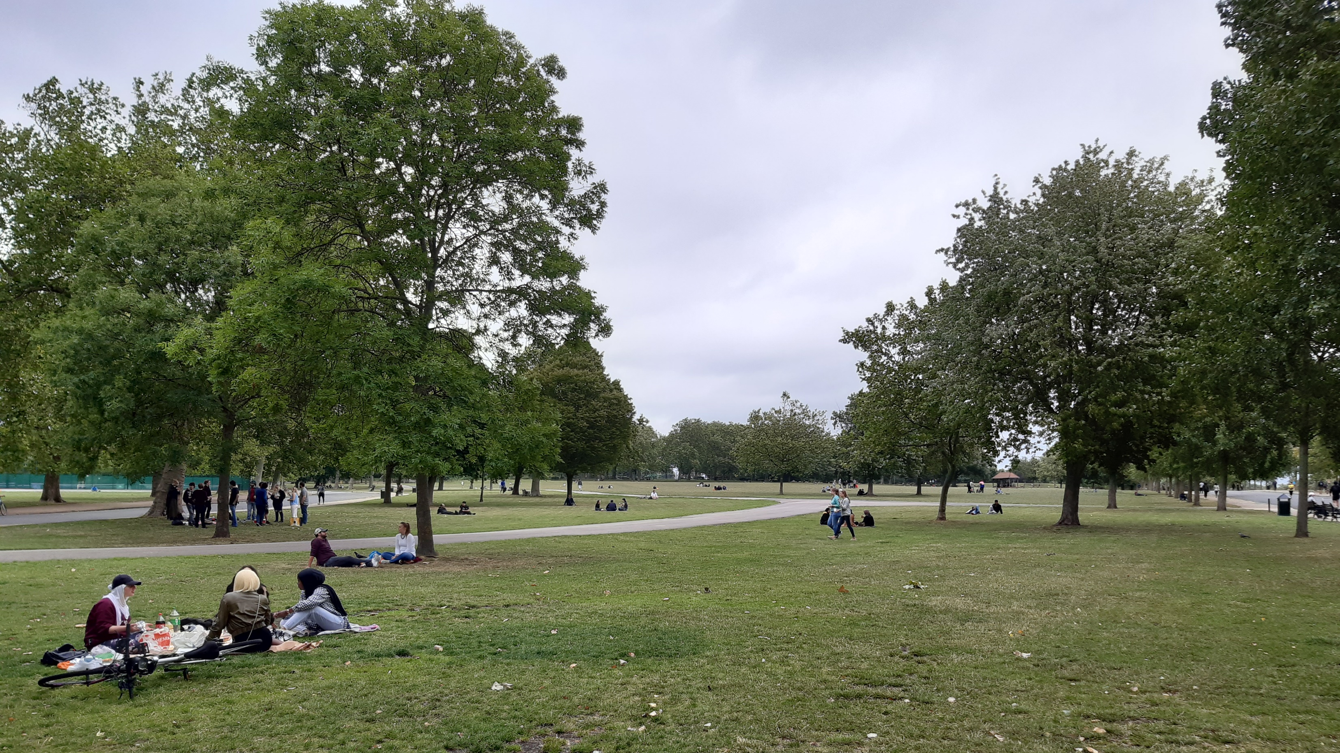

Slide 7
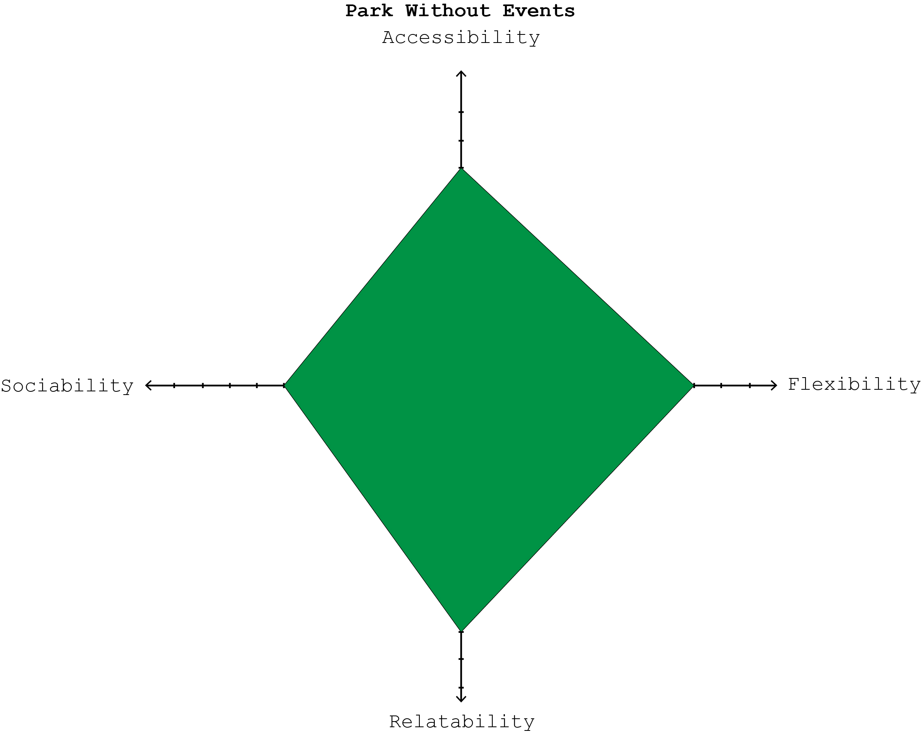

Slide 8
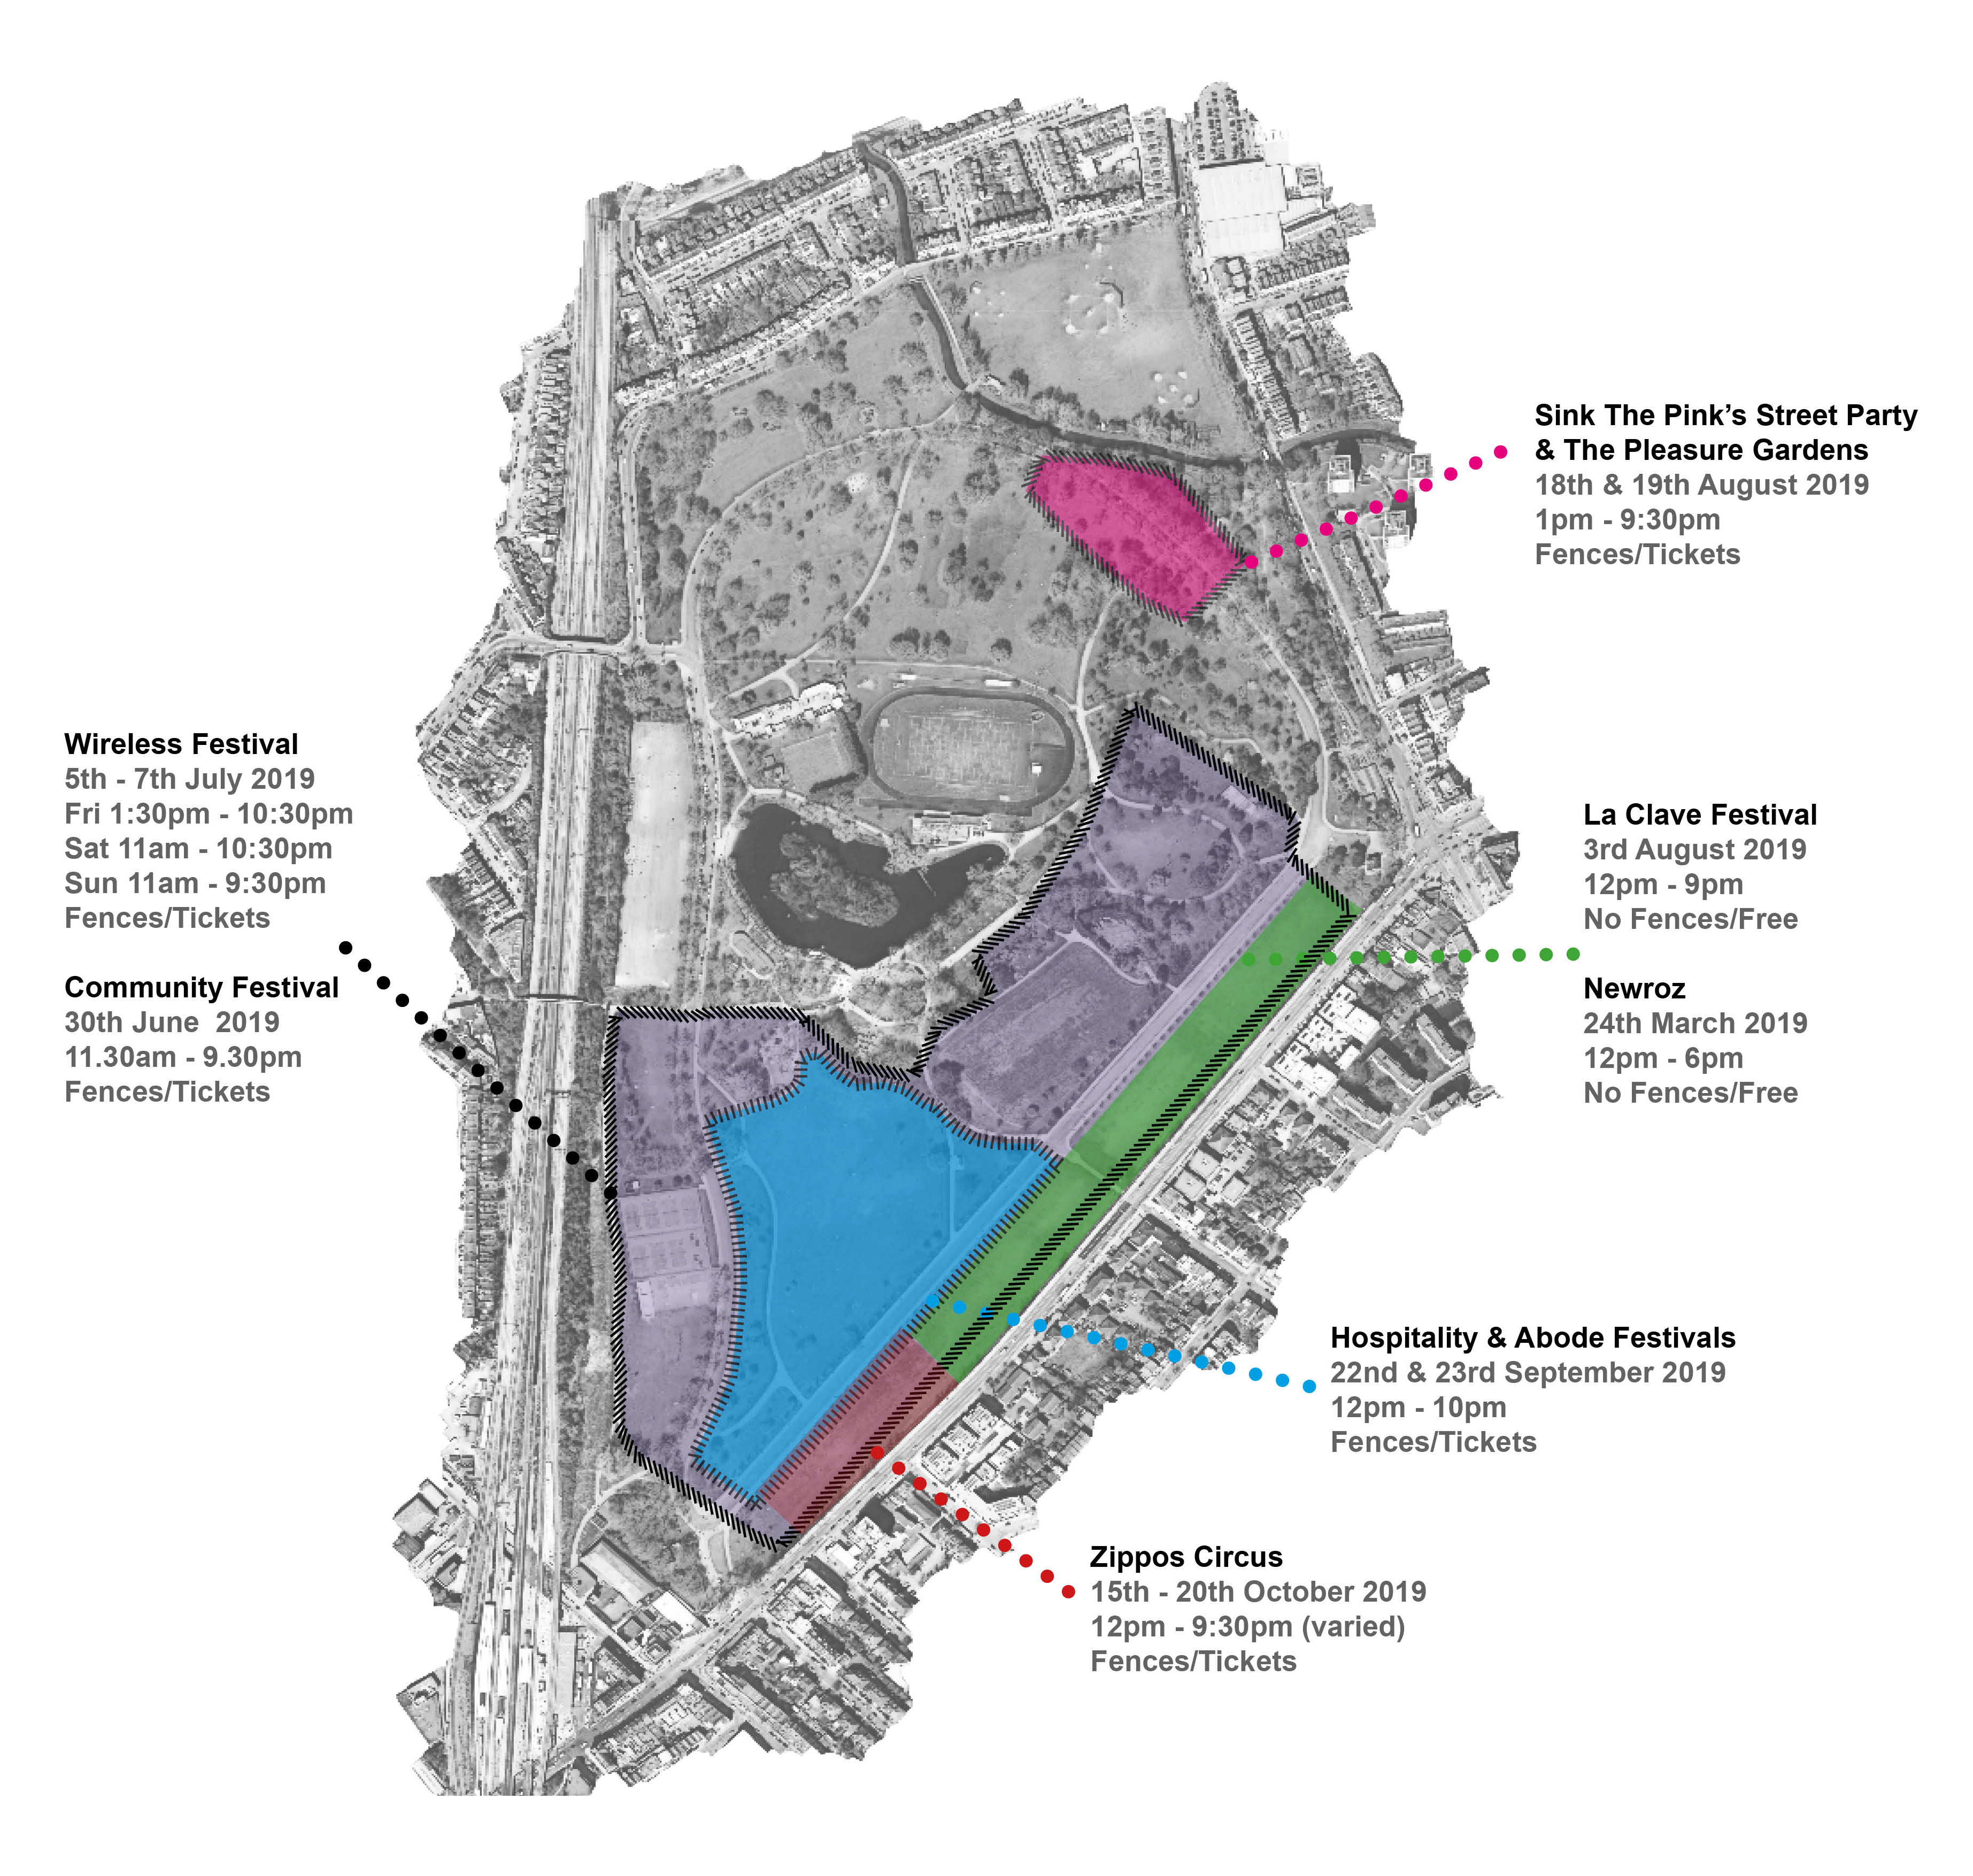
Three illustrative cases
Latino Life in the Park: medium sized festival, unfenced, free
Krankbrother events: small festivals, fenced, tickets c.£50
Wireless: large music festival, fenced, tickets c.£80+

Slide 9
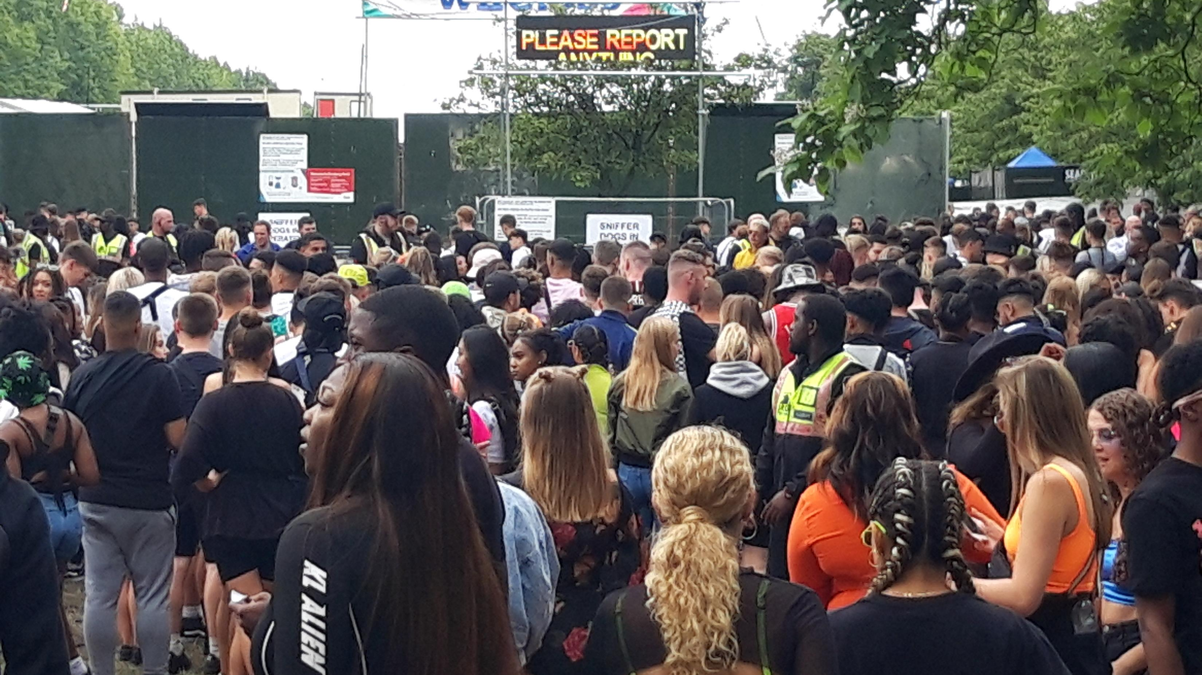

Slide 10
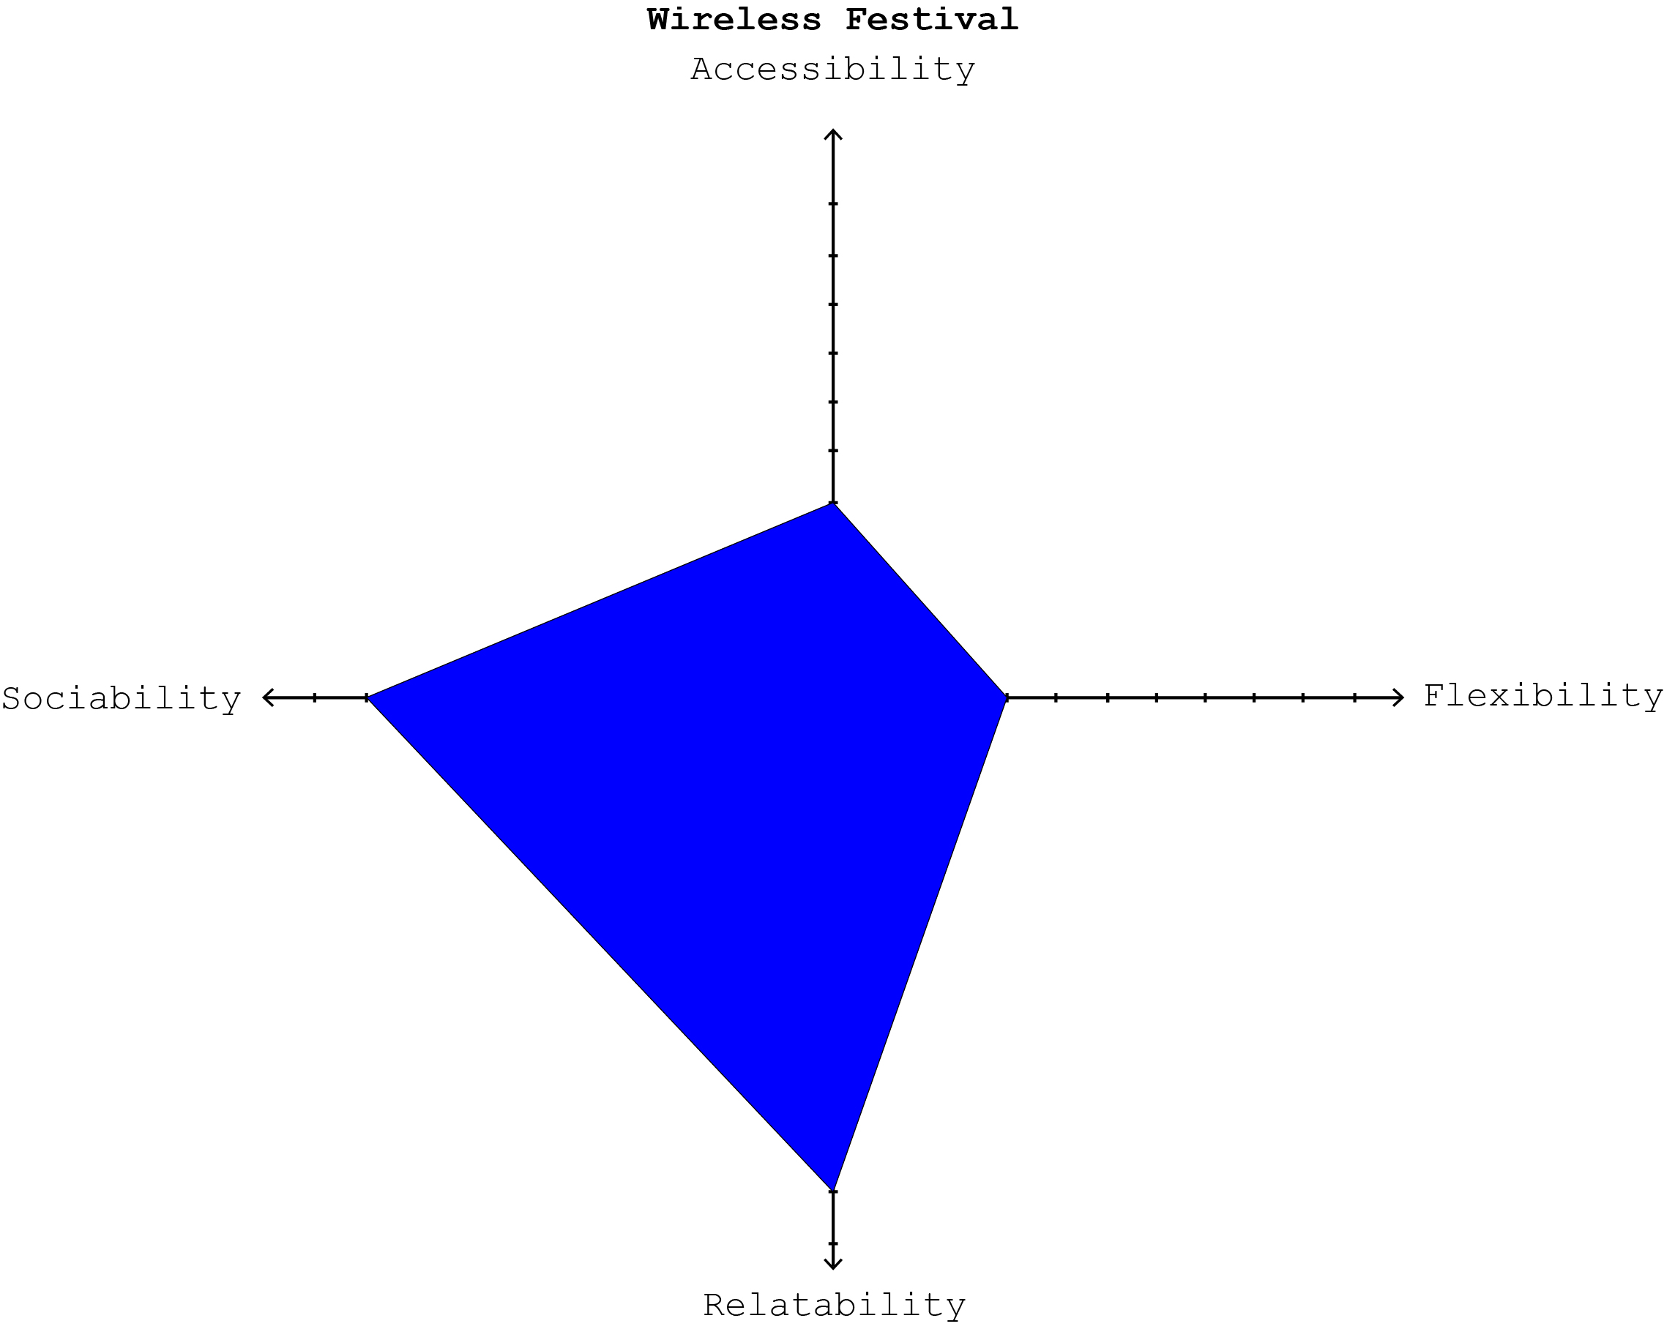

Slide 11
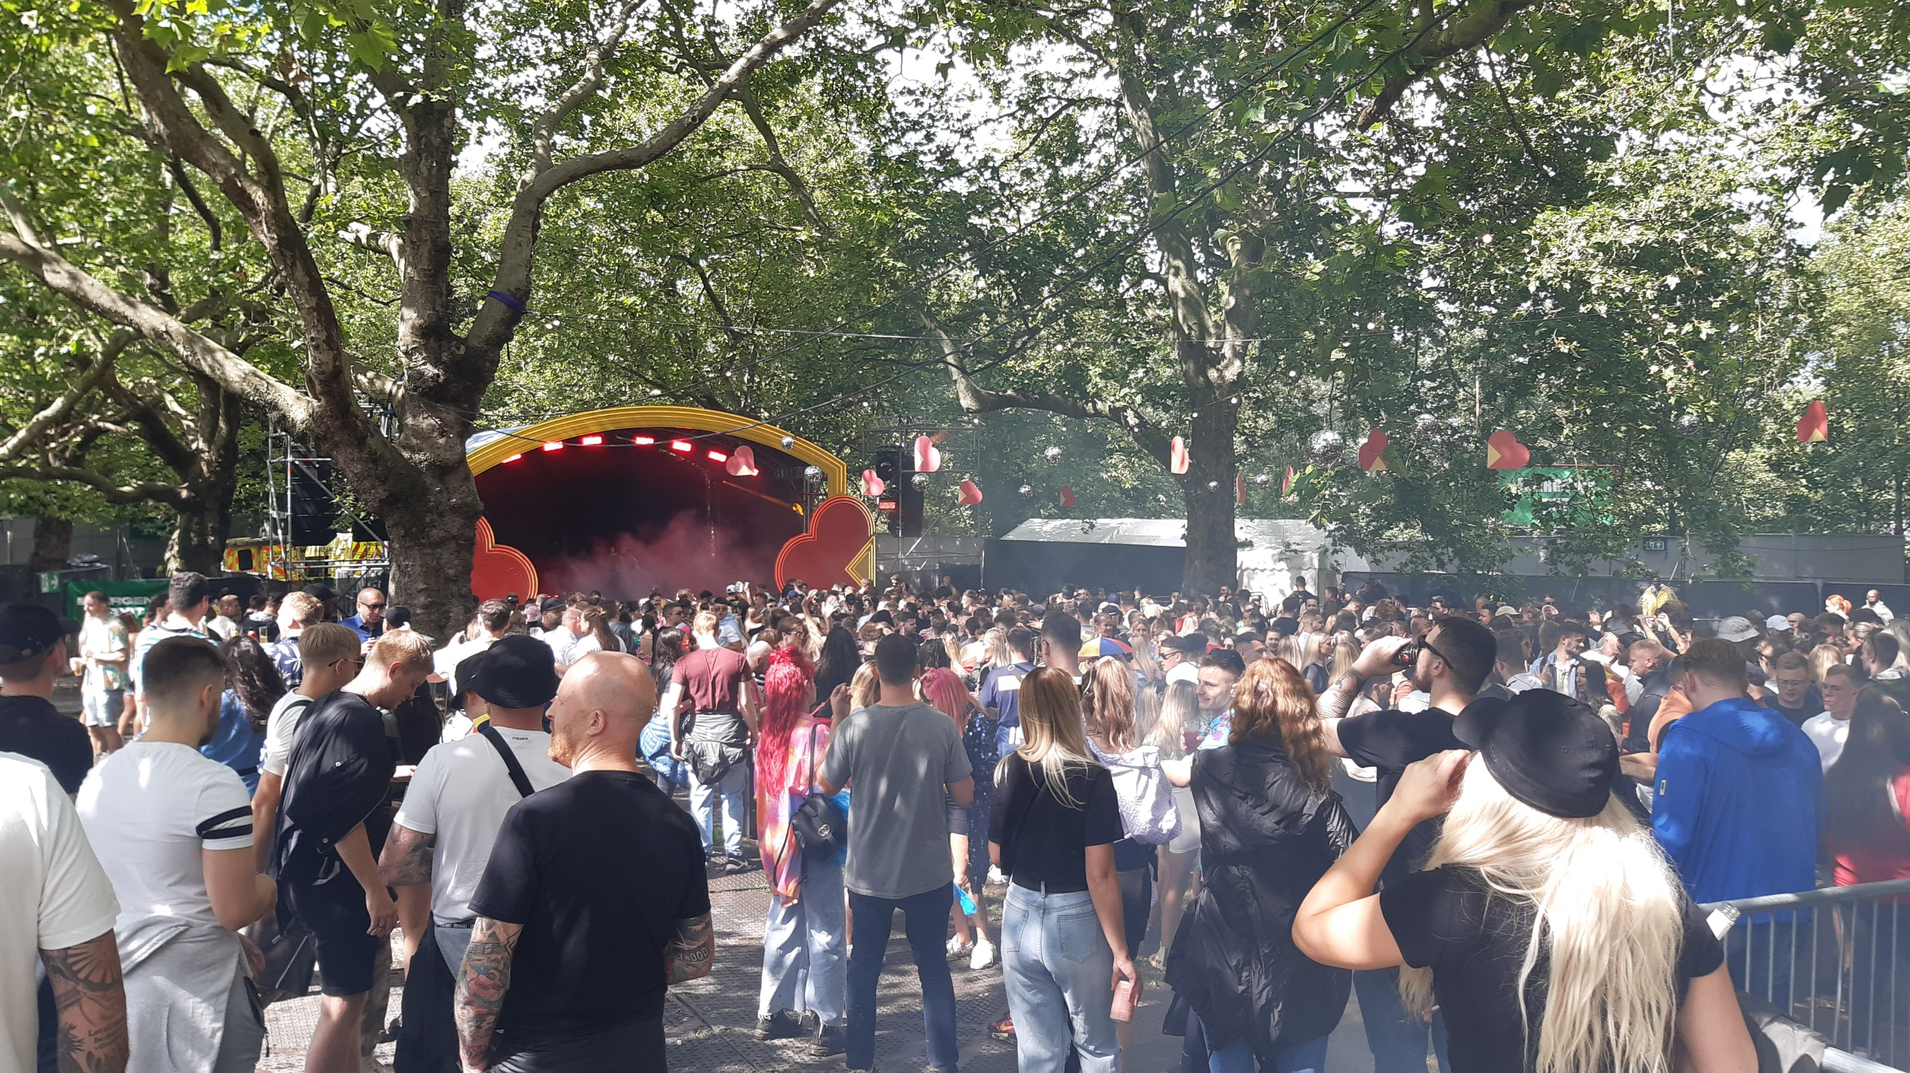

Slide 12
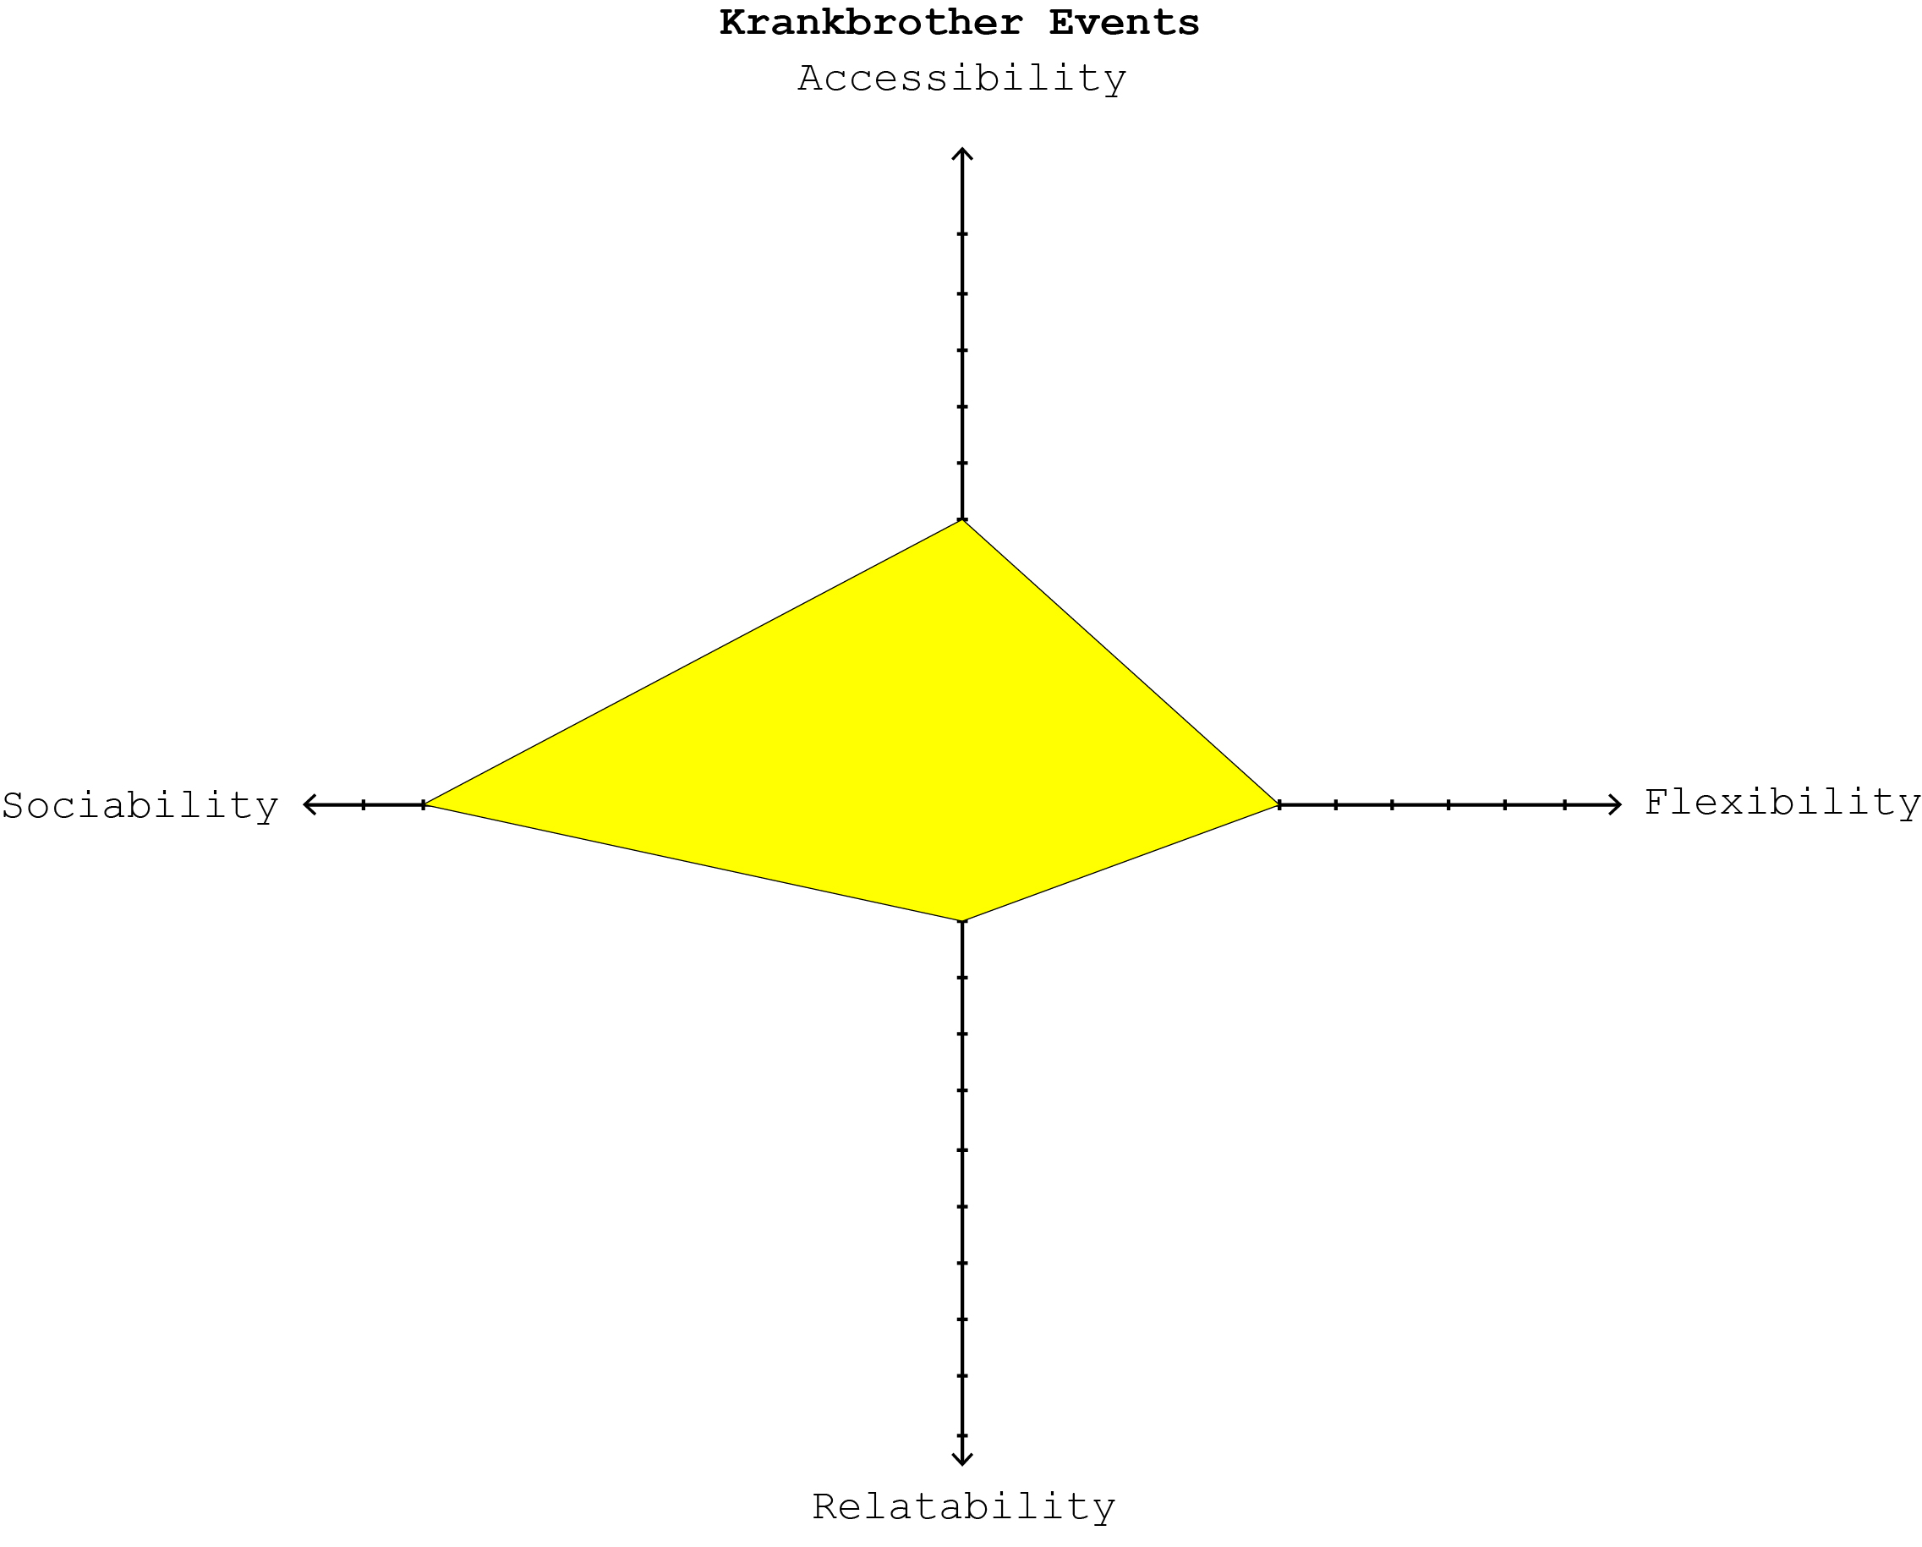

Slide 13
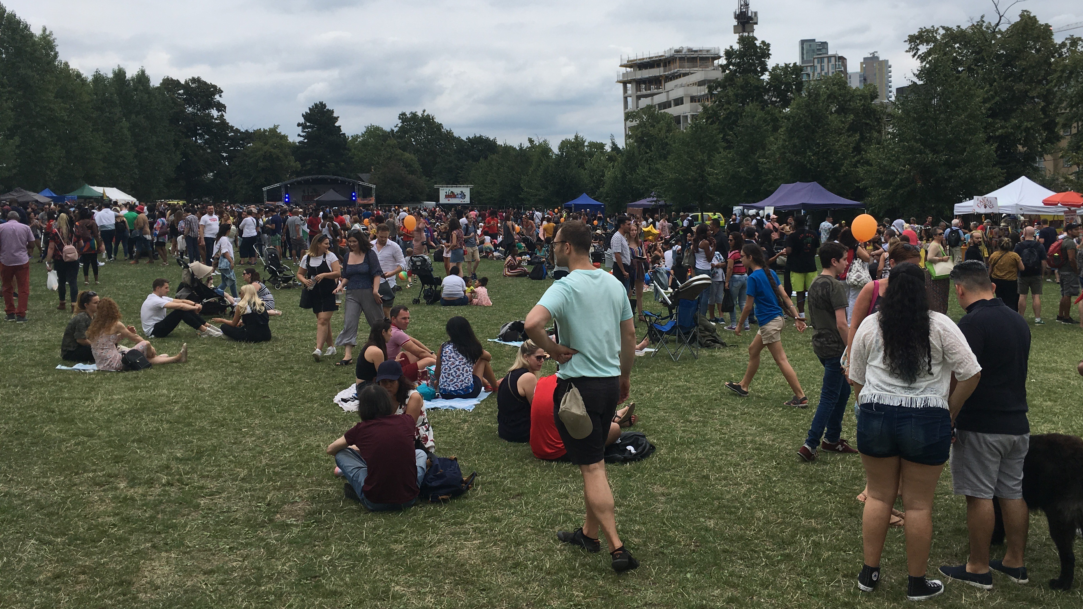

Slide 14
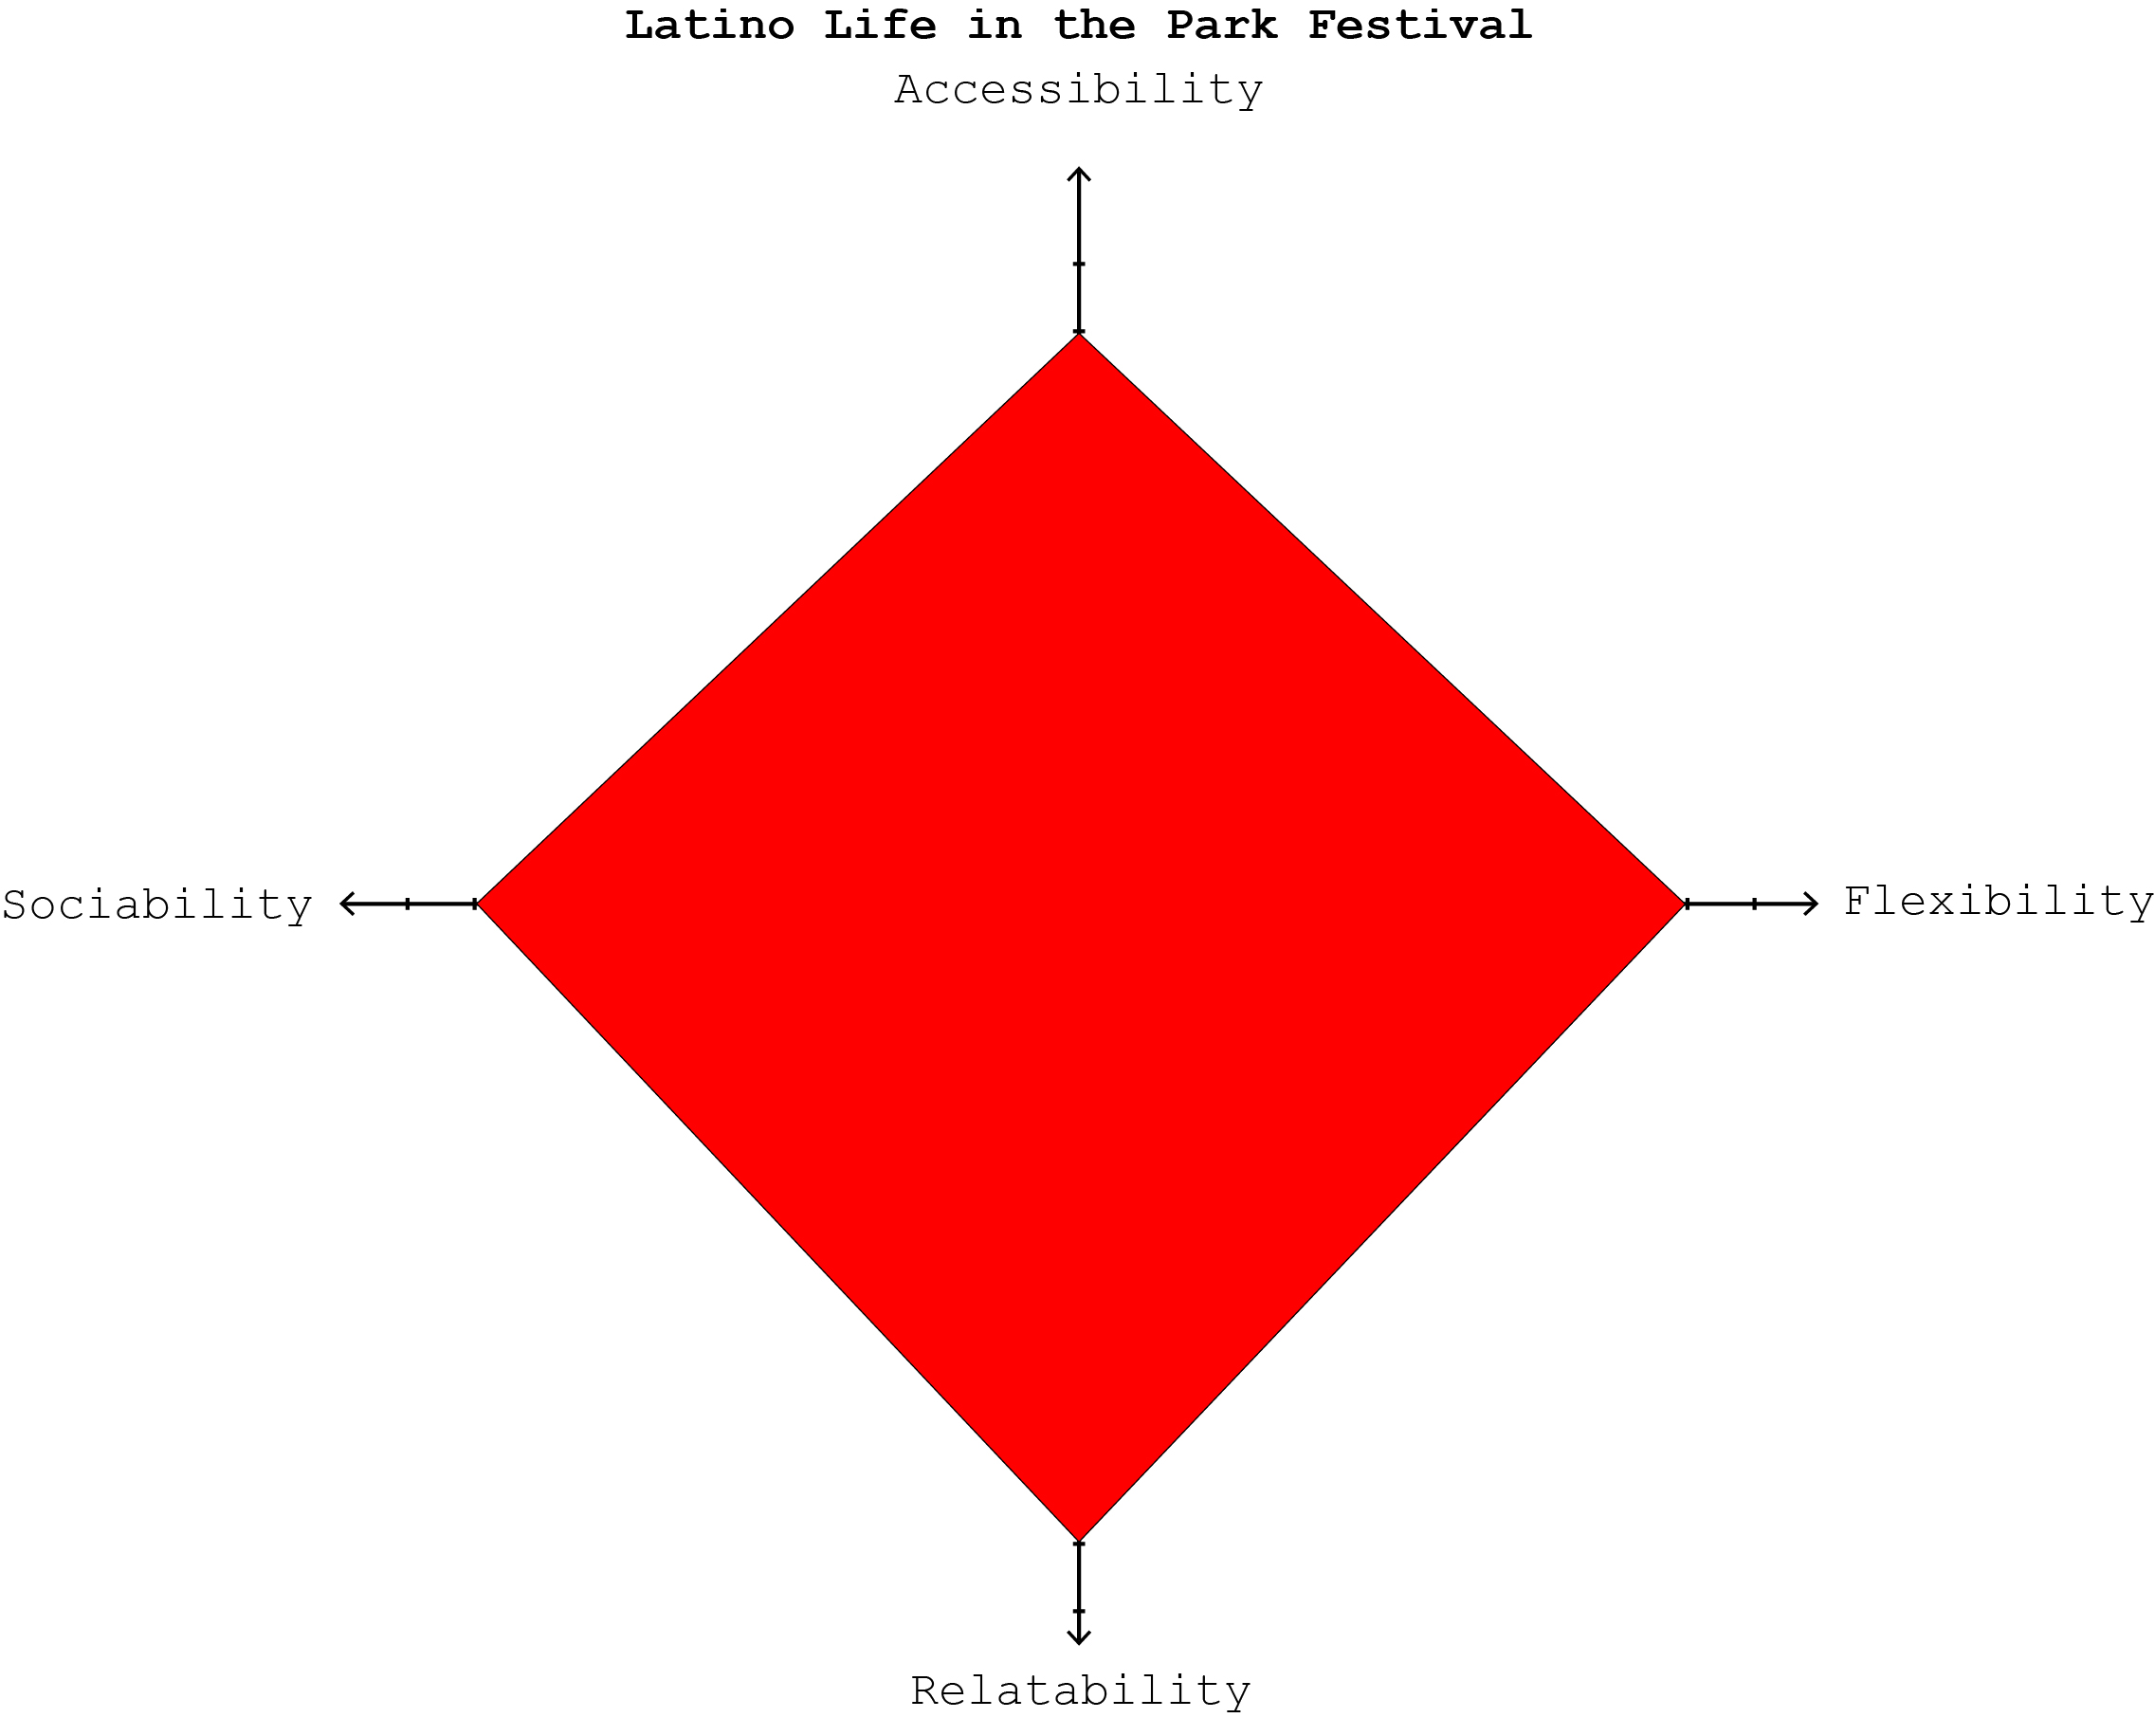

Slide 15
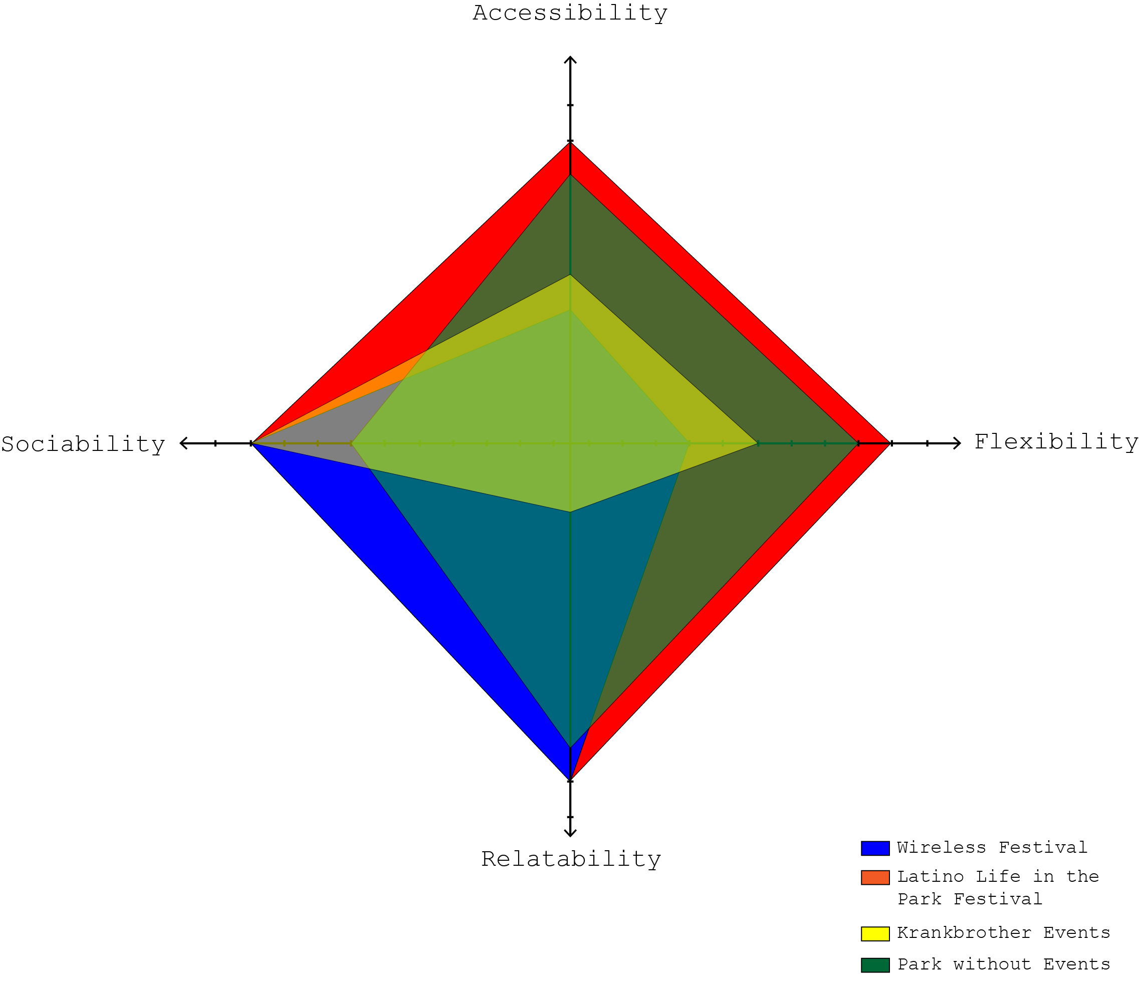

Slide 16
Key observations across events
Accessibility: fences disrupt access before, during and after events
Flexibility: over-programming reduces flexibility of park spaces
Relatability: festivals help to engage (some) under-represented groups
Sociability: importance of loose control & incidental engagement
+ Wider contributions and disruptions to everyday activities and other events

Slide 17
Conclusions
Festivals and events can assist inclusivity
But: financial imperatives can undermine inclusivity of programming
Fenced festivals & events introduce financial and physical barriers
The value of looser events: festive parks versus festivals in a park?
Notes:
via sociability + relatability
Fincial and physical barrers retrist acceesibilty / felexibilry of park

Slide 18
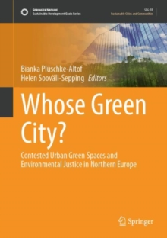
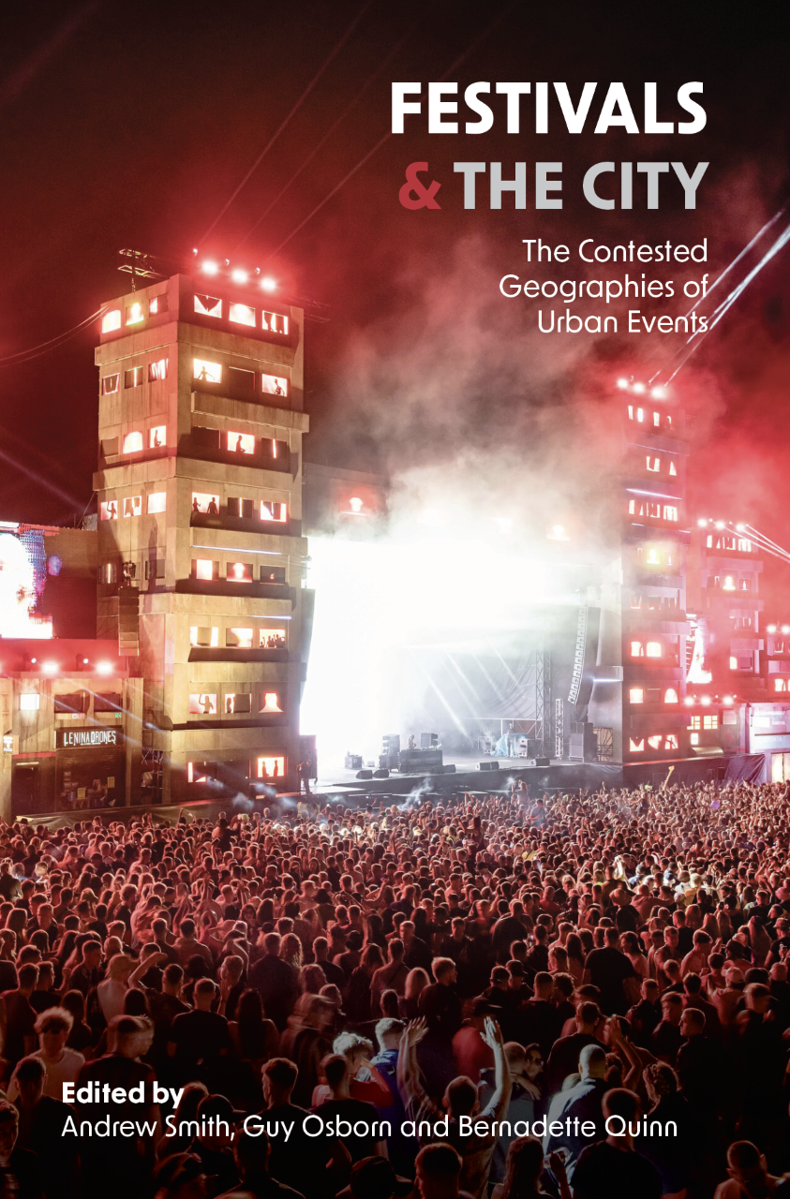
References relating to wider project
Smith, A., Osborn, G., Vodicka, G. (2022) “Private events in a Public Park. Contested Music Festivals and Environmental Justice in Finsbury Park, London”. In Plüschke-Altof, B; Sooväli-Sepping, H (2022) (Eds.). Whose Green City? Contested Urban Green Spaces and Environmental Justice in Northern Europe. Springer.
Smith, A. Osborn and Vodicka, G. (2022) “The Festivalisation of London’s Parks. The Friends’ Perspective”. In Smith, A., Osborn G. and Quinn, B. (2022) Festivals and the City: The Contested Geographies of Urban Events. UWP.
Jahan, T., Smith, A. and Ertem, D. (2022) Latino Life in the Park: Festivity and Inclusivity. Documentary film for FESTSPACE.
CONTACT US: a.smith@westminster.ac.uk / goran.vodicka@shu.ac.uk

