Slide 1
Diversity in community-led housing
Yael Arbell
6 July 2022, PPP Conference

Slide 2
Overview
What is CLH
A community’s story
...in context
New developments in research and practice

Slide 3
Community-led Housing
Not for profit
meets local needs
developed and managed by members of the community
Cooperatives, CLTs, self-help, cohousing
Ownership models vary

Slide 4
Benefits of CLH
Some need these more urgently than others
some can access these more easily than others
And some just get these in other ways!

Slide 5
It’s hard
Time
Skill
Money
Social capital
Cultural capital

Slide 6
Overview
What is CLH
A community’s story
...in context
New developments in research and practice

Slide 7
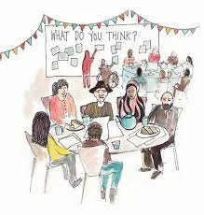
Community level
Who sets the table?
Who turns up?
Who is being heard?

Slide 8
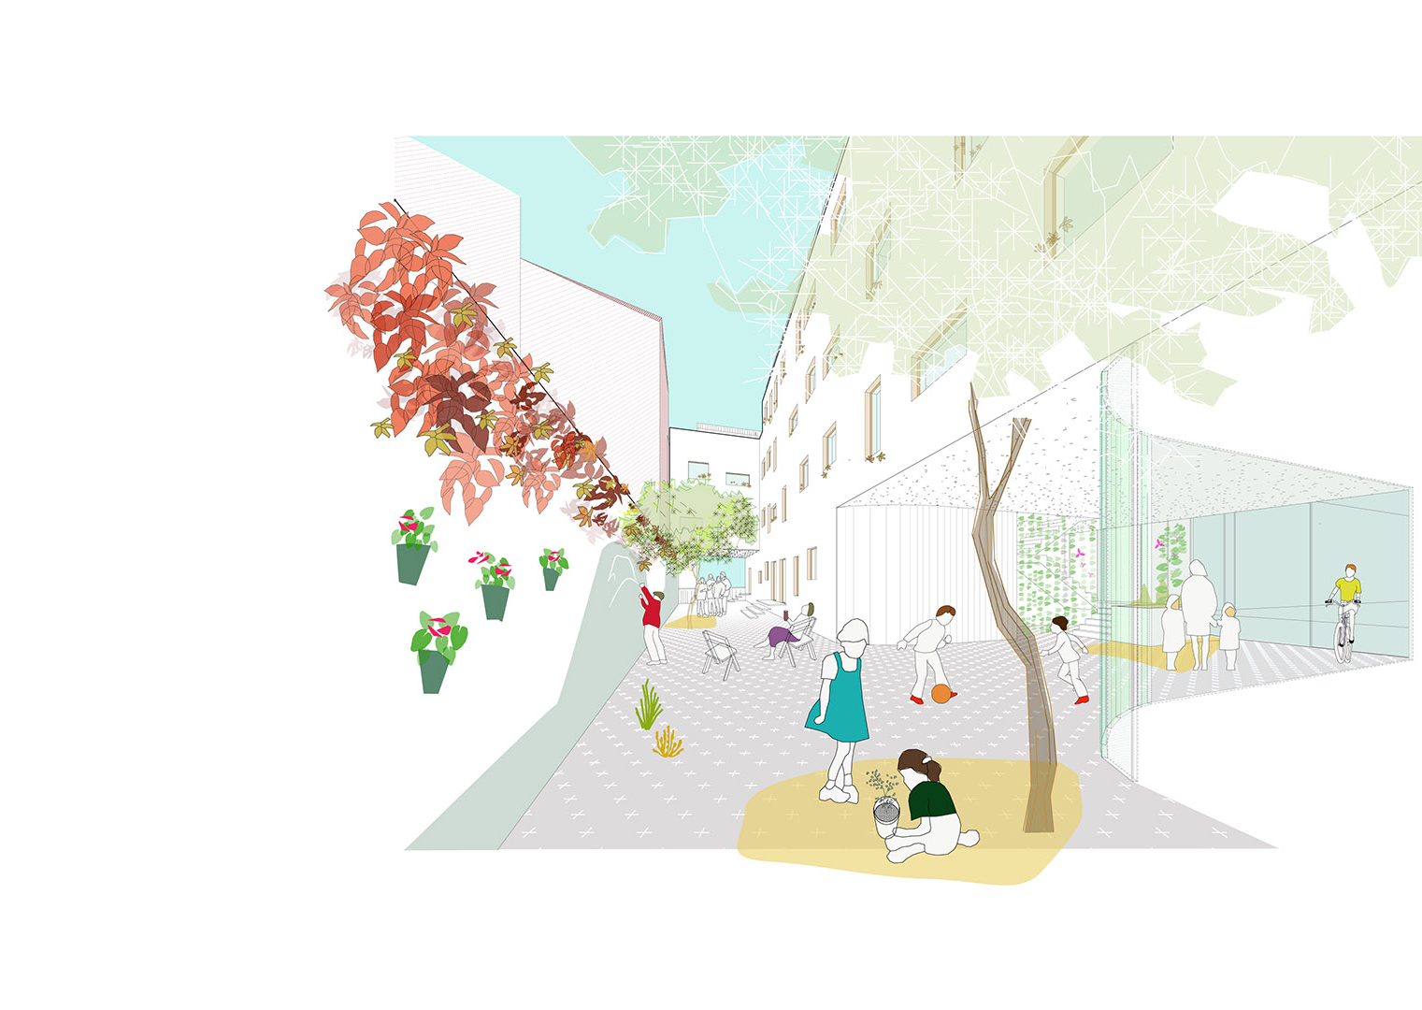
Cohousing
"a cohousing group who developed a beautiful cohousing developments in the South of England (...) they spent £11 million on it and they... they funded 1,000,000 pounds of pre development costs themselves, 'cause they all owned property in London. They'd all paid off their mortgages on houses in London“ (cohousing member)

Slide 9
White space, middle-class space
White space [n]: “Settings in which black people are typically absent, not expected, or marginalized when present”
(Anderson 2015)
“You want other people joining things but they find it difficult, you know, because people are not, you know, we don’t speak the language that you guys know how to” (cohousing member in a group discussion)
“I am unusual yes, in that I’m completely skint but I have – what do I have as privilege (…) you know middle-classy education and um… you know… (cohousing member)
“I remember someone saying NIMBYism, right? And after he left - I didn't say anything at the time, right? (laughs) - but I literally 'what does that mean?'. If you grew up in a garage, you're not gonna know that, there's no way you'll know what a NIMBY [is]...”. (cohousing member interview)

Slide 10
It’s a whole sector issue
There is value in homogeneity and in diversity in a single community
But is the sector systemically exclusive?

Slide 11
Ethnicity and age

Slide 12
Education and income
Mainly retired members

Slide 13
Overview
What is CLH
Micro practices
Macro contexts
New developments in research and practice

Slide 14
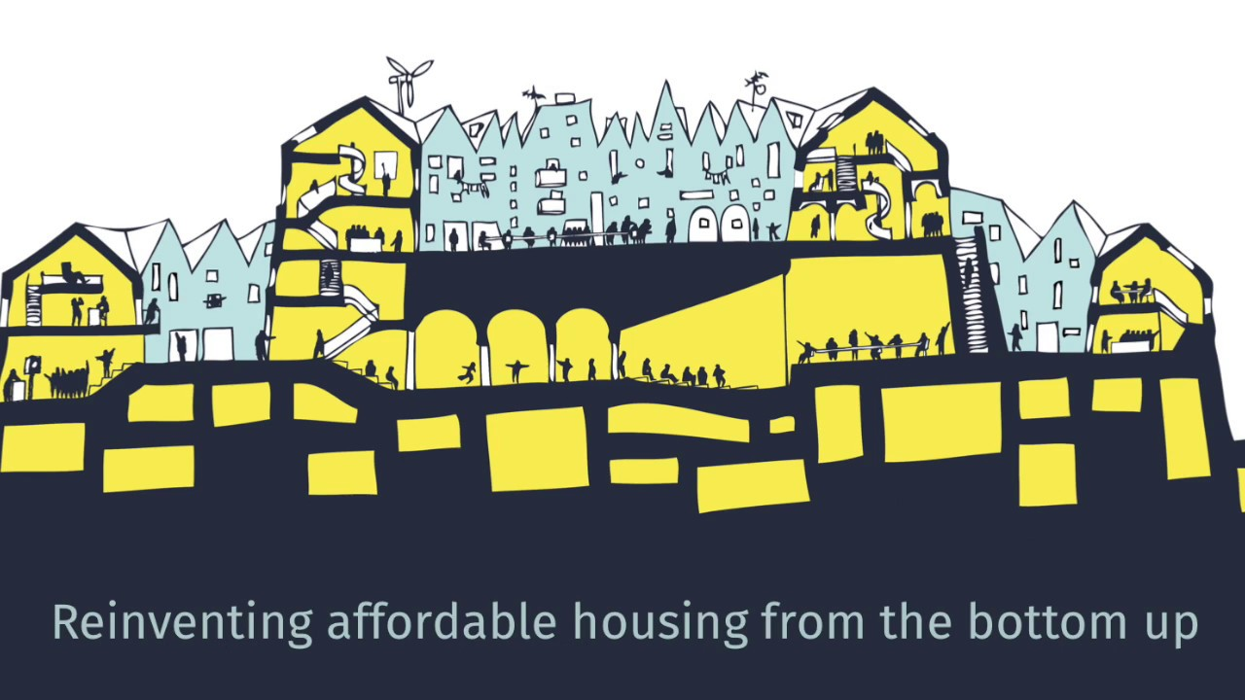
National level
Funding
Ideology
Structures
Notes:
"I'm delighted to be supporting this research project. Community Land Trusts originated from the civil rights movement in the USA, and over the pond the struggle for racial justice is central to the CLT movement. But English CLTs first took off in the rural south west with a focus on affordability for local people. Despite their spread into cities and towns we've not seen many Black-led CLTs, and too few CLTs in areas with large Black communities have much representation or involvement on their Board. I'm looking forward to better understanding the barriers, including any we are creating ourselves, and the Community Land Trust Network is committed to following through on the findings."

Slide 15
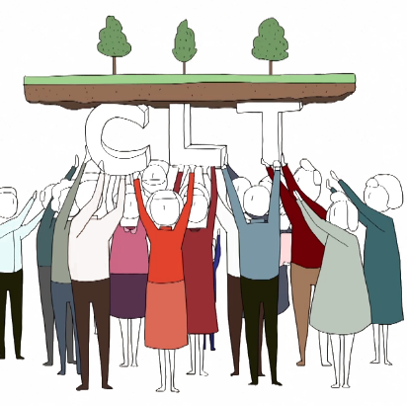
Sector level
CLT: mostly rural, White, democratic, directed by a board
Cooperatives: mostly urban, rented, various scales with implications for participation
Cohousing: mostly White, educated, private ownership, highly participatory
Notes:
"I'm delighted to be supporting this research project. Community Land Trusts originated from the civil rights movement in the USA, and over the pond the struggle for racial justice is central to the CLT movement. But English CLTs first took off in the rural south west with a focus on affordability for local people. Despite their spread into cities and towns we've not seen many Black-led CLTs, and too few CLTs in areas with large Black communities have much representation or involvement on their Board. I'm looking forward to better understanding the barriers, including any we are creating ourselves, and the Community Land Trust Network is committed to following through on the findings."

Slide 16
Overview
What is CLH
A community’s story
...in context
New developments in research and practice

Slide 17
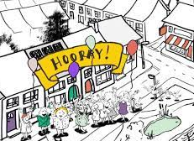
Neighbourhood Plannning
New funding to support urban areas and under-represented communities

Slide 18
CLT research
8 peer researchers from a range of backgrounds and communities
Identify barriers for diversity and inclusion and suggest ways to overcome them

Slide 19
UK Cohousing Network
New guide with a section on diversity and inclusion
Working group on diversity and inclusion
Big Lottery funding:
Learning community in housing associations around vulnerability
community coaching pilot

Slide 20
BME-led CLH
Action research
Led by Black practitioners
Identify barriers to BME-led communities
Recommend solutions to policy makers, sector organisations and communities

Slide 21
New Cohousing model
Initiated by a registered provider
Fully rented at social rent
Aimed for BME tenants
Inner city
Designed with tenants
How will greater accessibility affect participation, values and meaning?

Slide 22
Conclusion
Role of intermediaries
Equality <-> Liberty
Affordability $≠$ accessibility
Single community or sector-wide
Notes:
"I'm delighted to be supporting this research project. Community Land Trusts originated from the civil rights movement in the USA, and over the pond the struggle for racial justice is central to the CLT movement. But English CLTs first took off in the rural south west with a focus on affordability for local people. Despite their spread into cities and towns we've not seen many Black-led CLTs, and too few CLTs in areas with large Black communities have much representation or involvement on their Board. I'm looking forward to better understanding the barriers, including any we are creating ourselves, and the Community Land Trust Network is committed to following through on the findings."

Slide 23
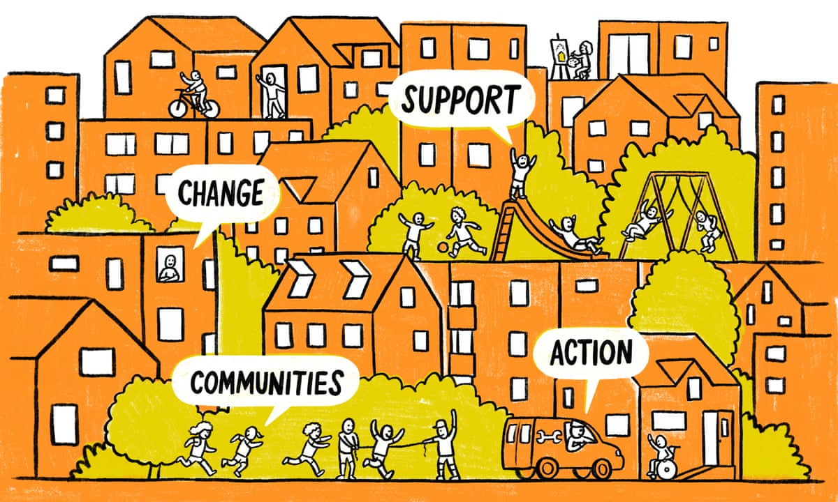
Thank you
Yael Arbell
y.arbell@shu.ac.uk
Illustration: Adam Hayes/Guardian

