Slide 1
Incomers: The Experience of Households Moving Into a Yorkshire Mining Village
John Erskine
Department of Urban Studies and Planning, University of Sheffield

Slide 2
Background
Policy
Coal Task Force/National Coalfields Programme: 1996-2010...
ERDF and ESF
Housing Market Renewal: 2002-2011
Personal
Professional Experience
PhD Research

Slide 3
The Study
A qualitative examination of household work strategies and the informal economy in a mining village in Yorkshire
Based on approaches developed by Pahl and Williams
Initially premised on a ‘hidden economy’ that did not actually exist for the households studied

Slide 4
Household Work Strategies
'...how households allocate their collective effort to getting all the work done that they define has, or they feel needs to be done...' (Pahl, 1984: 113)

Slide 5
The Village: ‘Ballyhenry’
In the Wakefield Metropolitan District
A growing resident population of just over 6000 (2011 Census), with rising economic activity levels
Above national and district average in Social Classes C2, D, E
Significantly lower qualification levels, with almost 40% with no qualifications
Rural location, with post-2000 housing development

Slide 6
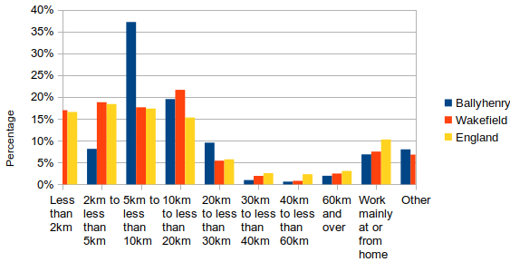
Distances Travelled to Work (ONS;2018)

Slide 7
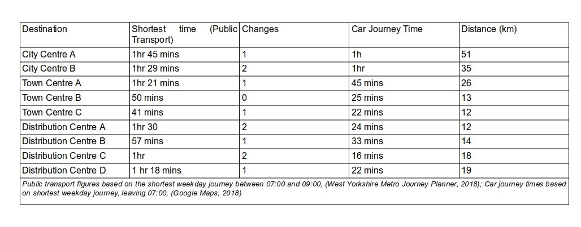
Journey Times: Key Employment Locations

Slide 8
The Households
17 households
5 working couples with children
2 working single men, one with a child
3 working single women
2 unemployed/long-term sick
2 retired couples
2 retired single women
12 households with at least one member educated to Level 4 or higher, 5 with postgraduate qualifications
All had moved into the village from elsewhere

Slide 9
Abigail (40) and Thomas (42)
Difficult commutes to Leeds and Sheffield
The impact of long hours
A third child born on Christmas Eve
A change to working from home
No family support

Slide 10
Katie (43) and Mark (42)
No typical weeks
The demands of a new business
Hyper-managed diaries
Conscious local networking
No family support

Slide 11
Gillian (41) and Terry (48)
Three autistic sons
Household repairs
Negotiating school
Pets as a safety valve
No family support

Slide 12
Rosemary (46)
Choosing to work nights
Ten pets
Interactions with other pet owners
Limited family contact
A sub-optimal location

Slide 13
Carole (53)
Non-driver, dependent on local cleaning and administrative jobs
Living with second husband, Alan
Seven grown-up children living within 20km
Caring for mother and grandchildren

Slide 14
Conclusions
The positive and negative impacts of space and location
The importance of care and caring
Families (and their absence) matter
The importance and the limitations of networks
The positive and negative effects of economic change
The importance of pets

Slide 15
Link to Thesis
https://etheses.whiterose.ac.uk/28808/

Slide 16
Selected References: 1
Bagnall, G., Longhurst, B., & Savage, M. (2003). ‘Children, Belonging and Social Capital: The PTA and Middle Class Narratives of Social Involvement in the North-West of England.’ Sociological Research Online, 8(4), 128–143. https://doi.org/10.5153/sro.862
Bernstein, B. B. (1971). Class, codes and control. London : Routledge and Kegan Paul, 1971.
Champion, T. (2009). Urban–Rural Differences in Commuting in England: A Challenge to the Rural Sustainability Agenda? Planning Practice and Research, 24(2), 161–183. https://doi.org/10.1080/02697450902827329
Cheshire, P. (2009). Urban Containment , Housing Affordability and Price Stability - Irreconcilable Goals (Issue September).
Cole, I. (2015). The Housing Market Renewal Pathfinder Programme - A Drop of Keynes in a Neo-Liberal Ocean? Built Environment, 41(2), 289–304. https://doi.org/10.2148/benv.41.2.289
De Ruijter, E., Van Der Lippe, T., & Raub, W. (2003). Trust Problems in Household Outsourcing. Rationality and Society, 15(4), 473–507.
Dennis, N., Henriques, F., & Slaughter, C. (1969). Coal is our life : an analysis of a Yorkshire mining community (2nd ed.). London: Tavistock. http://copac.ac.uk/search?isn=0422732508&rn=1#.UXkwE0Q-x28.mendeley
Elias, N., & Scotson, J. L. (1994). The Established and the Outsiders. Sage Publications.
Evans, M., Syrett, S., & Williams, C. (2006). Informal Economic Activities and Deprived Neighbourhoods. Department for Communities and Local Government. http://eprints.mdx.ac.uk/3760/1/Informal_economic_activities_and_deprived_neighbourhoods.pdf
Fletcher, D. R. (2009). Social Tenants, Attachment to Place and Work in the Post-industrial Labour Market: Underlining the Limits of Housing-based Explanations of Labour Immobility? Housing Studies, 24(6), 775–791. https://doi.org/10.1080/02673030903205895
Glucksmann, M. (2009). Formations, Connections and Divisions of Labour. Sociology, 43(5), 878–895. https://doi.org/10.1177/0038038509340727
Green, A. E. (2004). Is Relocation Redundant? Observations on the Changing Nature and Impacts of Employment-related Geographical Mobility in the UK. Regional Studies, 38(August), 629–641. https://doi.org/10.1080/0034340042000240941
Hickman, P., Walshaw, A., Ferrari, E., Gore, T., & Wilson, I. (2011). “The Houses all Look Posh Now” - Evaluating the Impact of a Housing Improvement Programme: The Case of Portobello and Belle Vue (Issue February).
Hochschild, A. (2015). Emotional life on the market frontier. Working in America: Continuity, Conflict, and Change in a New Economic Era, 37(1), 89–100. https://doi.org/10.4324/9781315631011
Hochschild, A. R. (2012). The managed heart : commercialization of human feeling. University of California Press.

Slide 17
Selected References: 2
Jarvis, H. (2005). Work/Life City Limits. Palgrave Macmillan. http://www.palgraveconnect.com/pc/doifinder/10.1057/9780230503304
Leather, P., Nevin, B., Cole, I., & Eadson, W. (2012). The Housing Market Renewal Programme in England: development, impact and legacy. Sheffield: CRESR Sheffield Hallam University, January.
McDowell, L., Ray, K., Perrons, D., Fagan, C., & Ward, K. (2005). Women’s paid work and moral economies of care. Social & Cultural Geography, 6(2), 219–235. https://doi.org/10.1080/14649360500074642
McKie, L., Gregory, S., & Bowlby, S. (2002). Shadow Times: The Temporal and Spatial Frameworks and Experiences of Caring and Working. Sociology, 36(4), 897–924. https://doi.org/10.1177/003803850203600406
McNicholas, J., Gilbey, A., Rennie, A., Ahmedzai, S., Dono, J.-A., & Ormerod, E. (2005). Pet ownership and human health: a brief review of evidence and issues. BMJ, 331(7527). http://www.bmj.com/content/bmj/331/7527/1252.full.pdf
Mulder, C. H., & Kalmijn, M. (2005). The geography of family networks. IUSSP XXV International Population Conference Tours, France, July 18-23, 2005, 1995, 1–19.
Pahl, R. E. (1984). Divisions of labour. B. Blackwell.
Raw, A., & McKie, L. (2020). Exploring Women’s Mutuality in Confronting Care-Precarity: ‘Care Accounts’ – a Conceptual Tool. Sociology, 54(1), 53–69. https://doi.org/10.1177/0038038519856236
Rijken, M., & Van Beek, S. (2016). About Cats and Dogs ... Reconsidering the Relationship Between Pet Ownership and Health Related Outcomes in Community-Dwelling Elderly Author ( s ): Mieke Rijken and Sandra van Beek Published by : Springer Stable URL : http://www.jstor.org/stable/41476490. Social Indicators Research, 102(3), 373–388. http://www.jstor.org/stable/41476490
Rowan, C. F. (2015). Health, well-being, and social dynamics in mixed communities. University of Glasgow.
Savage, M., Bagnall, G., & Longhurst, B. (2001). Ordinary, Ambivalent and Defensive: Class Identities in the Northwest of England. Sociology, 35(4), 875–892. https://doi.org/10.1177/0038038501035004005
Sihto, T. (2019). Placing women? How locality shapes women’s opportunities for reconciling work and care. University of Jyväskylä.
Swann, R., & Hughes, G. (2016). Exploring micro-sociality through the lens of ‘established-outsider’ figurational dynamics in a South Wales community. Sociological Review, 64(4), 681–698. https://doi.org/10.1111/1467-954X.12428
Wallace, C. (2002). Household Strategies: Their Conceptual Relevance and Analytical Scope in Social Research. Sociology, 36(2), 275–292. https://doi.org/10.1177/0038038502036002003
Warwick, D., & Littlejohn, G. (1992). Coal, capital, and culture : a sociological analysis of mining communities in West Yorkshire. Routledge.
Watt, P. (2009). Living in an oasis: Middle-class disaffiliation and selective belonging in an english suburb. Environment and Planning A, 41(12), 2874–2892. https://doi.org/10.1068/a41120
Wheelock, J., & Jones, K. (2002). ‘Grandparents Are the Next Best Thing’: Informal Childcare for Working Parents in Urban Britain. Journal of Social Policy, 31(03), 441–463. https://doi.org/10.1017/S0047279402006657

