Slide 1
Exploring value in alternative frameworks for local economic development
PPP Annual conference 2022 Rich Crisp (r.crisp@shu.ac.uk)
Peter Wells (p.wells@shu.ac.uk)
CRESR (Sheffield Hallam University)
06 July 2022
Notes:
Emerged out of work..
Little exploration of concepts and theories informing these frameworks to date
Want to develop a little by looking through the lens of value only one perspective. Interrogated through concepts of democracy + justice

Slide 2
Outline
Review conceptualisations of value and how these can shape (or challenge) inequalities (Mazzucato, 2019)
Explore if, and how, notions of value, are deployed in three alternative economic development frameworks:
Inclusive Growth
Doughnut Economics
Foundational Economy
Consider proposed forms of strategic transformation (Olin Wright, 2010)
Reflect on the implications of different ways in which value is embedded
Notes:
How do they envisage change occurring...And how links back to ideas of value?
These frameworks are not interchangeable and the choice will have very different implications for strategies as well as the prospects for reducing inequalities

Slide 3
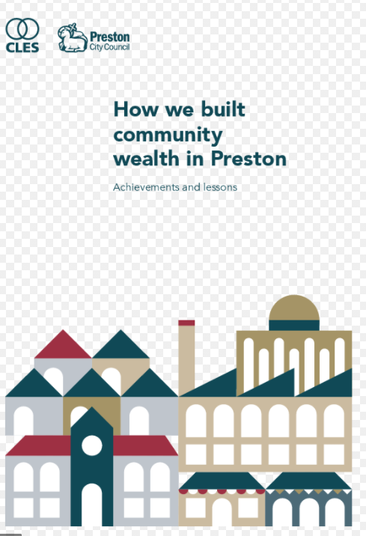
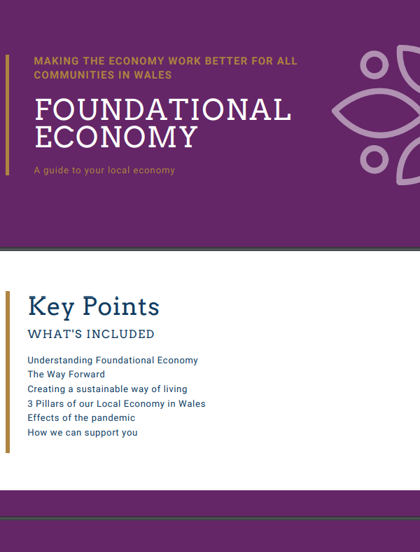
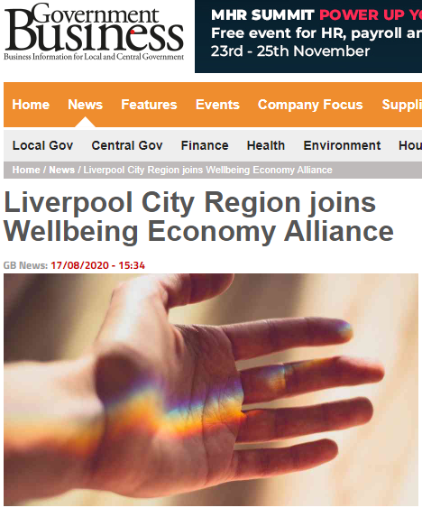
The rise of ‘insurgent political economies’*
Local challenge and experimentation around economic development:
Search for solutions to socio-spatial inequalities under conditions of austerity urbanism (Peck, 2012)
New forms of ‘entrepreneurial municipalism’ emerging as creative responses to the failures of austerity urbanism (Thompson et al., 2021)
Series of ‘beyond GDP’ critiques of prevailing economic models that advocate more economically, socially and ecological just approaches
* (Davies, 2021)
Notes:
A number of LEDF have gained traction over a number of years
Driven by concerns about the exclusionary spatial (and social dynamics) of prevailing growth models against a backdrop of austerity...
...have led to renewed interest in experimenting with alternative ways of doing economic development (EM)...
..all linked as beyond GDP critiques of prevailing;;but conceived in quite different ways

Slide 4
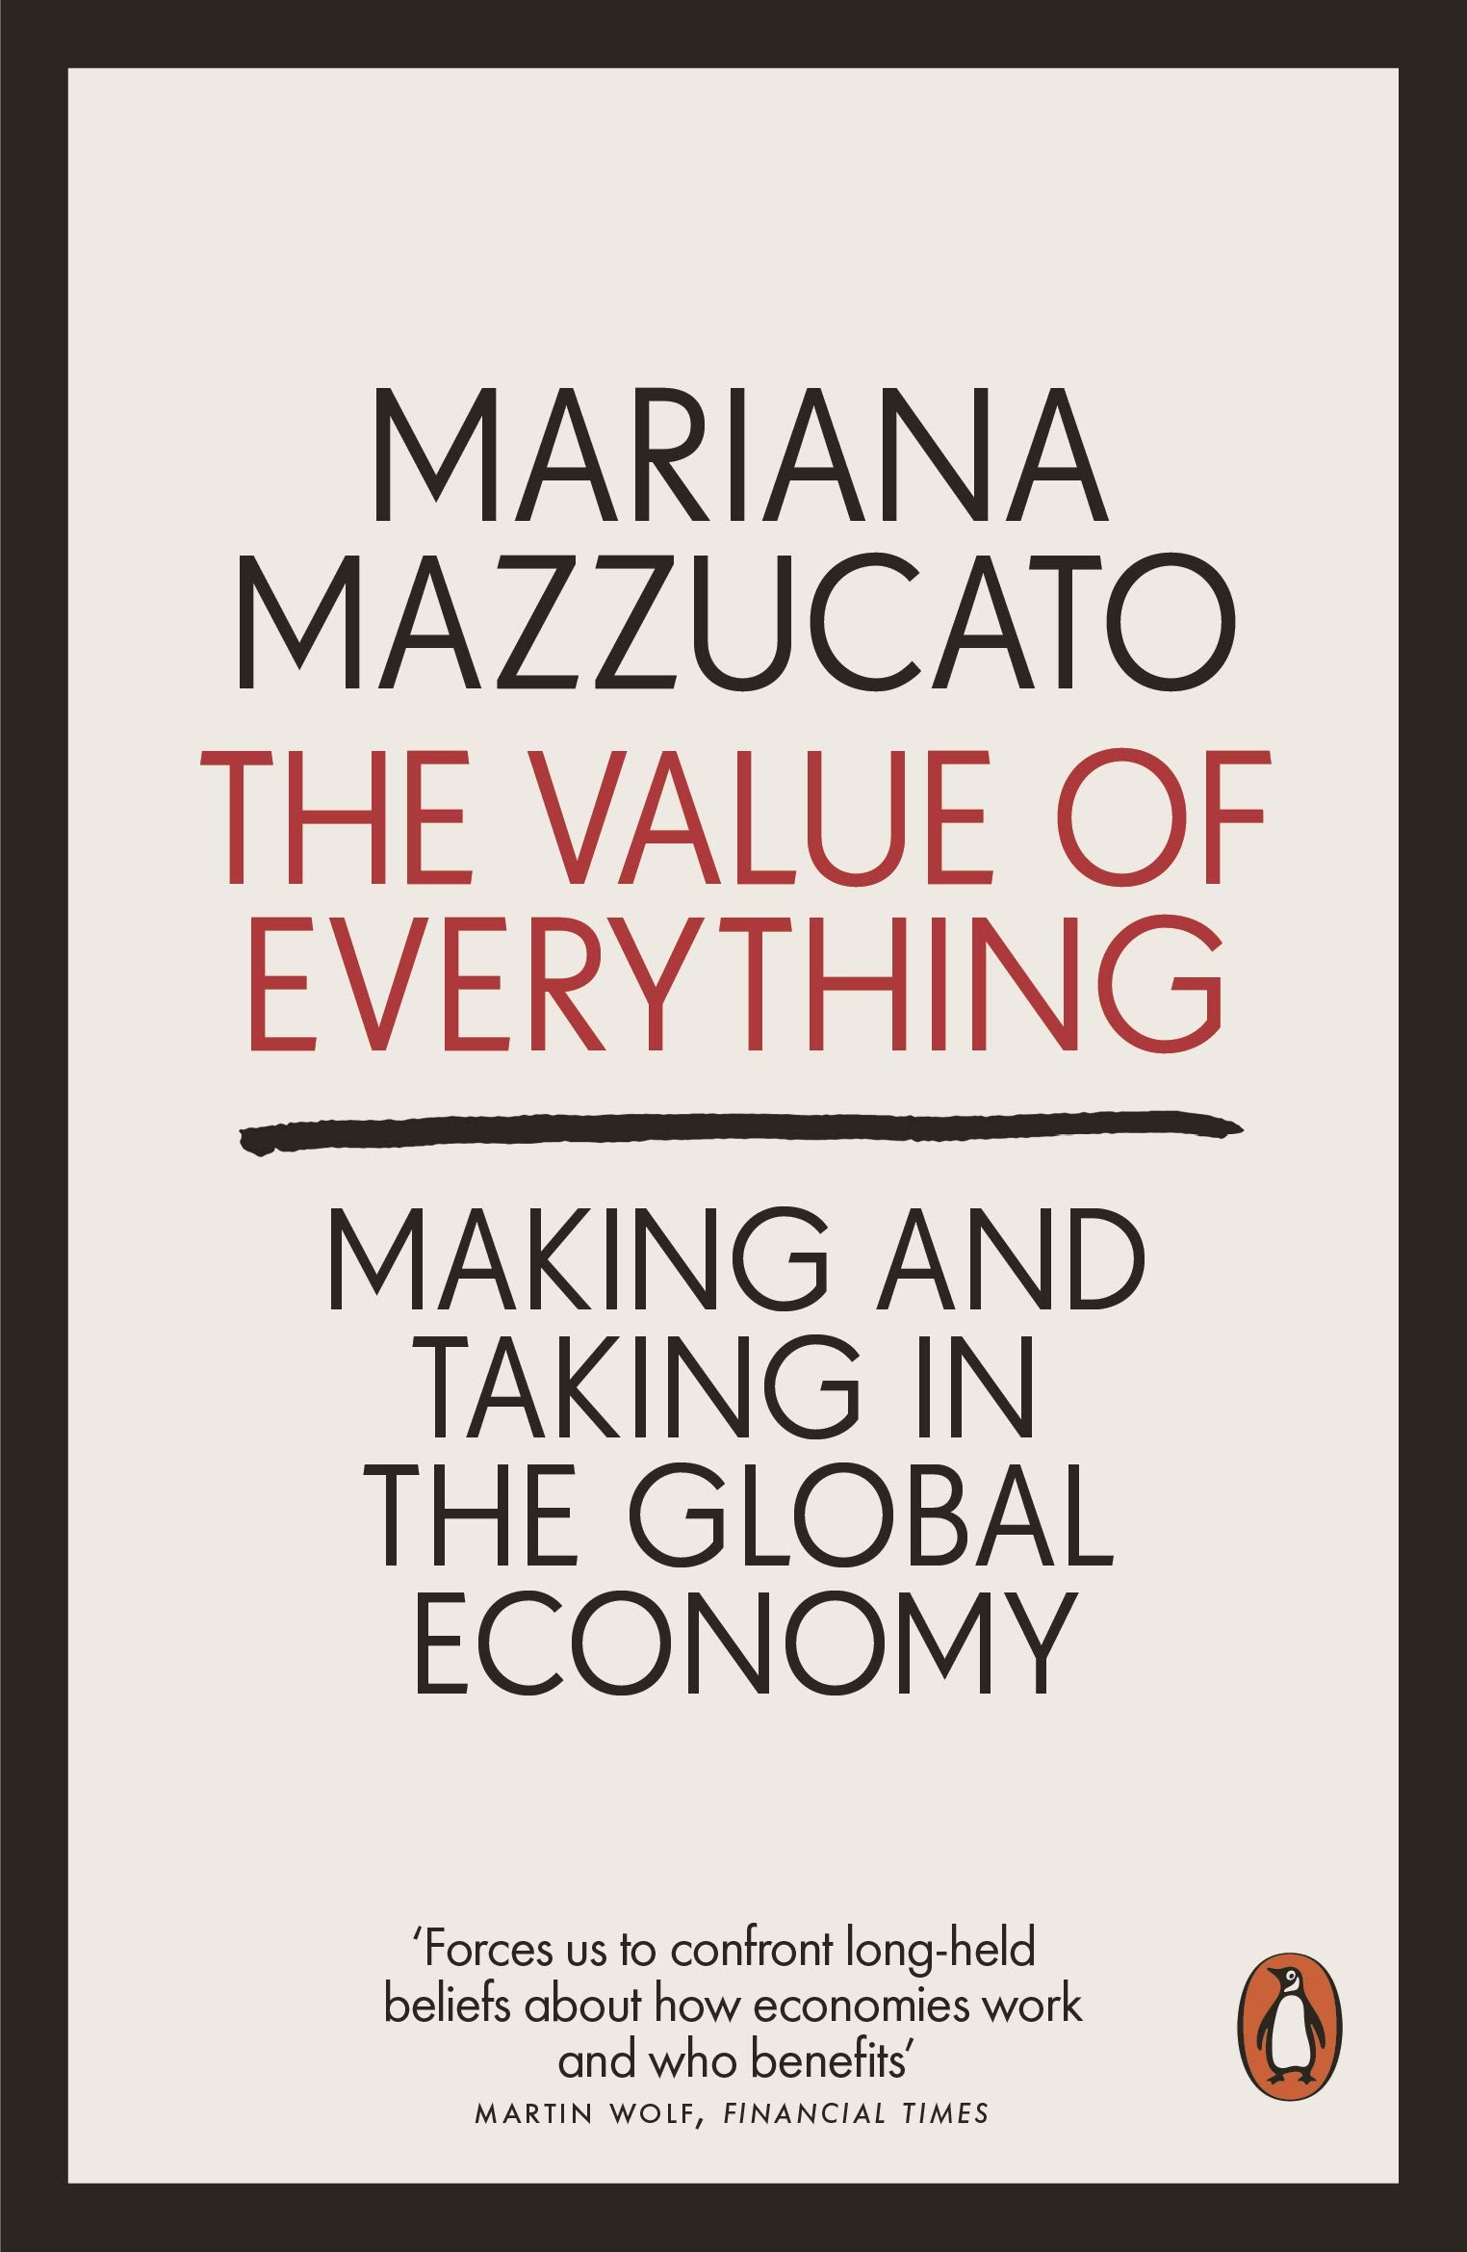
Using value to understand inequalities
Critique of GDP (macro) and price (micro) as dominant measures of value:
sidelines externalities (e.g. pollution)
devalues non-productive systems (e.g. informal care, biodiversity)
enables wealth extraction (rentier activities) to pass as wealth creation
undervalues the ‘unproductive’ state
drives inequality across society and places
Mazzucato influential in redefining role of the state as a “co-creator” of wealth that adds “public value” but also useful to explore:
“what kind of economy we want” (moral economy)
the political, economic and institutional drivers of wealth creation, or extraction (political economy)
Our questions:
How do AED frameworks understand and use value?
What are their moral-economic and political-economic foundations?
Notes:
Critical of orthodox forms of economics
Costs of clean up river polluted by industry would be counted in GDP
Uses example of finance as a rentier sector that was seen by policymakers to generate value until it collapsed secularly financial crisis.
No seen as a source of value and indeed taxes valuing-creating activities in the private sector
Technology sector from benefiting from public investment in new technologies like the internet.
Through legitimisation of value extraction and accumulation of wealth which has harmful distributional consequences.
Norms, principles and ultimately outcomes that should orient economic policy. Should we focus on care, wellbeing environmental sustainability?

Slide 5
Three frameworks – core principles
 | Inclusive Growth | Doughnut Economics | Foundational Economy
Vision of economic system | Enabling as many people as possible to contribute and benefit from growth | Ecologically safe and socially just space in which humanity can thrive | Focus on infrastructures that make civilised everyday life possible
Foundational principles | Inclusive economies good for growth and fairer outcomes for people and places | Realising social need without overshooting planetary boundaries Economies distributive and regenerative by design. | Emphasis on collective not private consumption Primary role of policy is to secure supply of basic services for all citizens
Notes:
Share ‘beyond GDP’ agenda – challenge to notion that growth alone will resolve inequalities
Different emphases:
IG – reversing often unjust distributional consequences of growth and the centred on the notion that inequalities stymie growth
DE put ecological harms at centre of critique – advocates economies that are not just redistributive but regenerative.
..identifying a set of social needs (e.g. health and education – informed by SDGs) that should be achieved without breaching ecological limits
FE – Focus on supporting collective consumption – provision of local infrastructures and services (utilities, housing, food, care)
...rather than competitive export sectors such as advanced manufacturing and knowledge-intensive business services that have been fixation of urban and regional policy.

Slide 6
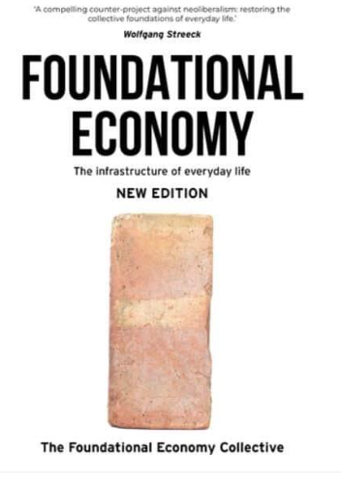
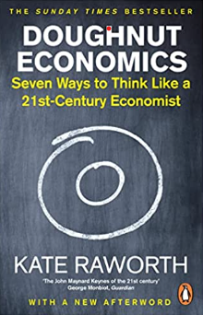
Three foundational texts
Source: RSA, 2017; Foundational Economy Collective, 2022; Raworth, 2017

Slide 7
Inclusive growth
Drivers of inequality:
Long-term structural imbalances (e.g. industrial restructuring, productivity gap)
Lack of public investment (austerity)
Vision of a new economy:
Need to measure quantity and quality of growth
Human experience matters e.g. sense of security and belonging
Strategy for change:
Invest in social infrastructure (e.g. education, childcare) alongside a higher productivity + better jobs agenda
Develop wider measures of “social value” e.g. HLE + wellbeing
Notes:
RSA Inclusive Growth commission
Each of three frameworks – PE, VE, strategies
Describes structural changes and imbalances – market failure - that lead to inequalities
Compared with other frameworks – no analysis of power. No active agent or institution that generates exclusion.
Q of G matters – not just in terms of the distribution economic benefits but also the subjective dimensions of human experience.
Move outside that traditional economic policy paradigm (ideas becoming more mainstream)
Long-term structural imbalances including industrial restructuring, asset inflation (housing), low skills, chronic productivity gap.
Lack of public investment (austerity).
Vision of a new economy:
Need to measure quantity and quality of growth and distributional impacts.
Includes subjective human experience e.g. community/economic security, identity, belonging, self-worth.
Strategy for change:
Investment in social infrastructure (e.g. education and childcare), physical infrastructure (e.g. transport and housing), inclusive industrial strategy (e.g. foundational sectors), productivity and jobs, and macro-environment (e.g. regional banking)
Wider measures of “social value” needed alongside conventional economic metrics (e.g. individual capabilities, community capital, household incomes, wellbeing, job quality, opportunties for social mobility, healthy life expectancy, school readiness, quality of PRS)

Slide 8
Doughnut Economics
Drivers of inequality:
Deep power imbalances between capital vs labour
Rentier landlords + accumulative advantage of wealth
Deregulation of financial sector, dismantling of protective legislation, privatisation
Vision of a new economy:
Explicit critique of utility (price) as a measure of value (“cuckoo in the nest”)
Prioritisation of social needs and ecological boundaries
Draws on humanistic economics to emphasise importance of capabilities
Strategy for change:
Doughnut as a tool for reorientating policy to achieve social and ecological goals
Create “values driven” corporate governance and alternative ownership models
Democratise ownership of wealth (e.g. land, technology)
Notes:
Starts from a very different position
Identifies agents, institutions and mechanism that generate forms of value extraction and inequalities
Analyses dynamics of wealth accumulation – ownership of land and property
Leads to inequalities such house price hikes and debt crises
Very clear vision of the good life
Envisions a fundamentally different economy which requires economic policy to be oriented
How do we develop capabilities of individuals...
Embed new norms and values in CG
To avoid the capture of wealth by elites.
Or at the very tax the gains that accrue from possession land and technologies

Slide 9
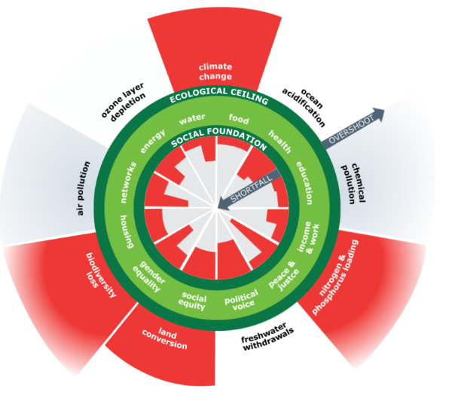
The Doughnut
Source: https://www.kateraworth.com/doughnut/

Slide 10
Foundational Economy
Drivers of inequality:
Financialised capitalism > extraction via privatisation + outsourcing
Corporate business models based on financial engineering + levered power
Need for “follow the money analysis”
Vision of a new economy:
Critique of utility (price) as a measure of value - lost insights of moral economy
FE as “immanent (implicit) moral theory of citizenship” and the “good life”
Economy = “politico-moral means to wellbeing and flourishing” (capabilities)
Strategy for change:
democratise policymaking
adopt social licensing for firms operating in foundational sectors
levy wealth taxes
Notes:
Has the most complex and sophisticated analysis of what it calls financialised capitalism
Detailed exposition of the agents and mechanisms of extraction.
FTMA....of corporate practice in foundational sectors.
Doesn’t have such a well-rounded vision of what the good life might constitute as DE
Sees provision of collective goods and services as performing a moral function in underpinning the good life
Argues need for more muscular regulation of corporate practice

Slide 11
Follow the money: West Coast trains
Source: Bowman et al., 2013

Slide 12
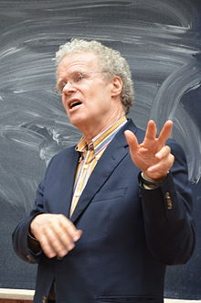
A theory of social transformation
Erik Olin Wright (2010, 2019) identifies three strategies of transformation:
Ruptural: Create a sharp break with existing institutions and structures (‘Smash first, build second’).
Interstitial: Build new forms of social empowerment in the niches and margins of capitalist society outside the state.
Symbiotic: Deepen institutional forms of popular social empowerment in ways that simultaneously solve ‘real problems’ faced by dominant classes and elites.
‘Contradictory character’ – creates ‘win-win’ situations
Notes:
US based sociologist
Develops a theory of how social transformation in his book ‘Envisioning Real Utopias’.
Has resonance for thinking AEDFs
Distinguishes three approaches
Interstitial ‘spaces and cracks’ – worker cooperatives, community land trusts,
Contradictory character: both expanding social power and strengthening aspects of the existing system (introduction of democracy as an eg) one hand might be seen to give power to the working class but actually helped to stable the capitalist system

Slide 13
 | Value as diagnostic tool (PE) what’s the problem? | VAlue as NORMATIVE VISION (me) HOW defined is the good life? | Strategy for transformation How do we get there?
INCLUSIVE GROWTH | Weak | Weak | Weak symbiotic ‘win-win’ benefits for all stakeholders
FOUNDATIONAL ECONOMY | Strong | Medium | Strong symbiotic - essential role for state as guarantor of FE + regulator of corporate practice Medium interstitial - advocates small scale experiments as basis of “scalable progress” - ambivalent about benefits of alternative forms of economic ownership
DOUGHNUT ECONOMICS | Medium | Strong | Medium symbiotic - clear role for state to catalyse investment but less focus on regulating corporate (mal)practice) Strong interstitial - advocates alternative forms of economic ownership as driver of new moral economy
Notes:
Think about to what extent V in PE as a diagnostic tool for understanding the ways in which value is created and – especially extracted – generates inequalities
Also extent to which V in ME terms emerging as a vision of new norms, principles and outcomes that define the ‘good life’
IG is weak on both those dimensions; FE strong on diagnosis; DE on envisioning a better life.
That has implications for the strategic approach envisioned.
IG lacks that analysis of power imbalances – falls back on weak symbiotic strategies – state, private sector, workers, civil society will all benefit from investment in social infrastructure, productivity improvements and better jobs - drives more equitable forms of growth.
Lacks explanation for how benefits of, say, productivity improvements will be secured for benefit of workers rather than returns for shareholders or employers.
FE – clear focus on SS - reshaping corporate business models through muscular state regulation of corporations operating in F. space. Reflects the analysis of this space as critical site of wealth extraction.
- more ambivalent about benefits of interstitial strategies due to challenges in scaling up local experiments and less obviously a solution to the challenges posed corporate by practice in delivering foundational goods and services and scale. If TESCOs is your problem
DE less focussed on political economy of inequalities - lacks that follow the money analysis - which perhaps explains its focus on the role of the state as investor (co-creator of wealth) but less clear on regulatory function in restraining exploitive modes of corporate practice.
In line with its deeper roots in moral economy focus it places more emphasis on how interstitial forms of eco development can create redistributive/regenerative models of enterprises. Sow the seeds of new alternative economy in the cracks and fissures rather than root and branch reform of existing structures.

Slide 14
Final reflections
Frameworks do different things and are not interchangeable – not a ‘picnic blanket’
Beware the localist trap:
how far can a new municipalism go?
austerity solutions: filling a policy vacuum?
Value of value:
importance of analysis of circuits of value
allows space for alternatives: prefigurative politics
shows the need to consider moral and political interactions of frameworks

