Slide 1
How e-commerce is adopted to shape inclusive development approach for lagged-behind rural communities in West China?
Yitian Ren
PhD Candidate
Department of Planning and Environmental Management, The University of Manchester
(Work in progress presentation, please do not record)
Center for Digital Development

Slide 2
Presentation Outline
Introduction and Research context
Research questions
The adoption of e-commerce for rural development in West China
Concluding remarks
Yitian Ren @ UoM
Notes:
Introduction (research context)

Slide 3
Introduction
Recent development of Information and Communications Technology (ICT) infrastructures (Internet, smartphones and online social networks, etc.) has contributed to rapid growth of e-commerce, which has gradually changed people’s lifestyle and begun to play an essential role in socioeconomic development (Pradhan et al., 2018; Lin, 2019).
The trajectories and patterns of ICT infrastructures and e-commerce development in western countries suggest that this process began and grew in urban areas initially and then spread to remote rural areas (Salemink et al., 2017)
With appropriate human capital conditions, ICT infrastructures and e-commerce are facilitating new forms of economic activity and providing an alternative development approach in some rural communities (Copus et al., 2011).
The development of ICTs and e-commerce has brought opportunities for “bottom-up” initiatives in rural communities, to help them address the conventional deprivation of information asymmetry and geographical remoteness.
---Rural development has entered into a digital era
Yitian Ren @ UoM

Slide 4
China is a typical case for navigating the role of these emerging factors in socioeconomic development trajectories in the Global South. The country has made remarkable progress on ICT infrastructures delivery and e-commerce development with the great amount of state investment.
government support and investment towards narrowing the urban-rural “digital” divide are essential, as remote rural areas where population sparsity leads to a higher unit cost present less investment attractiveness for private sector infrastructure providers.
Mobile Taobao, established by Alibaba Group, has become the world’s largest online e-commerce platform where customers can buy online products, interact with e-traders, and share their content with friends and other users (Lin, 2019)
Yitian Ren @ UoM

Slide 5
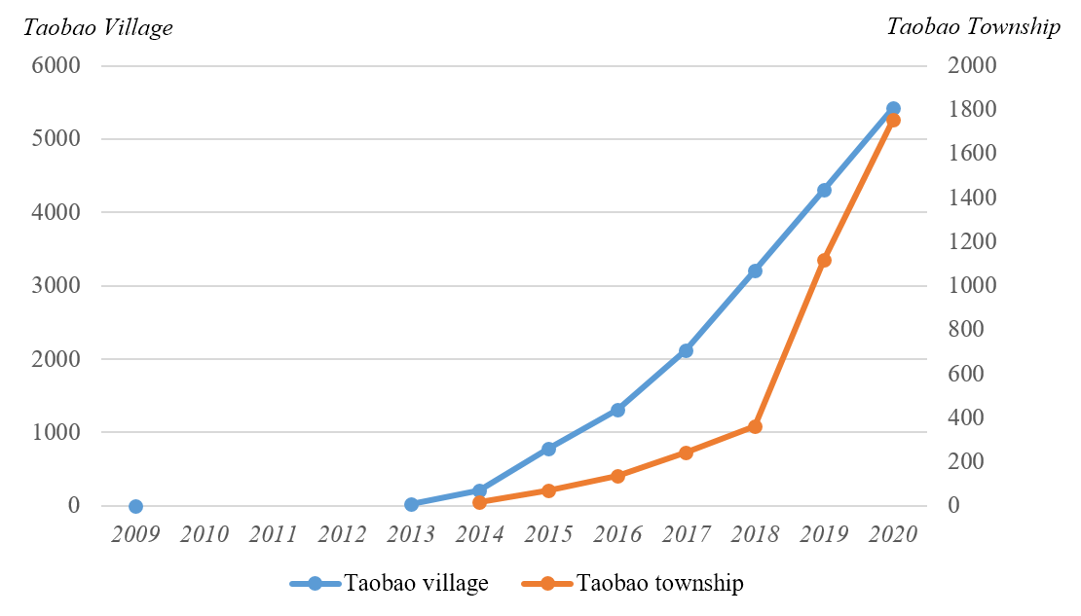
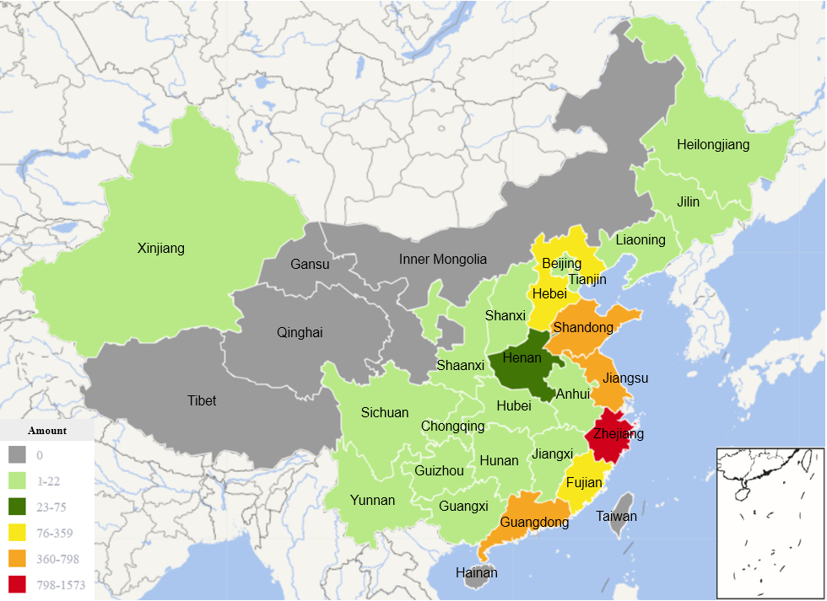
Amid the wave of ICT development, digital transformation and e-commerce growth, a new form of regional development based on online platforms has recently emerged in rural China (Wei, Lin & Zhang, 2019).
Figure: Increasing trend of Taobao villages and townships in China
(By Yitian Ren)
In particular, some of the rural villages developing e-commerce activities by Taobao platform are defined as Taobao village or Taobao township if certain criteria are met (AliResearch, 2019).
The booming of Taobao villages and townships has contributed to the socioeconomic development in rural China:
Job opportunities creation
Significant proportion in online retail sales
Attraction of return migrants
Yitian Ren @ UoM
Figure. Provincial distribution on the amount of “Taobao” village in China by 2019
Notes:
Following the first three Taobao villages emerged in Zhejiang, Jiangsu and Hebei province respectively in 2009, there are in total 5425 Taobao villages (appropriately 1% of the total villages number in China) and 1756 Taobao townships (appropriately 5.6% of the total townships number in China) distributed in 28 provinces in China by September 2020

Slide 6
Gap of existing literature
Extant studies have attempt to investigate the newly emerged phenomenon of Taobao village, and more generally, the e-commerce driven rural development. However, inherent limitations exist:
Existing studies mainly focus on explaining the phenomenon itself rather than investigate critically the mechanism and impact of the adoption of e-commerce-engaged development in rural China
Extant literature in the field presents limitations in deciphering how this e-commerce driven development mode is established across different stakeholders in the specificity context of Chinese rural society;
Previous research works tend to focus predominantly upon rural e-commerce practices in the East coastal region of the country, where the socioeconomic backgrounds distinguish significantly from the less-touched West counterparts
Also, this new form of regional development has still largely escaped the attention of international scholars
Yitian Ren @ UoM

Slide 7
Research questions
To investigate how e-commerce as emerging platform technological forces are exploited and harnessed towards rural revitalisation in the less-developed West China, by drawing in-depth empirical evidence from a county (xian, 县) of Chongqing Municipality.
In-depth fieldwork in Xiushan County, Chongqing Municipality during July to September, 2021
Semi-structured interviews with government officials at different administrative levels,
private sector professionals, grass-root communities/entrepreneurs
On-situ observations at the county seat, townships, and villages in Xiushan
Yitian Ren @ UoM

Slide 8
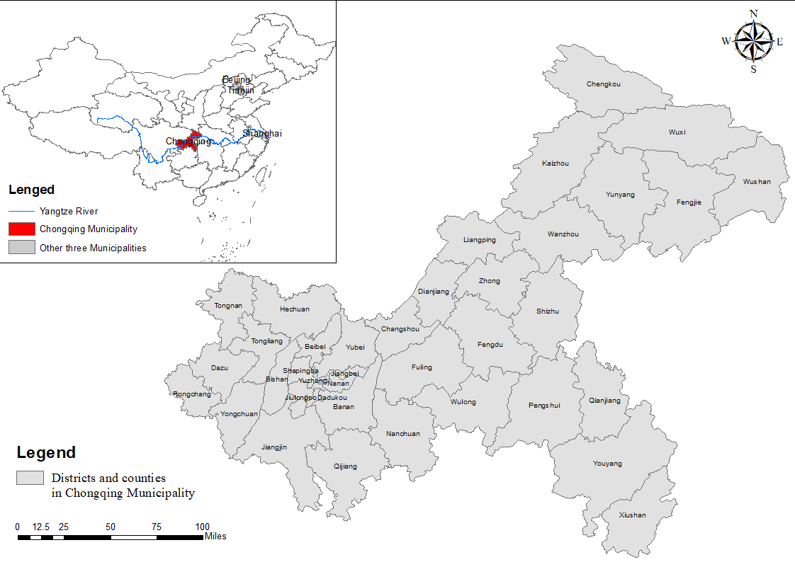
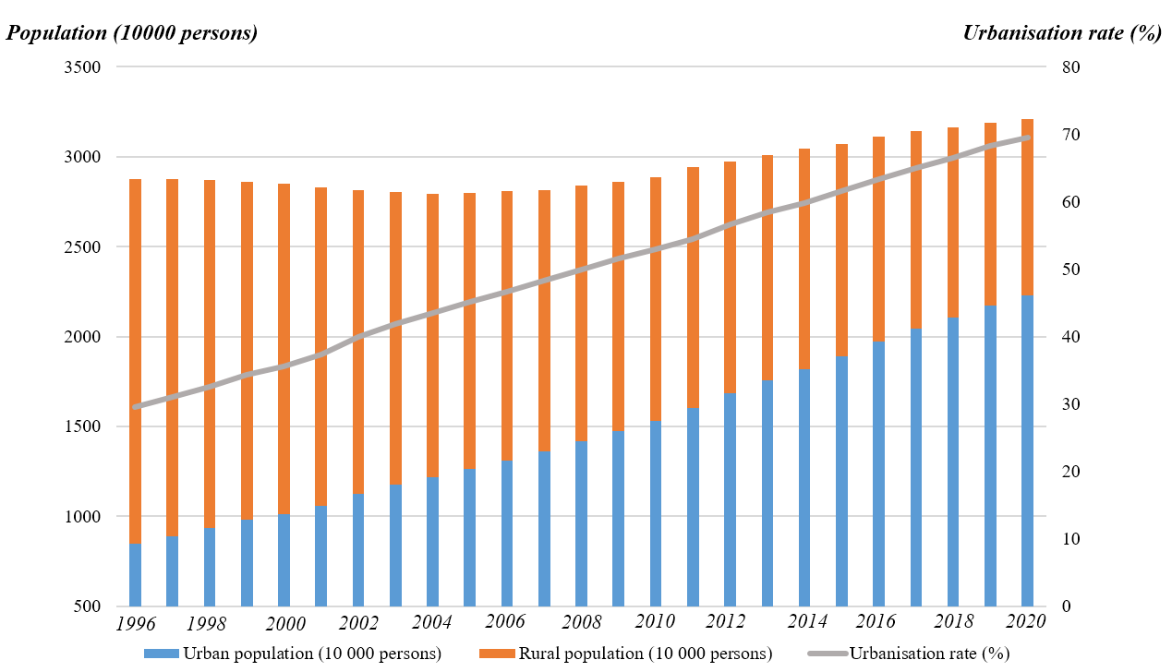
Setting the scene: Chongqing as an emerging arena for rural experiments in China
Chongqing, located in the Southwest region of China, covering 82400 km2 in the upper sections of the Yangtze River Basin, is the largest Municipality in China
In 1997, Chongqing was given the status of a centrally-administered Municipality directly under the governance of Central Government, mainly due to its role in the relocation of 1.2 million people displaced by the Three Gorges Dam
The municipality has been experiencing rapid urbanisation in the past two decades
By 2020, Chongqing has become the largest city worldwide in terms of population:
A total population of 32.09 million (22.29 million being urban and 9.80 million being rural)
Urban-rural population and urbanisation rate in Chongqing Municipality (1996-2020), by Yitian Ren
Yitian Ren @ UoM

Slide 9
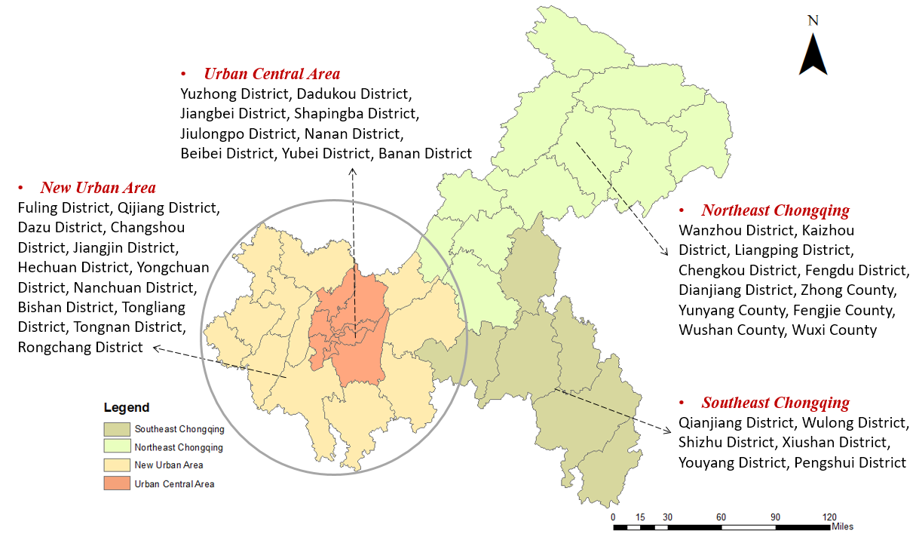
Setting the scene: Chongqing as an emerging arena for rural experiments in China
Chongqing Municipality is composed by 26 city-administrated districts, 8 counties and 4 autonomous counties
Great disparities exist between the county-level units of Chongqing Municipality in terms of spatial location and socioeconomic development contexts.
Spatially: A “Central-Periphery-Fringe” spatial pattern, corresponding to “Urban Central Area-New Urban Area-Northeast Chongqing/Southeast Chongqing” structure
(“One Core-Two Wings”)
Socioeconomically, the economic structure and social development status between urban central area, new urban area, and the relatively remote Northeast and Southeast Chongqing vary significantly
Yitian Ren @ UoM

Slide 10
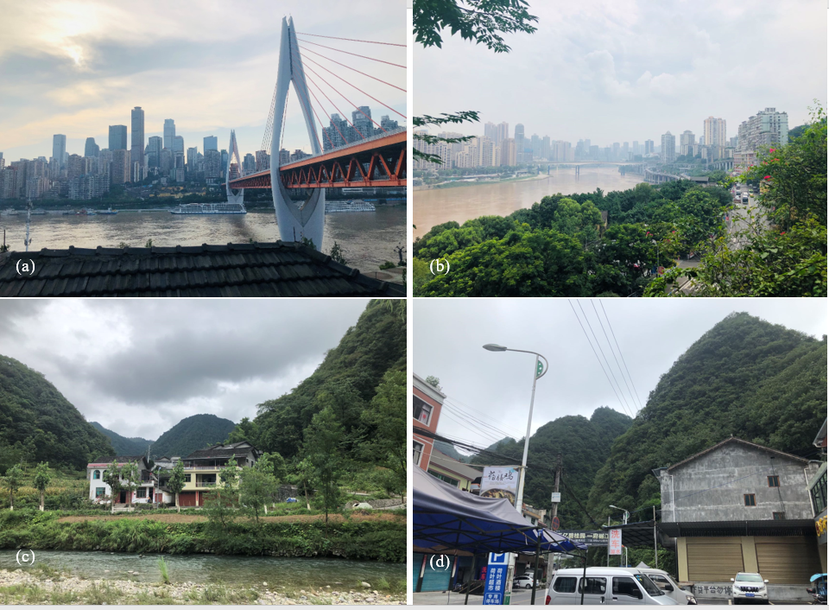
Setting the scene: Chongqing as an emerging arena for rural experiments in China
Therefore, from the discourse of regional disparity, Chongqing is a typical epitome of urbanising China, where high-speed urban sprawl in urban central area is intertwined with rural decline in the remote fringe area. The gaps and relationship between “urban central area” and “remote fringe rural area” of Chongqing is much like the “urban” - “rural” relationship in a wider context of urbanising China
A glimpse of comparative urban-rural landscape in Chongqing Municipality
(a,b) typical morphology of urban Chongqing; (c,d) typical rural morphology in counties of CQ
(Photo by Yitian Ren)
Yitian Ren @ UoM

Slide 11
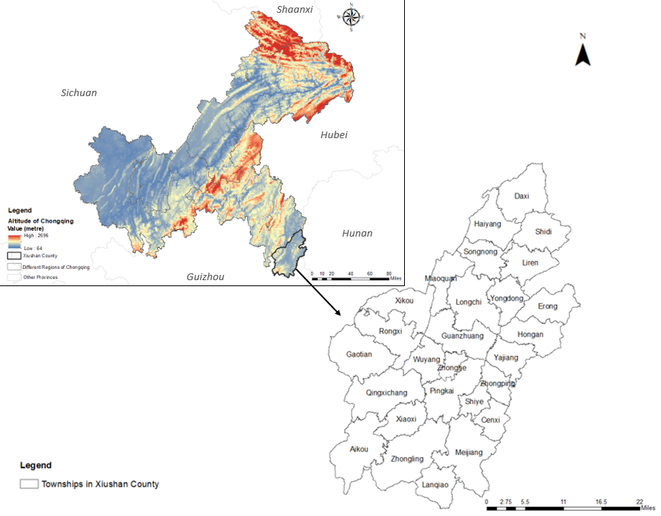
Adoption of e-commerce in the rural development in Xiushan County, Chongqing
Why Xiushan County adopt e-commerce for rural development?
Located in the Southeast corner of Chongqing Municipality, Xiushan Tujia and Miao Autonomous County (hereafter referred as Xiushan) neighbours the other three provinces of Hunan, Hubei and Guizhou. The majority of county territory is covered by the Wuling Mountainous area
Wuling mountainous area used to be one of the 14 most lagged-behind poverty-stricken region nationwide in China
Socioeconomic development in Xiushan was traditionally weak given the geospatial barriers, which was not connected by train line with Chongqing urban core area and other provinces till 2006 and was not covered by high-way road system till 2008
The county territory is endowed with rich manganese mineral resources, and the exploitation of mineral resources has conventionally been the dominant industry of Xiushan County since 1980s.
However, from 2009, the extensive exploitation of manganese mineral has gradually been forbidden under the Chinese Central Government’s macro policy rhetoric of eco-environment and natural resource protection
Yitian Ren @ UoM

Slide 12
Adoption of e-commerce in the rural development in Xiushan County, Chongqing
Why Xiushan County adopt e-commerce for rural development?
Therefore, the county-level government of Xiushan was forced to seek an alternative development pathway for local socioeconomic transition and long-term development.
As an autonomous county of Tujia and Miao ethnic minority who is socioeconomically lagged and located in the most remote area of Chongqing, Xiushan County indeed faced with significant pressure induced by development orientation transition in around 2009.
“Rural livelihoods being impacted and rural villagers seeking petition to upper-level government, economic development challenges, political performances being sabotaged, and standing at the time point of county-level government leadership change”
By reviewing its local resources endowment, since 2009, the county-level government of Xiushan consequently chose to construct logistics park in its county seat and to develop commercial and logistics industry
Later on, in early 2012, after careful investigation, instead of the conventional offline commercial industry, the decision-making board of Xiushan County-level government began to explore rural e-commerce development based upon the foundation of logistic industry
“After seeking consultancies and advices from several commercial experts that we invited from nationwide, we found that it is ‘hopeless’ to develop conventional offline commercial industry in the ‘physical space’ of Xiushan, a remote county territory with extremely marginal geospatial location (边城); instead, we aim to exploit Internet as powerful engine to drive the e-commerce development at ‘internet space’ by expanding potential consumer groups and selling markets.” ---A government official at Xiushan County Government
Yitian Ren @ UoM

Slide 13
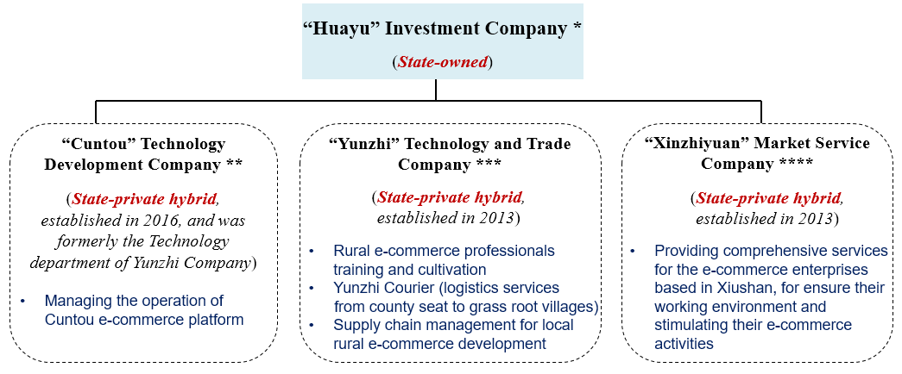
Adoption of e-commerce in the rural development in Xiushan County, Chongqing
How e-commerce is adopted in Xiushan County for rural development?
The prerequisite infrastructure and services provision of rural e-commerce include ICT infrastructures, transportation networks, logistics services, professional talents, e-commerce platform, rural products transforming into commercial goods, among others.
To fulfil the above gaps and frictions for cultivating and enabling rural e-commerce growth at local territory, the county-level government of Xiushan has devoted tremendous efforts across these essential aspects underpinning rural e-commerce activities, for which various novel institutional setting, policy incentives and other entrepreneurial government-driven actions have been designed, deployed and implemented since 2012.
* 华渝投资公司
** 村头科技发展公司
*** 云智科贸公司
**** 欣之园市场服务公司
Agencies of local state (Institutional actors) undertaking key functional responsibilities for the establishment and growth of Xiushan’s rural e-commerce development
Yitian Ren @ UoM
Notes:
Here I will pick up two aspects of cultivating local e-commerce professionals and tackling last-mile rural logistics challenges, to demonstrate how the local state managed to address the key issues for supporting local rural e-commerce development.

Slide 14
Adoption of e-commerce in the rural development in Xiushan County, Chongqing
How e-commerce is adopted in Xiushan County for rural development?
Establishing e-commerce professionals: Cultivation of “new peasant in digital era” and attraction of e-commerce entrepreneurs
“The key of rural e-commerce is that peasants are willing to buy and sell products online, for this, technology application abilities, peasants’ awareness and trusts upon e-commerce all matter.”
Yunzhi Company managed to train simultaneously the government officials (particularly covering the Commerce department, Poverty alleviation department, Agricultural and rural department, and Reform and development department) and the massive grass-root peasants across all villages in Xiushan.
For the massive training, Lecturers enter into the grass-root villages to deliver on-site lectures.
Also, the lecture delivery ways are quite flexible in order to serve as many rural residents as possible, which considers villager’s busy schedule of everyday life, high-mobility and relatively complex group profile (some of them are college graduates returning to the rural, some are young people without employment or informally-employed, some are experienced and senior peasants.
On-site rural e-commerce training in Pingba Village, Songnong Township of Xiushan
(Photo by Yitian Ren)
Yitian Ren @ UoM

Slide 15
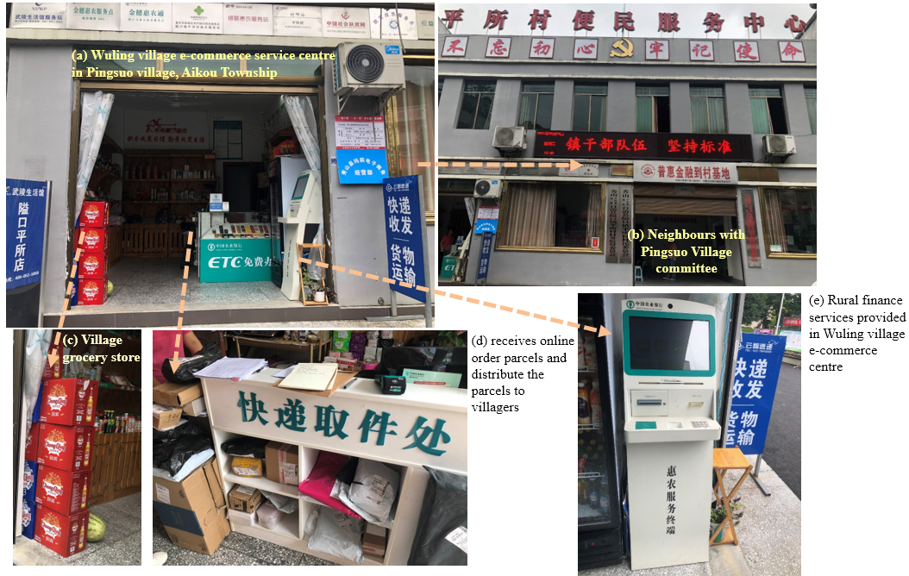
Adoption of e-commerce in the rural development in Xiushan County, Chongqing
How e-commerce is adopted in Xiushan County for rural development?
Tackling “last-mile” logistics challenges and enhancing e-commerce logistic services
“The Municipality Government of Chongqing over-emphasises the development of urban core area whilst overlook the development of Southeast rural wing.
A marginalised county like us tend to receive very limited municipal-level strategic consideration and policy attention upon the transportation planning, industrial orientation, not to mention the leapfrog development. So we have to ‘stand on our own two feet’ to break through the ‘last-mile’ barriers and fulfil the logistic system to realise our rural e-commerce roadmap and make sure our rural agricultural products can be expressed from the villages to county seat then to the outside regions in a timely and efficient manner.” ---- A local government official
Village e-commerce service centre in Xiushan plays as the carrier and nexus for the “free follow of agricultural products and industrial products between urban and rural areas
Establishing village e-commerce service centres
Functional components of a typical rural e-commerce service centre in Xiushan County
Overwhelmingly located at the spatial centre of village
Village e-commerce service centre receives online order parcels that the villagers purchased, and distributes the parcels to different households within their village
Rural households can hand in agricultural products to the “manager” of village e-commerce centre, who will check the quality standard of the agricultural products, do some basic processing (if necessary) and packaging. Then the agricultural products will be delivered from the village to the factory or warehouse of e-commerce enterprises based in the county seat of Xiushan, which would be further processed or industrialised into certain e-commerce products
Other functions, such as: Village grocery store; Village centre for utilities (water, electricity and internet) bills payment
Yitian Ren @ UoM

Slide 16
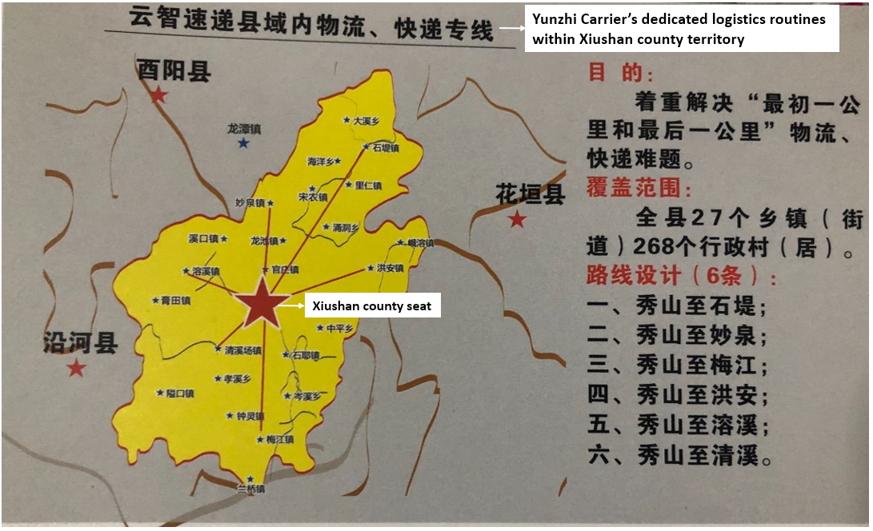
Adoption of e-commerce in the rural development in Xiushan County, Chongqing
How e-commerce is adopted in Xiushan County for rural development?
Tackling “last-mile” logistics challenges and enhancing e-commerce logistic services
Establishing village e-commerce service centres
Constructing the logistics service team dedicated to the products delivery between the rural villages and county seat (“last-mile” logistics)
Remoter rural communities where population sparsity leads to a higher unit cost for the delivery of ICT services and infrastructures
So that the per unit cost for the “last-mile” logistics services between county-seat and grass-root villages (in the Chinese context) would be much heightened and presents less investment attractiveness for private sector providers
Under this context, the Logistics Sector of Yunzhi company, named as “Yunzhi Courier” has been established with the strong support from Xiushan County Government in early 2015. The key responsibility of “Yunzhi Courier” is to link mutually all the villages with the Xiushan County seat following the high-standard of one-day timeliness
Design the most efficient logistic routes
Deliver orders from county seat down to each villages
Collect agricultural products from each villages up to county seat
Attracting the national-leading logistics company to set up regional distribution centre in Xiushan County seat so that the logistics efficiency and timeliness between the county territory and outside regions can be enhanced
(Photo by Yitian Ren)
by implementing multiple preferential policy measures such as the place provision and rent discount
Yitian Ren @ UoM

Slide 17
Adoption of e-commerce in the rural development in Xiushan County, Chongqing
How e-commerce is adopted in Xiushan County for rural development?
Xiushan’s rural e-commerce development shaped by the local actors and their interactions
1
State Power
2
Private Sector
To achieve socioeconomic transition and leapfrog development, the local state leverages, mobilises and manipulates private sector for cultivating and empowering the grass-root communities to get involved in rural e-commerce activities across the county territory
3
4
5
1: Leveraging; Manipulating; Guiding; Regulating; Governing
2: Obey; Facilitate; Enable development roadmap achievement
3: Guiding; Organising; Cultivating; Subsidising; Empowering
4: Seek support; Improve political performance; Fulfill
development blueprint
5: Training; Service providing (logistics and others)
6: Seek support; Feedback and Adjustment
6
Grass-root
Communities
Yitian Ren @ UoM

Slide 18
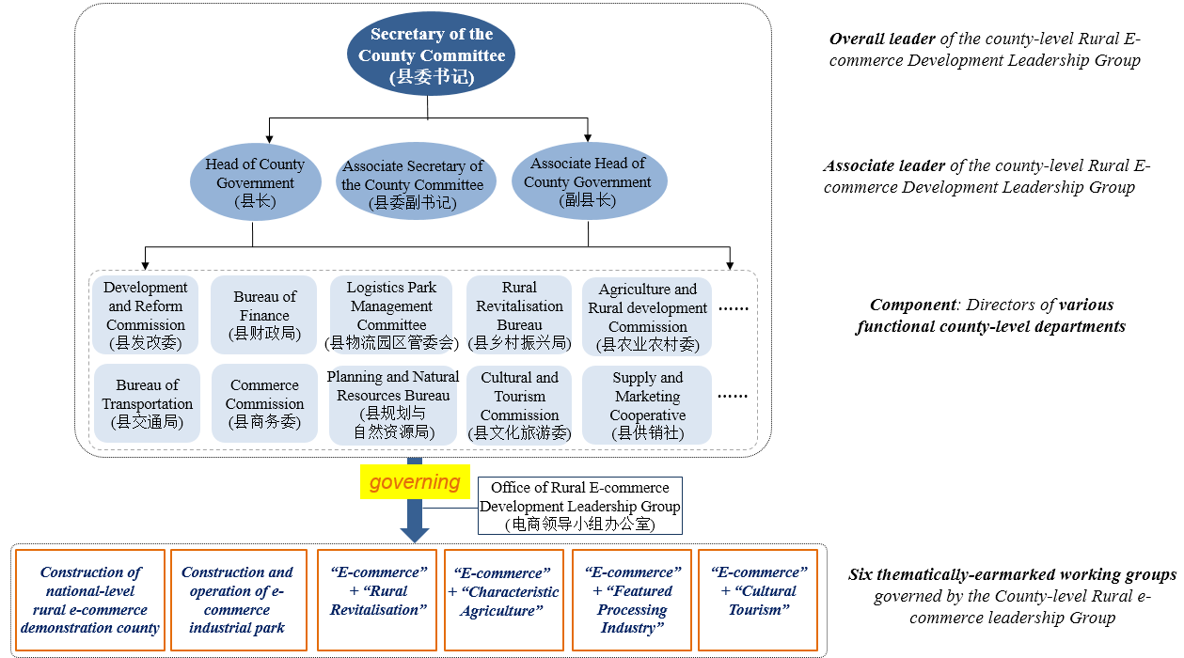
Impacts of rural e-commerce development
Institutional restructuring
In 2015, Xiushan County Government set up a dedicated leadership group for comprehensively governing and promoting local rural e-commerce development.
Emergence of newly-established institutions and government agencies underpinning and driving rural e-commerce
Hierarchical governance structure and key working thematic centred with rural e-commerce the
Yitian Ren @ UoM
Notes:
At the end, I am going to present some initial findings upon the impacts of e-commerce development upon rural society across multiple made-ups.

Slide 19
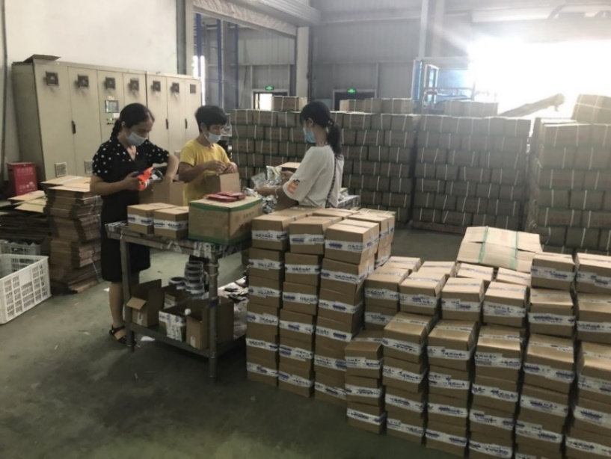
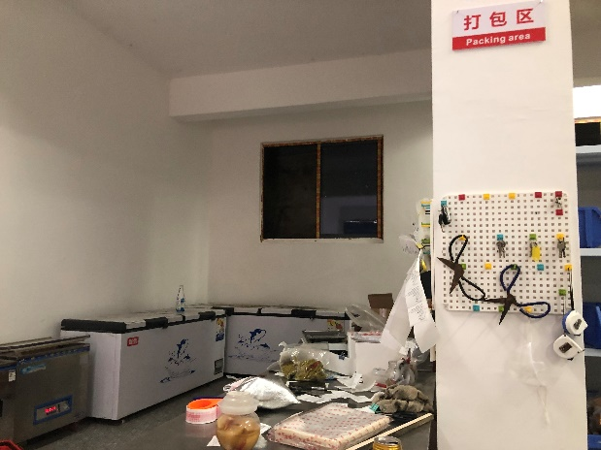
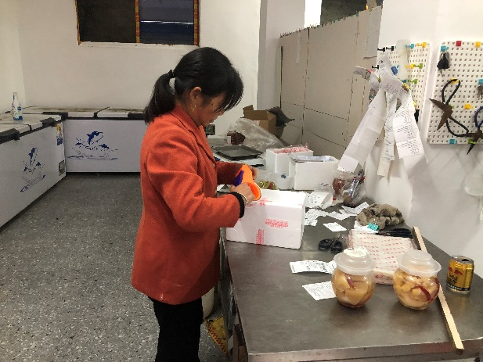
Impacts of rural e-commerce development (continue)
Improvement and diversification of rural livelihoods
E-commerce directly related jobs include customer service, marketing, sales, goods packing & dispatch etc. E-commerce also drives jobs like tailors, carpenters, express delivery men, photographers, etc. In recent years, professional services also emerge in some Taobao Villages, such as lawyers, accountants, patent agents, etc. (AliResearch, 2017)
The rural e-commerce development in Xiushan has created 22 types of job opportunities given the “ecosystem” nature of e-commerce business
Female villagers packing orders at a household-based e-commerce entrepreneur’s operation space
(Photo by Yitian Ren)
Female workers packing the e-commerce orders at Xiushan logistic park
(Photo by Yitian Ren)
Yitian Ren @ UoM

Slide 20
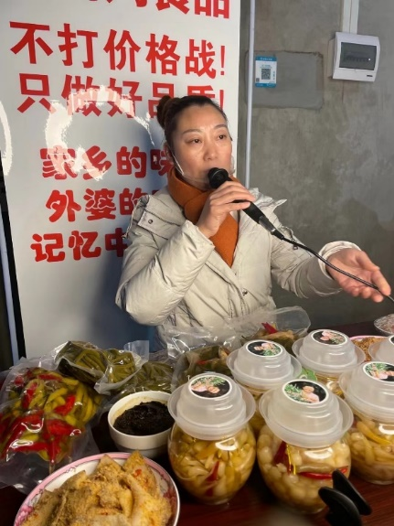
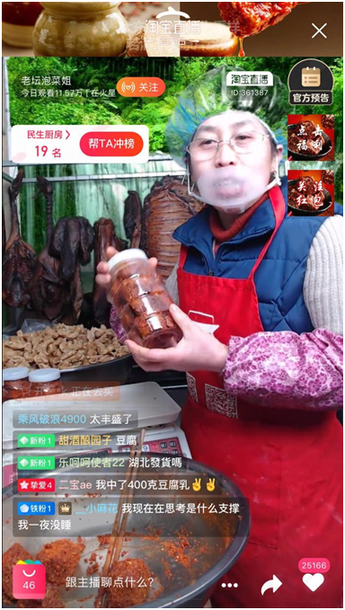
Impacts of rural e-commerce development (continue)
Return migrates and local rural villagers’ grass-root entrepreneurship
Restructuring of rural residents’ everyday life
Rural e-commerce entrepreneurs on live-streaming for selling household-made products online
(Photo by Yitian Ren)
Yitian Ren @ UoM

Slide 21
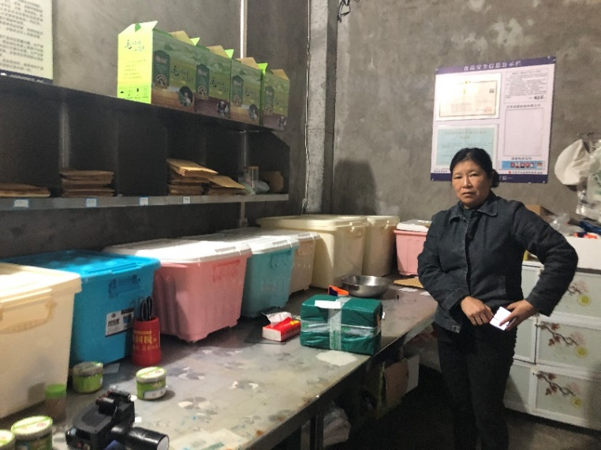
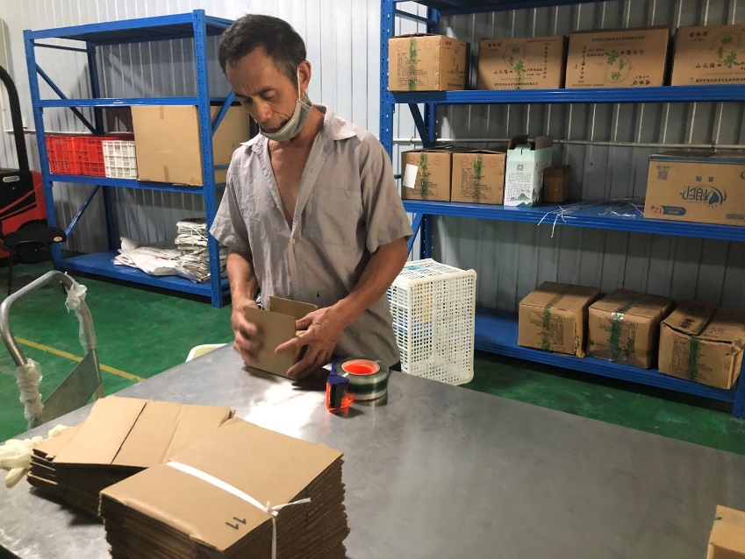
Impacts of rural e-commerce development (continue)
Enrollment of marginalised villagers into rural production activities
A rural female villager at 50s participating her neighbour household’s e-commerce business by packaging e-commerce orders
(Photo by Yitian Ren)
A rural male villager at 50s participating his son’s e-commerce business
(Photo by Yitian Ren)
Yitian Ren @ UoM

Slide 22
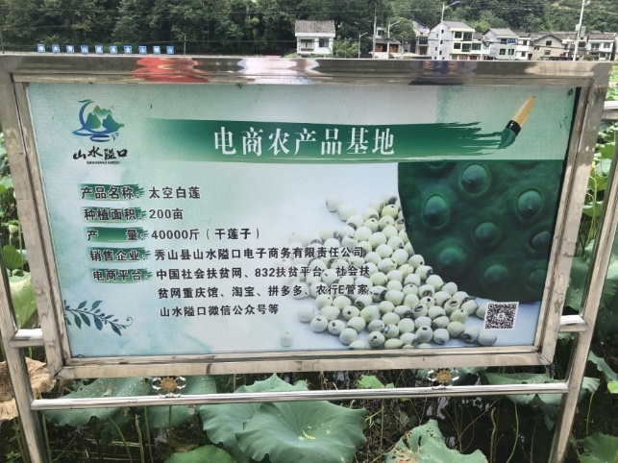
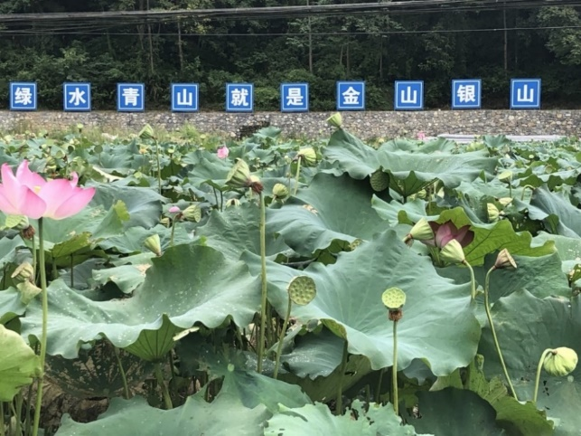
Impacts of rural e-commerce development (continue)
Reinvigoration of rural wasted resources
For example, the reutilisation of wasted land resources
Planting base of rural e-commerce products (Lotus) in Pingsuo Village, Aikou Township, Xiushan County, where used to be a plot of wasted land
(Photo by Yitian Ren)
E-commerce products base being utilised as a rural tourism spot in Pingsuo Village, Aikou Township, Xiushan County
(Photo by Yitian Ren)
Yitian Ren @ UoM

Slide 23
Concluding Remarks
E-commerce can be exploited and harnessed by the rural society as an alternative and effective development approach for rural revitalisation and socioeconomic transition.
In the context of rural west China, the adopting and exploitation of e-commerce is found to be overall organised by the local state, and involves various rural actors of private sector and communities.
Local state presents entrepreneurial characteristics in mobilising and manipulating the private sector to empower grass-root community amidst the development of rural e-commerce in West China
Comparing with the widely-reported east costal region, rural e-commerce in west China is a more top-down driven process; whilst in the east coastal counterparts, the tale of rural e-commerce tend to be a more bottom-up initiated process
Multi-faceted impacts have been brought by the e-commerce engaged rural development, spanning across rural livelihoods, economic, demographical, social, cultural, environmental and institutional.
Yitian Ren @ UoM

Slide 24
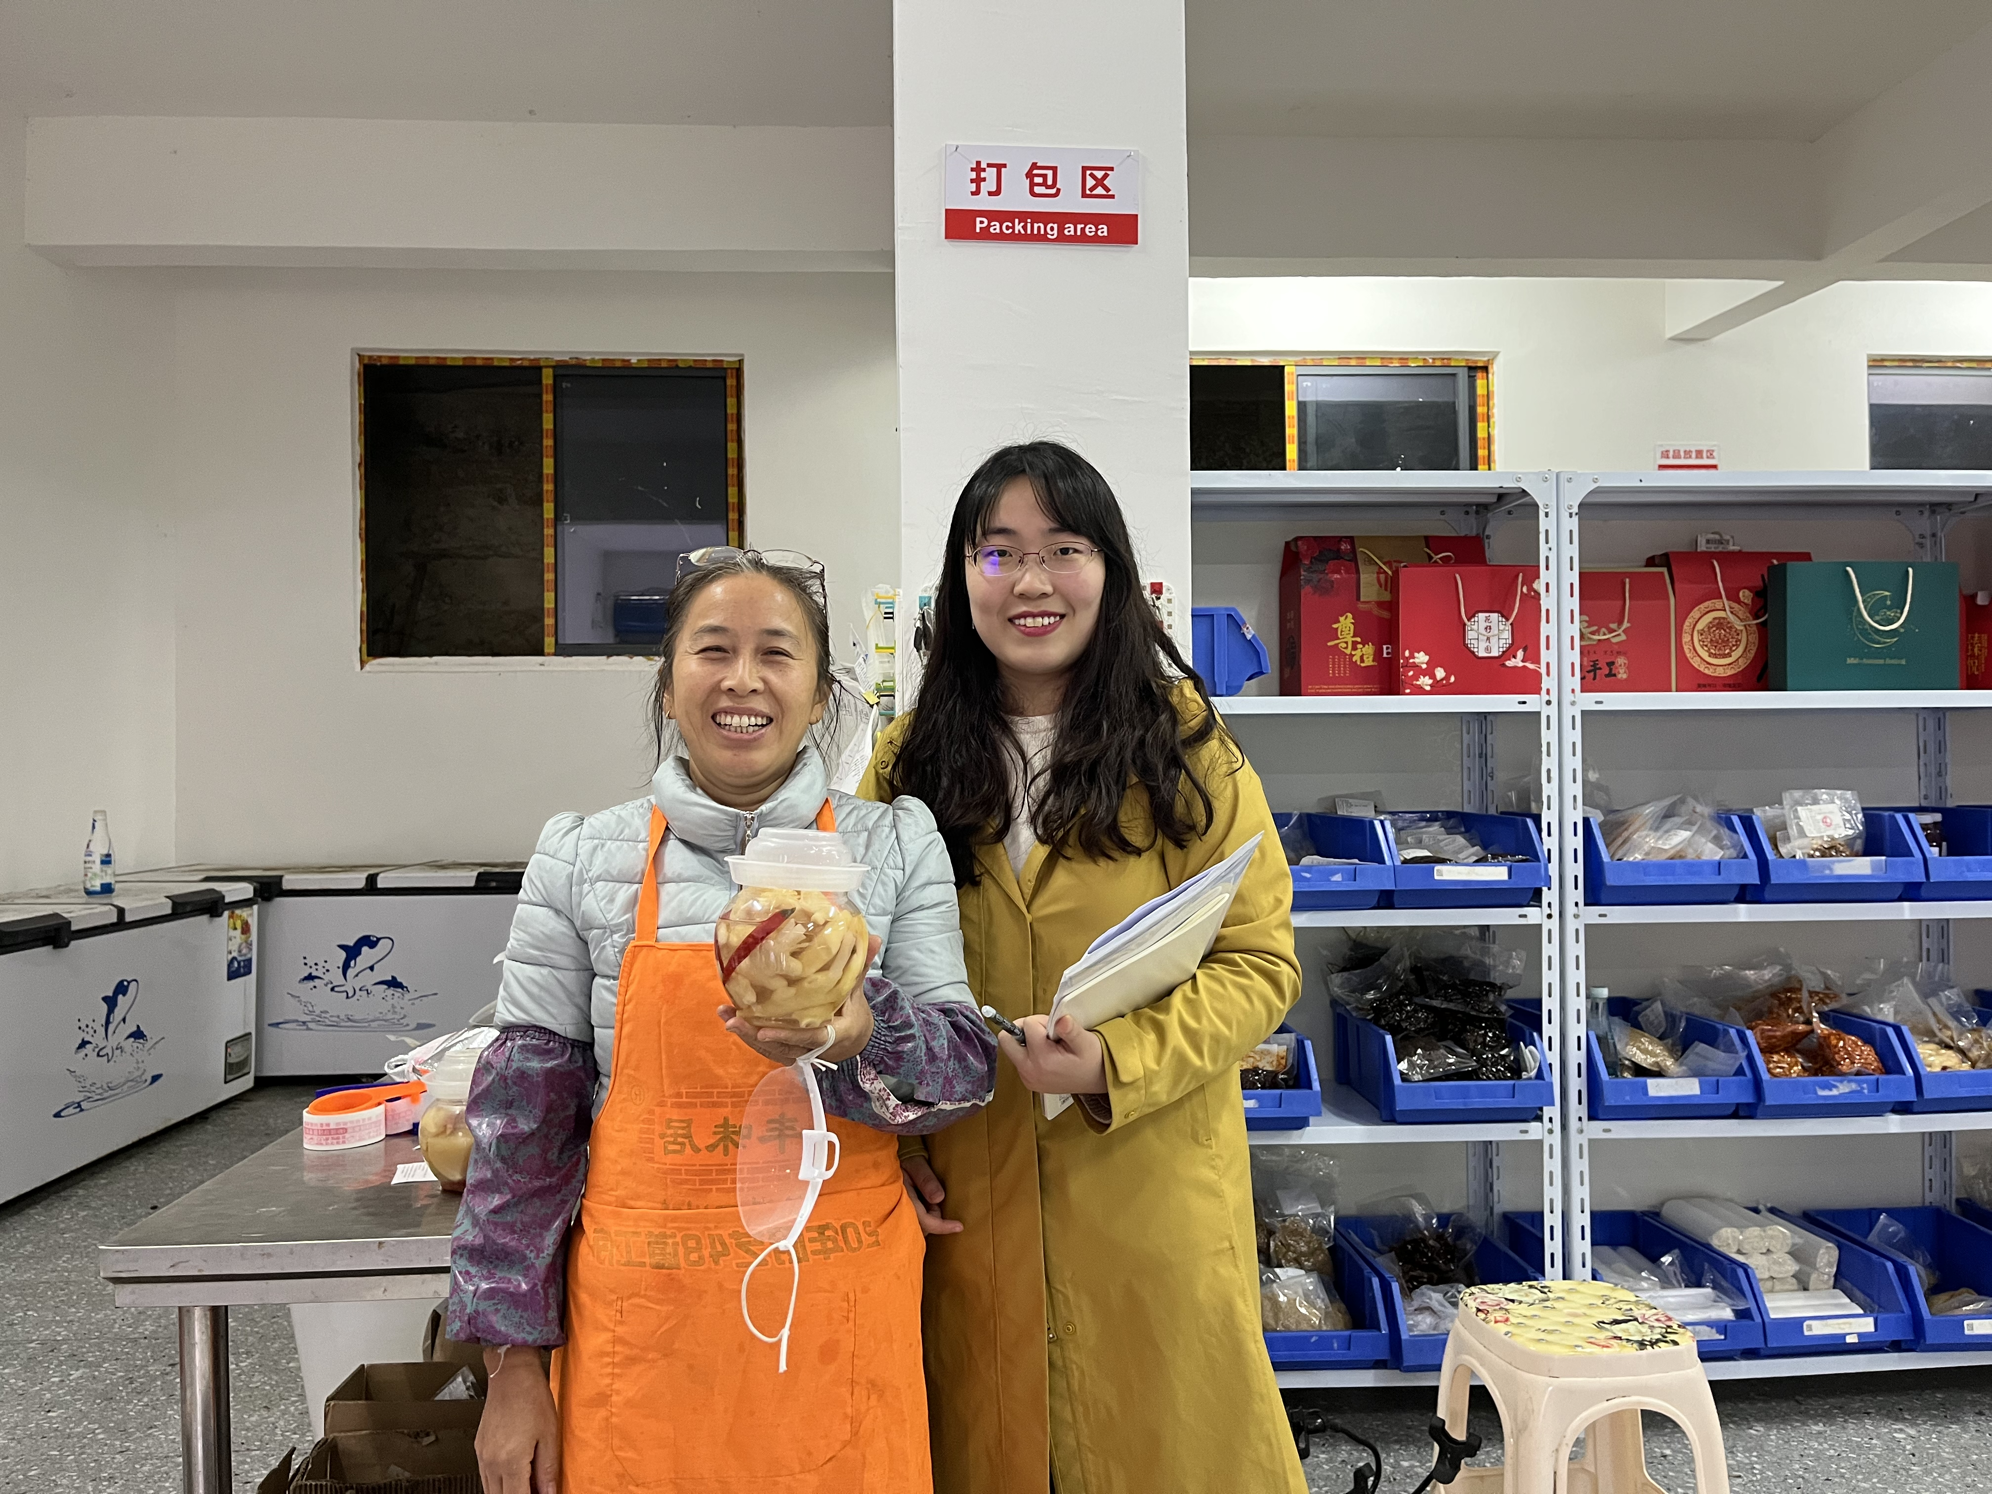
Thanks
yitian.ren@manchester.ac.uk
Fieldwork moment:
Yitian with a rural female e-commerce entrepreneurs
UoM personal website
https://www.research.manchester.ac.uk/portal/yitian.ren.html
ResearchGate personal website
https://www.researchgate.net/profile/Yitian-Ren

