Slide 1
Economic Security, Work & Young People
Lessons from the RSA's economic security stream

Slide 2
Introduction to the RSA
Introduction to Economic Security
Young People’s Economic Security
Policy Recommendations & Next Steps

Slide 3
About the RSA

Slide 4
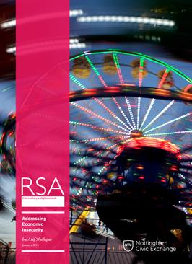
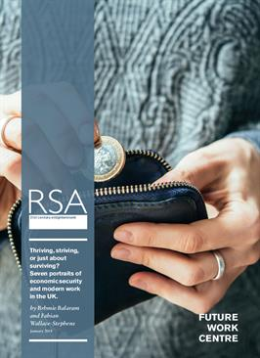
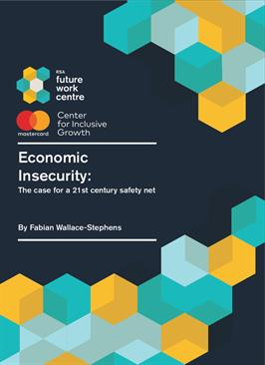
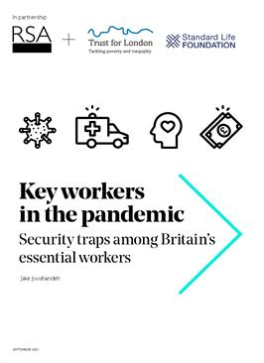
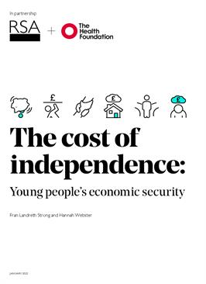
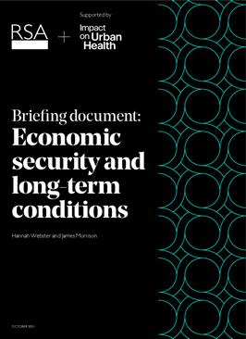
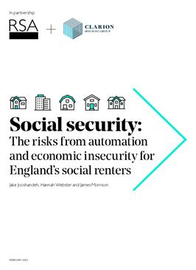

Slide 5
“…delivering greater economic security for our people, accelerating growth and productivity, and making sure the proceeds of that growth are shared fairly”.
“We would improve economic security for thousands right now by keeping energy bills down as the cost of living bites”

Slide 6
The degree of confidence that a person can have in maintaining a decent quality of life, now and in the future, given their economic and financial circumstances

Slide 8
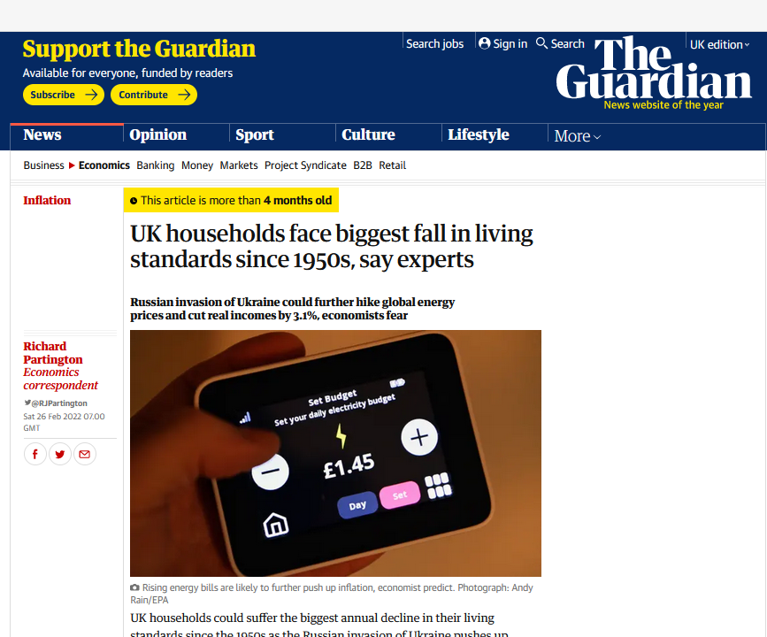

Slide 9
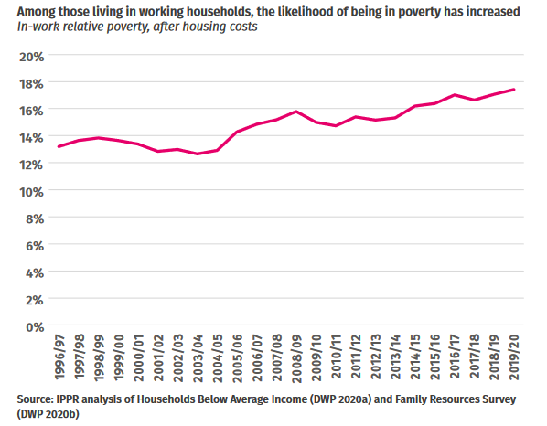

Slide 10
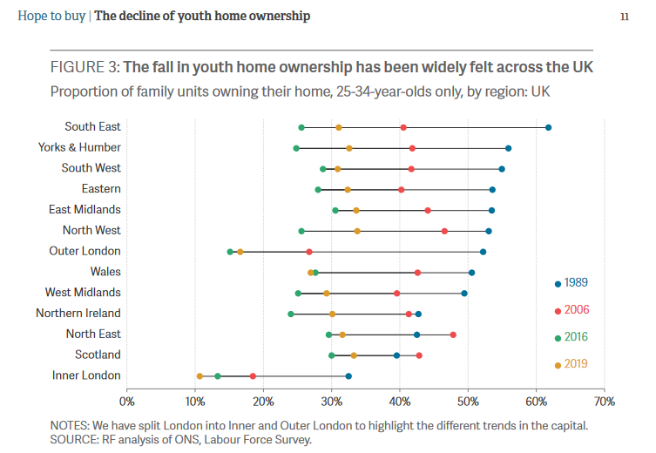

Slide 11
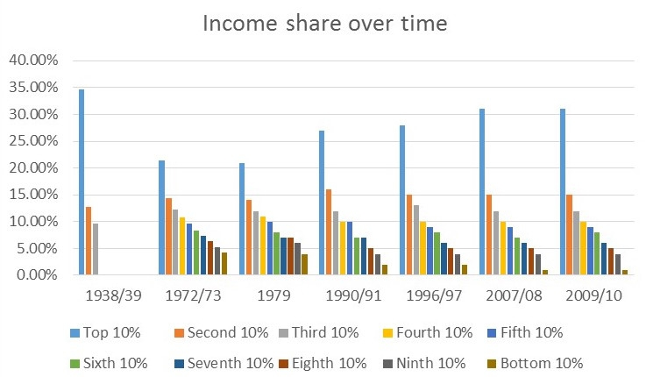

Slide 12
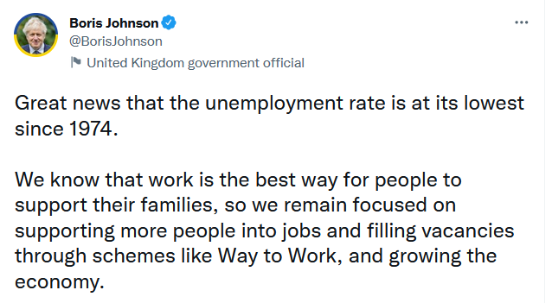

Slide 13
Why Economic Security?
Captures both objective + subjective
Captures household experience
Captures broad experience
Captures shifting risks
Captures buffers and stressors

Slide 14
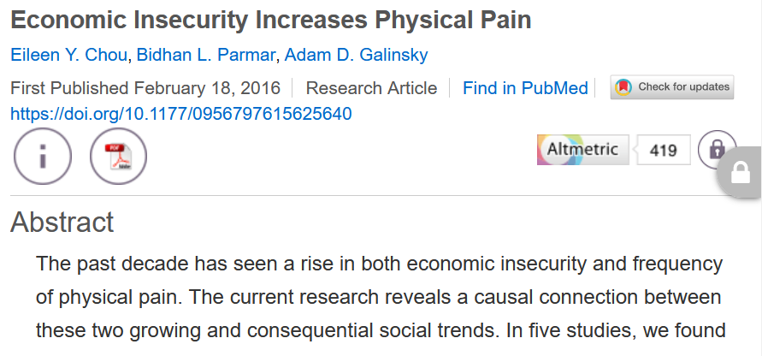

Slide 15
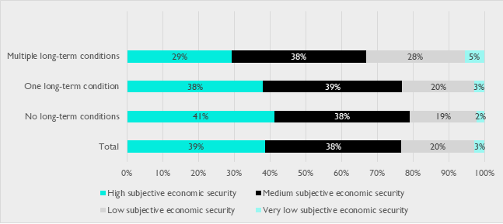

Slide 17
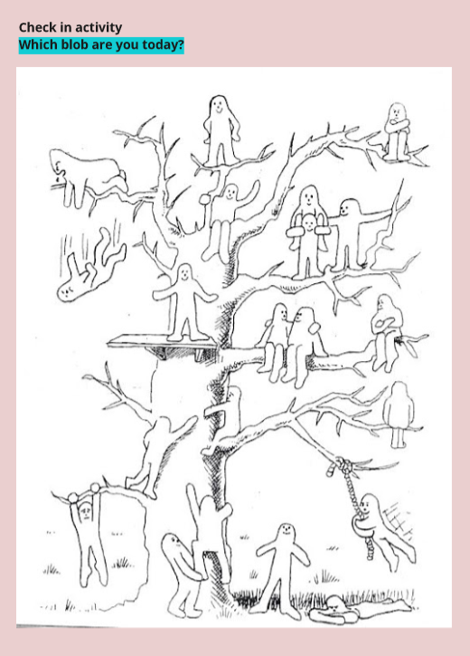

Slide 18
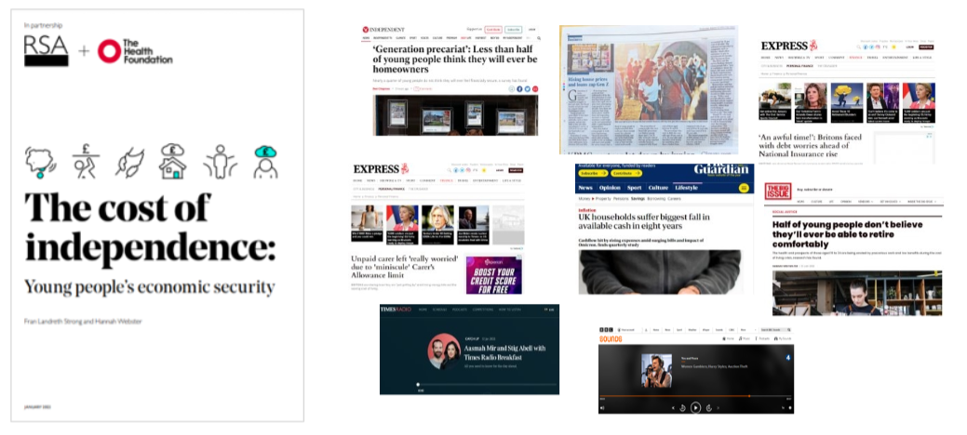

Slide 19
Key Findings
Young people are paying for growing up
Work and welfare aren’t helping young people
Young people lack confidence in their future

Slide 20
1. Young people are paying for growing up

Slide 21
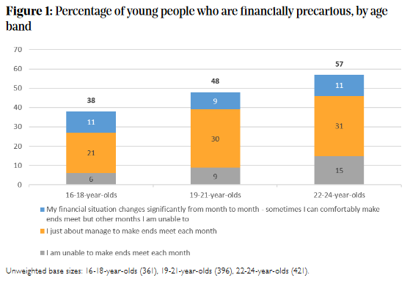

Slide 22
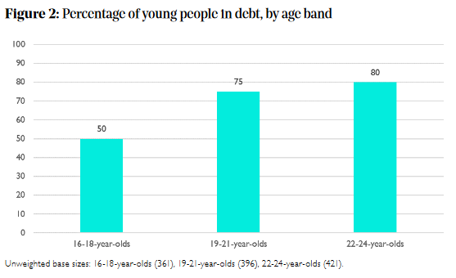

Slide 23
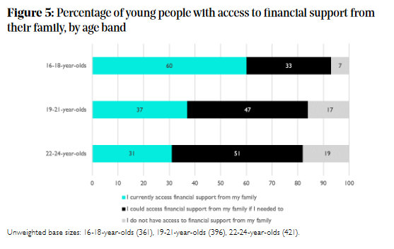

Slide 24
There is an assumption that young people’s independence is not truly autonomous, rather young people have a safety net from family members. However, this is often not the case. Young people are not equipped nor educated on all the tools to keep a stable financial state
- Revati, 20

Slide 25
2. Work and welfare aren’t helping young people

Slide 27
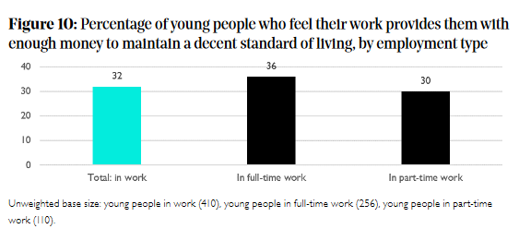

Slide 28
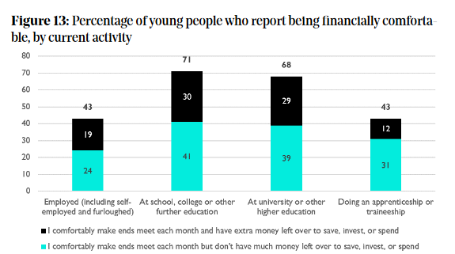

Slide 29
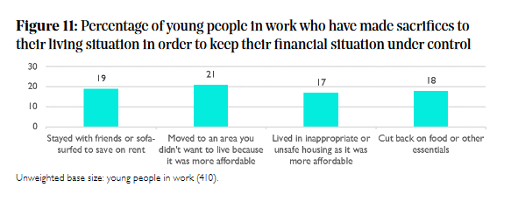

Slide 30
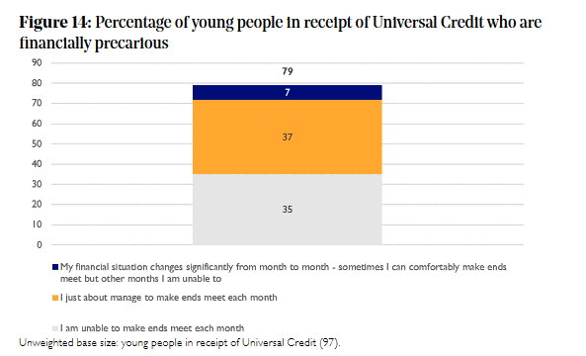

Slide 31
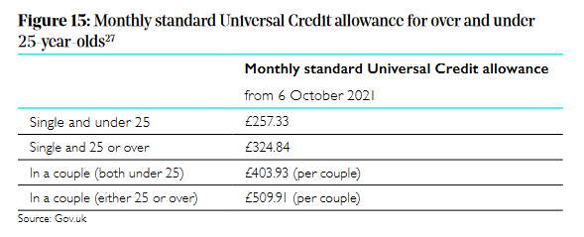

Slide 32
The findings indicate a lack of accountability from government and employers to secure and help future generations build their lives. Young people view their economic security negatively. And rightly so. They are being faced with less jobs, higher requirements for lower skilled jobs as well as an economic climate that stops young people from being able to have a life outside of working.
- Saira, 23

Slide 33
3. Young people lack confidence in their future

Slide 34
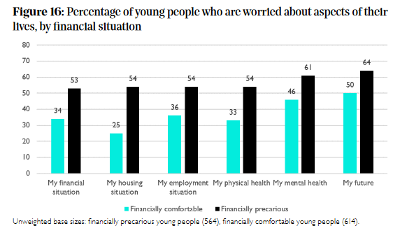

Slide 35
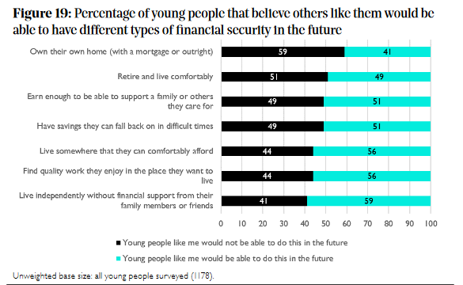

Slide 36
It is important that all young people have economic security to provide them with the best chances in the future to excel, without letting barriers like anxiety about money restrict them from reaching their full potential
- Precious, 17

Slide 37
Policy?

Slide 38
Policy Shifts
Recognise the changing needs of young people

Slide 39
Policy Shifts
Recognise the changing needs of young people
Pro-young people policies

Slide 40
Policy Shifts
Recognise the changing needs of young people
Pro-young people policies
Long-term policies that protect young people’s economic security

Slide 41
What next?

Slide 42
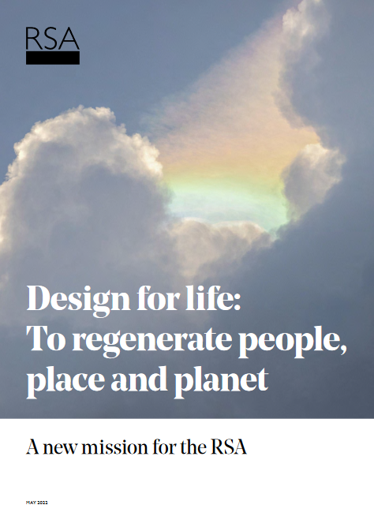
What next?

Slide 43
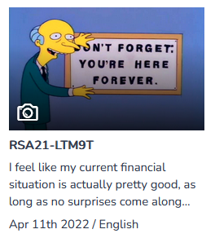
What next?

Slide 44
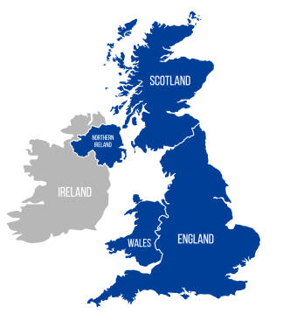
What next?

Slide 45
As the future generation, young people need a seat at the table. Their voices need to be heard and their unique experiences understood. There needs to be a commitment to listening to the lived experiences of young people, they need to consider us beyond targets to meet
- Scarlett, 20

