Slide 1
Evaluating Economies for Healthier Lives Understanding how joint action across health and economic development can address health inequalities
Sharlene McGee
Liz Cairncross
June 2022

Slide 2
The Health Foundation is an independent charity committed to bringing about better health and health care for people in the UK.
We connect what works on the ground with effective policymaking and vice versa.

Slide 3
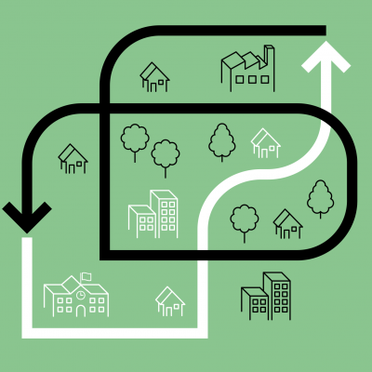
Economies for Healthier Lives
A new funding programme to strengthen relationships between economic development and health
Economic
Environmental
Social
A £2.1m funding programme to support partnerships to promote health and reduce health inequalities through economic development strategies.
The Economies for Healthier Lives programme is supporting four partnerships across the UK with funding of between £300,000 and £500,000 for three years.
Partnerships are led by a local authority or a statutory regional body and will bring together a range of organisations including an academic and collaboration partner.
EHL will find out how to best use economic development to improve people’s health
Notes:
-Against this backdrop, the work of the four sites couldn’t be more timely and aims to provide evidence and insight into how economic development and public health teams can work together to achieve this goal and the wider metrics, governance and decision making that needs to support this.

Slide 4
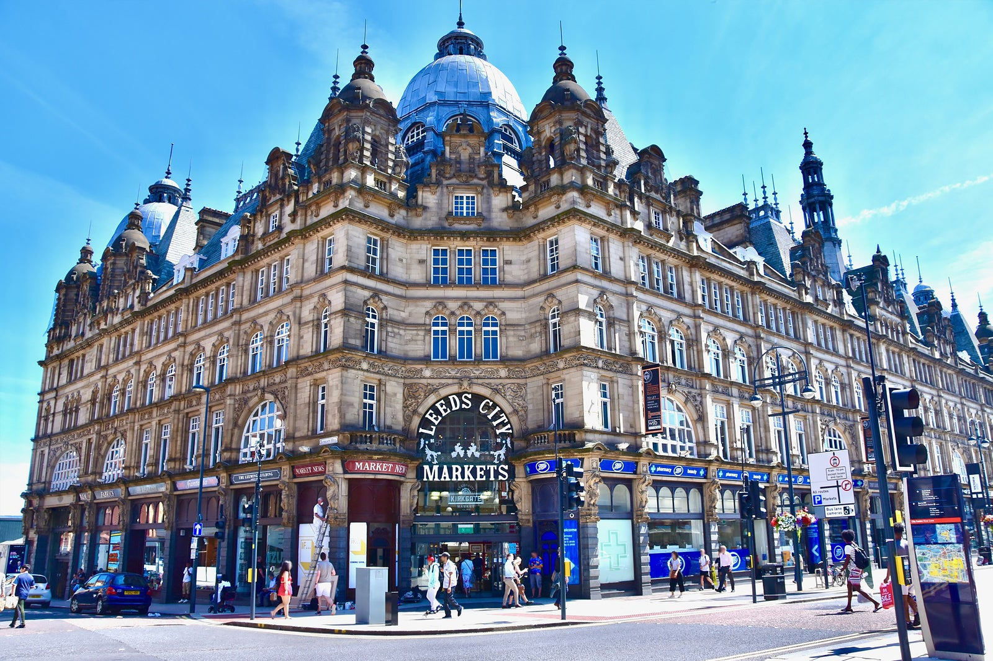
The projects
Glasgow City Region
Capital Investment Health Inequalities Impact Assessment Tool
£2bn annual investment
Havant Borough Council
Wraparound health and wellbeing support model
Redesign of employment services
Liverpool City Region
Leeds City Council
How can capital spending projects improve health?
Strengthening data infrastructure and metrics
Combined Authority with 1.5m inhabitants
Leeds Inclusive Anchors Network
Private sector anchors
1.84m population in the Region
Linking up young people to regeneration plans e.g. Solent Freeport
Coordinating health and social needs on a household basis
Linking up anchors to priority neighbourhoods
Leigh Park, the largest council estate in Europe
13 institutions, 58,000 employees, £2bn+ annual expenditure

Slide 5
Our learning support model

Slide 6
Six critical challenges
Challenge | How might we...
Siloed approaches | support a more joined up culture that reflects the nested nature of the system?
Short-termism | encourage organisations and communities to think and act for the long term?
Resistance to change | support the partnerships to identify and overcome barriers to change?
Headspace for learning and imagination | create a learning culture within and across the network of partnerships?
Austerity and crises | support the teams to develop plans that have a range of competing priorities and external factors?
Measuring the wrong things | support the partnerships to identify and measure the metrics that matter

Slide 7
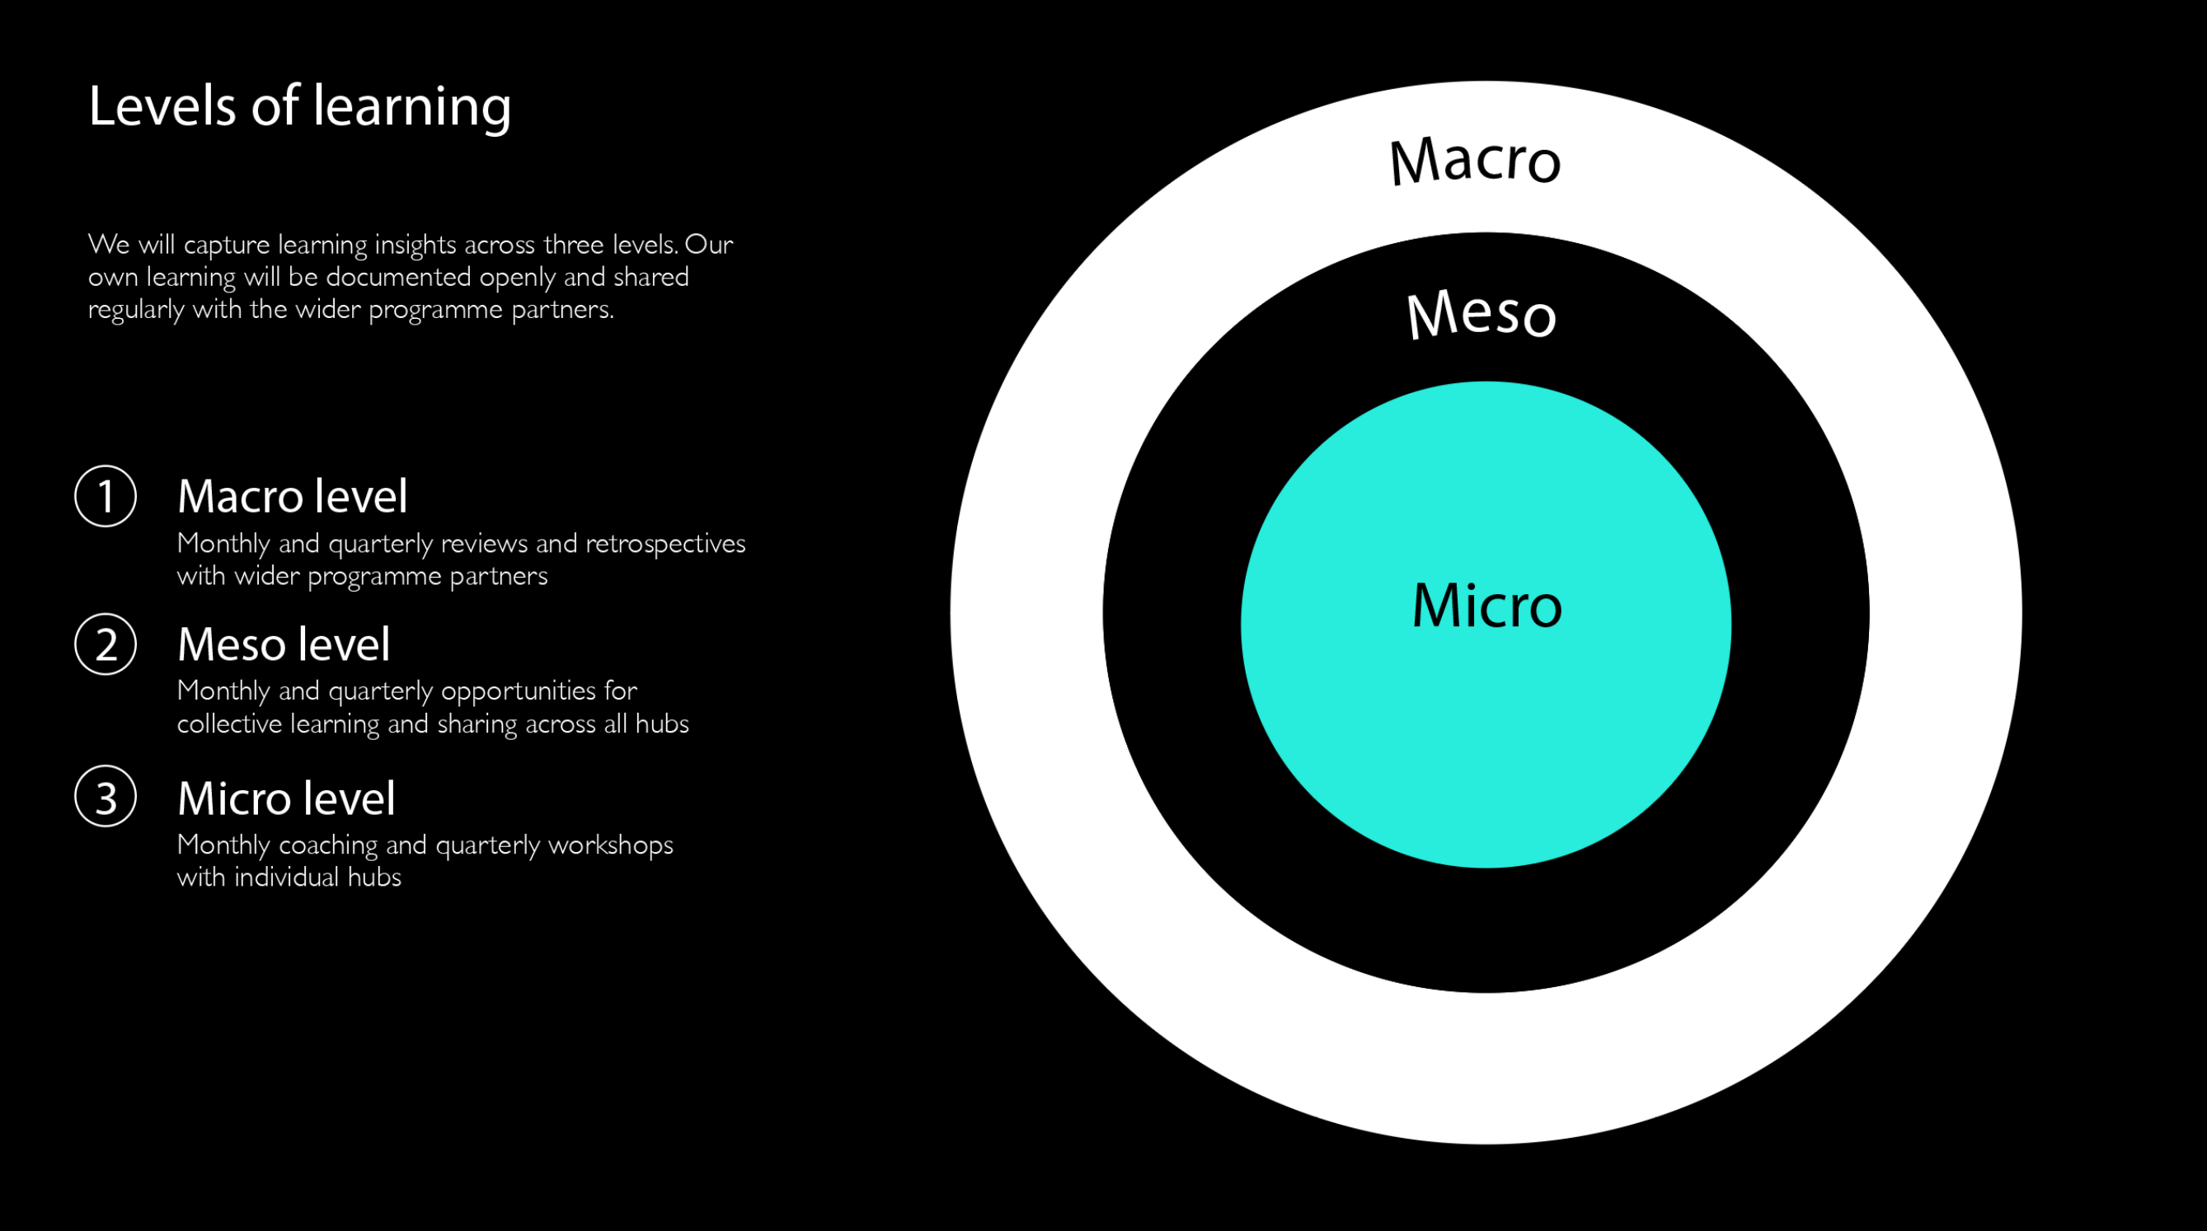
RSA learning package
Learning support provider: the RSA

Slide 8
Programme evaluation – key questions:
What new insights are generated about how to build capacity and closer working between public health and economic development at a local and/or regional level?
What resources and conditions are supporting the projects to meet their objectives, and what is missing?
How are wider stakeholders external to the programme engaging with the programme and how do they perceive the strengths and weaknesses of the programme?
What are the lessons, including unintended consequences, of the programme for funders and wider stakeholders?

Slide 9
Theory of change
Dart J (2018) Place-based Evaluation Framework - A guide for evaluation of place-based approaches in Australia, Dept of Soc Services, Australian Govt.
Notes:
The grey side of the cube (labelled ‘change focus’) shows four basic levels of change (foundations; enablers for change; systemic changes in our community and population impact). This relates to how we expect change to happen over time – and related to the ‘generic theory of change’ which we discuss in the next section.
The yellow side of the cube (labelled ‘stage of the initiative) shows the phases of a PBA in terms of the number of years that the PBA has been implemented (year zero, the initial years, middle years and later years ). Note, these timeframes are not meant to be prescriptive, and instead, are estimates to provide a guide to how long each phase of a PBA may take.
The orange side of the cube (labelled ‘key evaluation criteria’) shows the different types of criteria that may be important to cover in your evaluation, and these include focusing on the principles, process, learning and change.
Principles refer to our intended approaches to achieving these changes. Process refers to the quality and reach of our engagement and activities. Learning refers to our ability to learn from data and evaluation, and adapt our work to improve our chances of achieving outcomes and using appropriate ways of working. Change (or outcomes) refer to the changes that we expect to happen because of our work. The generic theory of change (Figure 6) can help you think through the changes you might expect to see at different levels.
You will notice that our cube sits in a base of context. It is very important to consider and adapt your approach to suit the context. By context we refer to the socio-historical context of what has gone before, the physical context, the community context in terms of demographics, assets, services, and the willingness and capability of the community and stakeholders to embrace change.

Slide 11
Evaluation framework
Year 1: Focus on establishing an understanding of the Foundations / situational analysis of each project context, to fully capture the starting point of each place and their stakeholder ecosystem.
Year 2: Focus on capturing the enablers and barriers, changes in circumstances, trends/levels of systemic change that emerge across projects and at programme level.
Year 3: Similar to Year 2, + collecting information around emerging instances of impact across projects and at programme level + key successes, barriers/challenges, trends & differences, and recommendations for future programmes and projects.

Slide 12
Year 1: Early learnings and challenges
1. External economic and policy context
2. Understanding impact/ how system change is achieved
3. Structural programme challenges

Slide 13
economiesforhealthierlives@health.org.uk
Sharlene.mcgee@health.org.uk
Liz.Cairncross@health.org.uk

