Slide 1
Volunteering and activism: resisting and advancing traditions at the same time
Rosemary Joiner, Federation University, Australia
The People, Place and Policy Annual Conference
July 2022

Slide 2
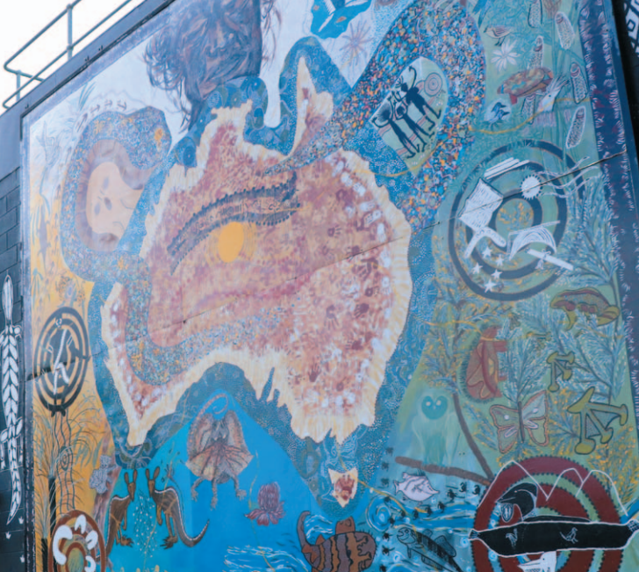
Acknowledgement of Country
Credit: The Koori mural at Federation University Gippsland campus, designed by Marlene Drysdale and Lynne Holten.

Slide 3
Introduction
Introduction: Who am I?
Overview

Slide 4
Practice-based creative research
Practice based creative research is a research methodology in the arts which is exploratory and embedded in creative practice (Gauntlett, 2021)
Research project in two parts: Creative work (artefact) & critical thesis (exegesis)
Using an artistic practice to learn about something else

Slide 5
My research study
using the practice of writing a young adult novel as part of my research into the impact of volunteering
Research questions

Slide 6
Volunteerism: the context
How do we measure the impact of volunteering?
Definitions:
Volunteering has been defined as “time willingly given for the common good and without financial gain.”
Volunteering and activism

Slide 7
How it’s always been done
How we’ve researched the impact of volunteering in the past

Slide 8
Asking meaningful questions
the challenges involved with incongruous questions
Research which uses incomprehensible and meaningless questions risks producing incomprehensible and meaningless answers (Tully, 2018)

Slide 9
The writerly experiment
Seeking answers through narrative storytelling
volunteers contributing during the pandemic (Gubrium and Gubrium, 2021)
acts of benevolence can lead to increased generosity and selflessness in people who volunteer. (Haski-Leventhal et al., 2011)
the transformative impact of volunteer work. (Ronel et al., 2009)

Slide 10
Volunteering and activism
Recognising the combined potential of volunteering and social activism to broaden and sustain people’s participation in human development and social change
“With a shared understanding of the common and interdependent characteristics of volunteering and social activism, the vast potential of volunteerism can be released for the advancement of human development.” (Cronin, K. & Perold, H., 2008)

Slide 11
References
Gauntlett, D, What is practice-based research?, https://davidgauntlett.com/research-practice/what-is-practice-based-research/, 2021
Barnett,T, Meyrick, J & Phiddian, R, What Matters, Monash University Publishing, 2018
Gubrium and Gubrium, Gubrium and Gubrium, Narrative complexity in the time of COVID-19, Perspectives; The Art of Medicine, Volume 397, Issue 10291, June 12, 2021
Haski-Leventhal, D, Hustinx, L & Handy, F, What Money Cannot Buy: The Distinctive and Multidimensional Impact of Volunteers, Journal of Community Practice, Volume 19, Issue 2, May 2011
Ronel, N, Haski-Leventhal, D, Ben-David, M, York, A, Perceived Altruism: A Neglected Factor in Initial Intervention, International Journal of Offender Therapy and Comparative Criminology, Vol 53, Issue 2, April 2009

Slide 12
Rosemary Joiner
School of Arts
Federation University Australia
rosemaryjoiner@students.federation.edu.au

