Slide 1
Exploring the role of VCSE organisations in diabetes care of underserved communities Lucie Nield, Sadiq Bhanbhro, Sally Fowler-Davis 06.07.2022

Slide 2
Background
Covid-19 pandemic highlighted and elevated the importance of Voluntary, Community and Social Enterprise (VCSE) sector role (MacInnes et al., 2021)
VCSE organisations often have a deep understanding of local community needs (UK Community Foundations, 2022)
Provide support to marginalised communities who may not access traditional healthcare settings (PHE, 2021)
Type 2 diabetes mellitus (T2DM) prevalence correlates with low socio-economic status (SES) and often underserved groups (Roper et al., 2001; Brown et al., 2004)

Slide 3
Study context
Diabetes self-management is necessitated but not easy for individuals to achieve
Voluntary Action Sheffield (VAS) have been working to understand the role of the VCSE sector in diabetes management
Thinking about whole-systems approaches to diabetes management in Sheffield
Notes:
A short term project designed as a simple evaluation to capture insights into the effectiveness of VCSEs supporting people with Type 2 Diabetes

Slide 4
Aims & Objectives
To work with VCSE organisations to co-design a qualitative research study
To collect user perspectives and stories of people with lived experience
To evaluate the combined service offers across the health and care system.
To evidence the impact of the VCSE services in diabetes care
Notes:
The purpose is, to develop better outcomes for people living with type 2 diabetes mellitus by collecting user perspectives / stories of people with lived experience and evaluating the combined service offers across the health and care system.
The outcomes of the project over the next six months is to co-produce a framework for measuring system -level benefits and re-enforce a culturally-sensitive, community-based response, based on connections within communities and particularly recognise the best ways of engaging with diverse ethnic communities that statutory services don’t currently reach.
To identify best practice
Ultimately, to develop better outcomes for people living with T2DM

Slide 5
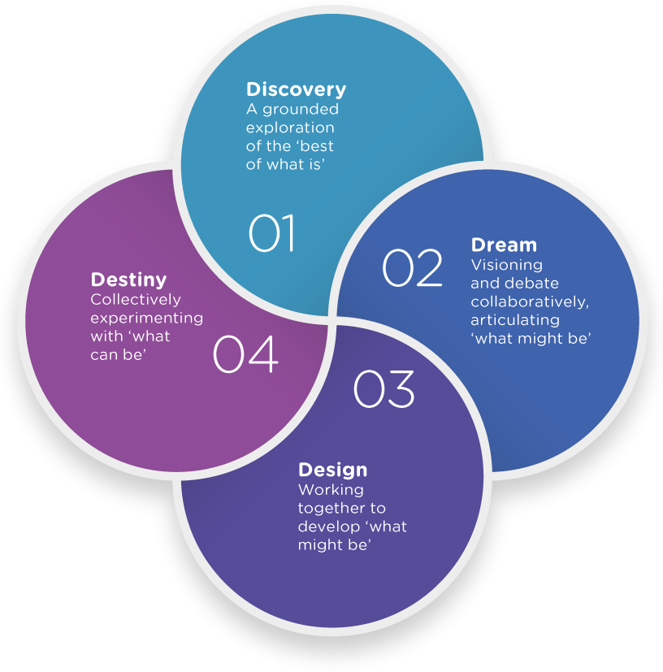
Appreciative Inquiry (AI)
Developed in the mid 1980s by David Cooprider and Suresh Srivastva.
It is a methodology that begins a dialogue between individuals, expands to groups and builds to embrace community wide intentions and actions.
Based in social constructionism that focuses on positive inquiry about accomplishments and values.
It generates new meaning and inspires new possibilities by seeking to achieve significant insights
Appreciative Inquiry and Public Dialogue: An Approach to Community Change | SpringerLink (2002)
Notes:
Appreciative Inquiry (AI) was used as an overarching framework to inform the co-production process to achieve the project's aim. AI is a forward-thinking way and process of knowledge generation through the 4D cycle, i.e., discovery (what is the best of what it is), dream (envision the impact), design (co-production) and destiny (how to empower, learn and improvise?). AI seeks out the best of "what is" to help ignite the collective imagination of "what might be". The aim is to generate new knowledge that expands the "realm of the possible" and helps members of an organisation envision a collectively desired future and to carry forth that vision in ways that successfully translate images of possibility into reality and belief into practice" (REF).

Slide 6
Methods
Stage 1- VCSE partners conducted qualitative semi-structured interviews with past/present service users living with T2DM
Stage 2- SHU transcription and qualitative framework analysis by 3 researchers following the 5 stages:
familiarising (reading and rereading data transcripts)
identifying a thematic framework (the theory change thematic framework informed the analysis)
indexing (entered short summaries into the coding frame)
charting (entering themes into a matrix using columns and rows for summarised data)
mapping and interpretation (comparing and contrasting data excerpts, searching for patterns, and seeking explanations for patterns in the data).
Stage 3 – Synthesis of findings involving drafting and sharing results with all participants, providers and participants to refine and sense-check data findings for fidelity
Notes:
Adopted a collaborative bottom-up approach
engaging and training VCSE partners interested in diabetes to design the data collection tools and conduct the interviews
Developed an designed an interview topic guide in collaboration with VCSE partners
Trained VCSE partners in how to perform a qualitative interview based on the principles of AI
The interviews were conducted online, face-to-face or via telephone using the predetermined co-developed topic guide; each lasted between 20 and 40 minutes. After obtaining informed consent, the interviews were audio-recorded or hand-written verbatum, and then some of the interviews were translated from Urdu to English. The research team (SFD, LN & SB) received anonymised voice files and were transcribed by Otter.ai software. The research team listened to the audio interviews and edited the transcripts produced by Otter.ai. Text files were read by the research team.

Slide 7
Participants
Notes:
In total, 33 interviews were submitted from 7 organisations. Two interviews were excluded as the interviewee had type 1 diabetes and 1 interview was a duplicate. Thirty interviews were transcribed in total
Participants had been diagnosed between 12 months to over 30 years, with the majority of participants being diagnosed within 5 years. Nearly half of the participants lived in the top 20% most deprived centiles according to the English Indices of Multiple Deprivation (2019) from postcode data.

Slide 8
Findings
Six key themes were identified:
1) Information sources and communication
2) Trusted services and health professionals
3) Personal diabetes journey
4) Diet and nutrition choices
5) Active self-management
6) Additional support

Slide 9
Theme 1: Information sources and communication
Commonly participants received early advice and guidance which was generic and not tailored or culturally appropriate
DESMOND courses were received variably by the participants, as was information provided by their health care professionals (HCPs)
Many felt that information from professionals wasn’t available when they were ready to accept it or when they needed reassurance.
They readily turned to the internet and friends or family members for advice in the absence of HCPs, accessing evidence of variable quality
They told me to watch my diet, watch what I eat- plenty greens, less carbs, and to exercise and that will keep my blood sugars down (White British Male, 65+ years )

Slide 10
Theme 2: Trusted services and health professionals
A good rapport and regular contact with HCPs was appreciated and useful; particularly when this information was tailored or personalised
Many of the interactions with HCPs were impacted by the Covid-19 pandemic leaving patients feeling alone with their diabetes management
Those who engaged with VCSE organisations felt that they were provided with support and information which allowed them to better manage their diabetes
The information I was given was appropriate for me. I visited the nurse at the Doctors surgery every 3 months for my bloods, She was very good and I developed a good relationship with her, she told me about exercise classes in the area and also told me about health walks. (Asian Female, age 56-64 years)

Slide 11
Theme 3: Personal diabetes journey
Biographical disruption was commonly reported post-diagnosis which had detrimental and sometimes long-lasting effects on the individuals mental health
The reported impact of the diagnosis on their mental health was very significant and often prevented them from processing or using the diabetes management information.
Many also report ongoing concerns about the long-term implications of living with diabetes
I was sad- did nothing, got stressed, put on a lot of weight, eating a lot more than usual. (White British Female, 26-45 years)

Slide 12
Theme 4: Diet and nutritional choices
My husband was very helpful and supportive...he helped me reduce some weight…I realised that when I cut down on sugary stuff and started eating less rice and chapati my weight dropped by itself. I also started walking a lot and me and my husband would go for walks after the evening meal (Asian Female, age 56-64 years)
Those who had support from friends and/or family members reported making better food choices, whilst others were limited by household challenges such as deprivation and multiple morbidity
In addition to social support, self-motivation and elicitation of knowledge from multiple sources was effective at providing individuals with the confidence to make changes.

Slide 13
Theme 5: Active self-management
The information I got was from ….a really good group. You know, it's, it helps me really, to manage the day to day... Day to day menu, day to day exercising everything. I mean, every…everyone that was there was going through the same thing. I mean, the shared experience, we all shared our experience, you know, because everybody was different there. And they understood what everybody else had going on. So it helped. (Black British Caribbean Female, age 65 years+)
Participants who had engaged with the local VCSE service benefitted from local knowledge and a shared understanding of the challenges of living well with diabetes, and the practical steps they could take through discussion with others in a similar situation
While some participants were self-motivated and able to make changes due to their perceived “self-control”, others found that there were barriers such as ill health and side-effects to medication.
Many also self-medicated using alternative therapies and traditional remedies

Slide 14
Theme 6: Additional Support
There is a need for a lot of improvement culturally because then if we introduce…traditionally if there is one person get the information he spread it out to the … a big job to for the people's awareness in mainly in Asian community (Asian British Male, age 46-55)
Most participants wanted to be recognised as having both a cultural heritage and a health support need. There was recognition that some groups were missing out on the collective knowledge about health.
They wanted practical, supportive information and services delivered by professionals in ways specifically tailored to their community
They felt that group and community building would be important to learn with and from one another
They requested support to be offered regularly and sustainably rather than a programme of a defined duration

Slide 15
Conclusion
Participants reported an inconsistent range of support post T2DM diagnosis and very limited engagement with the main educational programme offered as a standard (DESMOND)
The evaluation identified the benefits of hyper-local group activities, often employing peer to peer processes to share information about living with T2DM.
Advice, guidance, and long-term support were not consistently available, but deemed important.
While VCSE organisations maintained relationships and were more culturally appropriate (concerning language and cultural diets), there was still a demand for more responsive and cohesive support for lifestyle and behaviour changes.

Slide 16
Impact of this study
1. The theory of change associated with VCSE activity demonstrated the opportunities for systemic support for more marginal populations with T2DM and City-wide discussions are progressing about their role across primary care
2. The evaluation has enabled a large specific grant application from a collaborative group of VCSE organisations to enable a partnership approach to piloting new services to meet the more deprived population health need
3. An NIHR programme grant is being prepared in respect of the findings; to develop a health coaching intervention across primary care, based on this preliminary co-production
4. The VCSE sector has an increased role in healthcare. There is a case for capacity and capability building of the sector organisation to support the broader healthcare sector effectively.

Slide 17
References
Brown AF, Ettner SL, Piette J, Weinberger M, Gregg E, Shapiro MF, et al. (2004) Socioeconomic position and health among persons with diabetes mellitus: a conceptual framework and review of the literature Epidemiol Rev, 26: 63-77
Finegold, Holland & Lingham (2002) Appreciative Inquiry and Public Dialogue: An Approach to Community Change Public Organization Review, 2:235–252
MacInnes J, Wilson, P, Sharp R, Gage H, Jones B, Frere-Smith K et al. (2021) Community-based volunteering in response to COVID-19: The COV-VOL Project https://arc-kss.nihr.ac.uk/news/voluntary-sector-plays-key-role-in-delivering-community-services-during-lockdown
PHE (2021) https://www.gov.uk/government/publications/health-inequalities-place-based-approaches-to-reduce-inequalities/place-based-approaches-for-reducing-health-inequalities-main-report
Roper NA, Bilous RW, Kelly WF, Unwin NC, Connolly VM (2001) Excess mortality in a population with diabetes and the impact of material deprivation: longitudinal, population based study BMJ, 322: 1389-1393
UK Community Foundations (2022) https://www.ukcommunityfoundations.org/our-impact/understanding-local-need

