Slide 1
NGO-led Rural Development in Egypt
Breaking down barriers: increasing inclusion across society
Hoda Elhalaby
PhD Student
Department of Urban Studies and Planning
haelhalaby1@sheffield.ac.uk
Twitter: @Hoda_el_Halaby
Supervisors
Dr. Steve Connelly
Dr. Tom Goodfellow

Slide 2
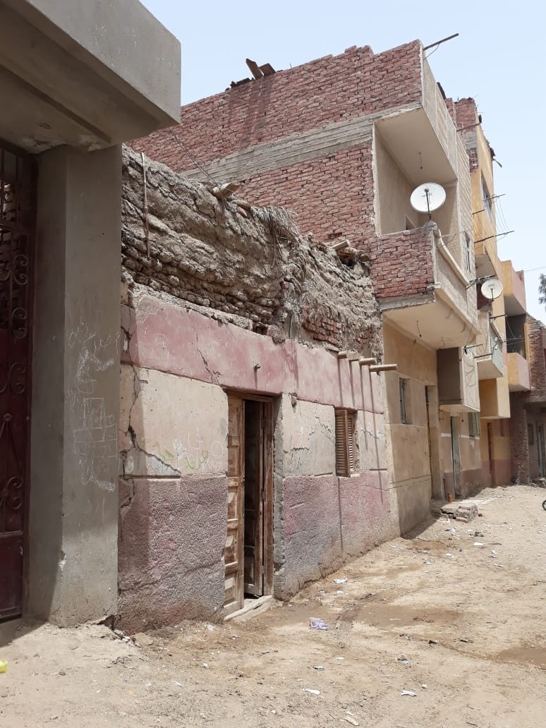
57 %
Of the Egyptian population live in Rural Egypt
32.5% of rural inhabitants
are living in poverty (Worldbank 2020)
Notes:
Which has increased from 27% in 2015 and which is greater than poverty in urban egypt
Daily workers with no stable income
Inflation

Slide 3
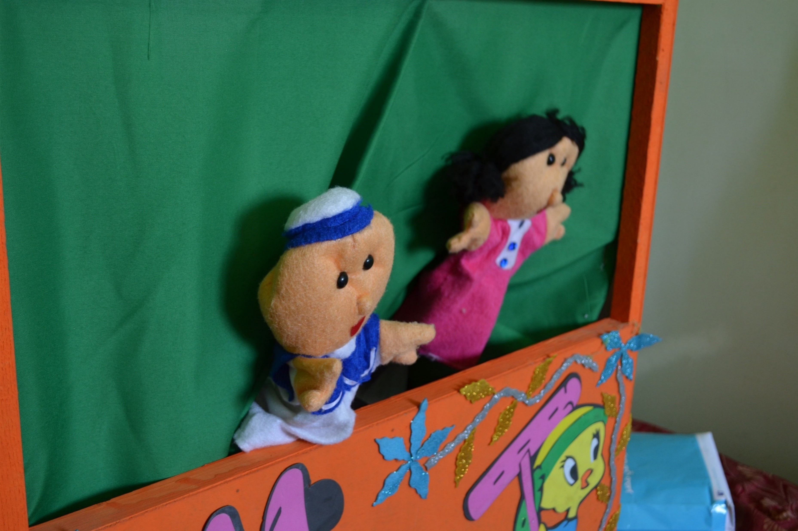
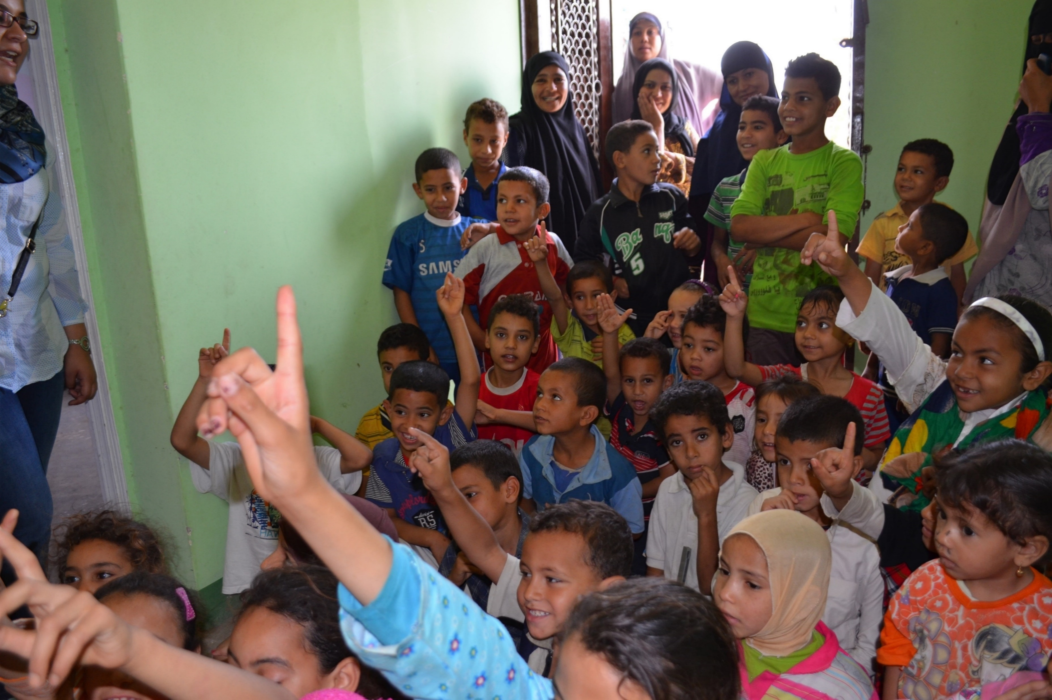
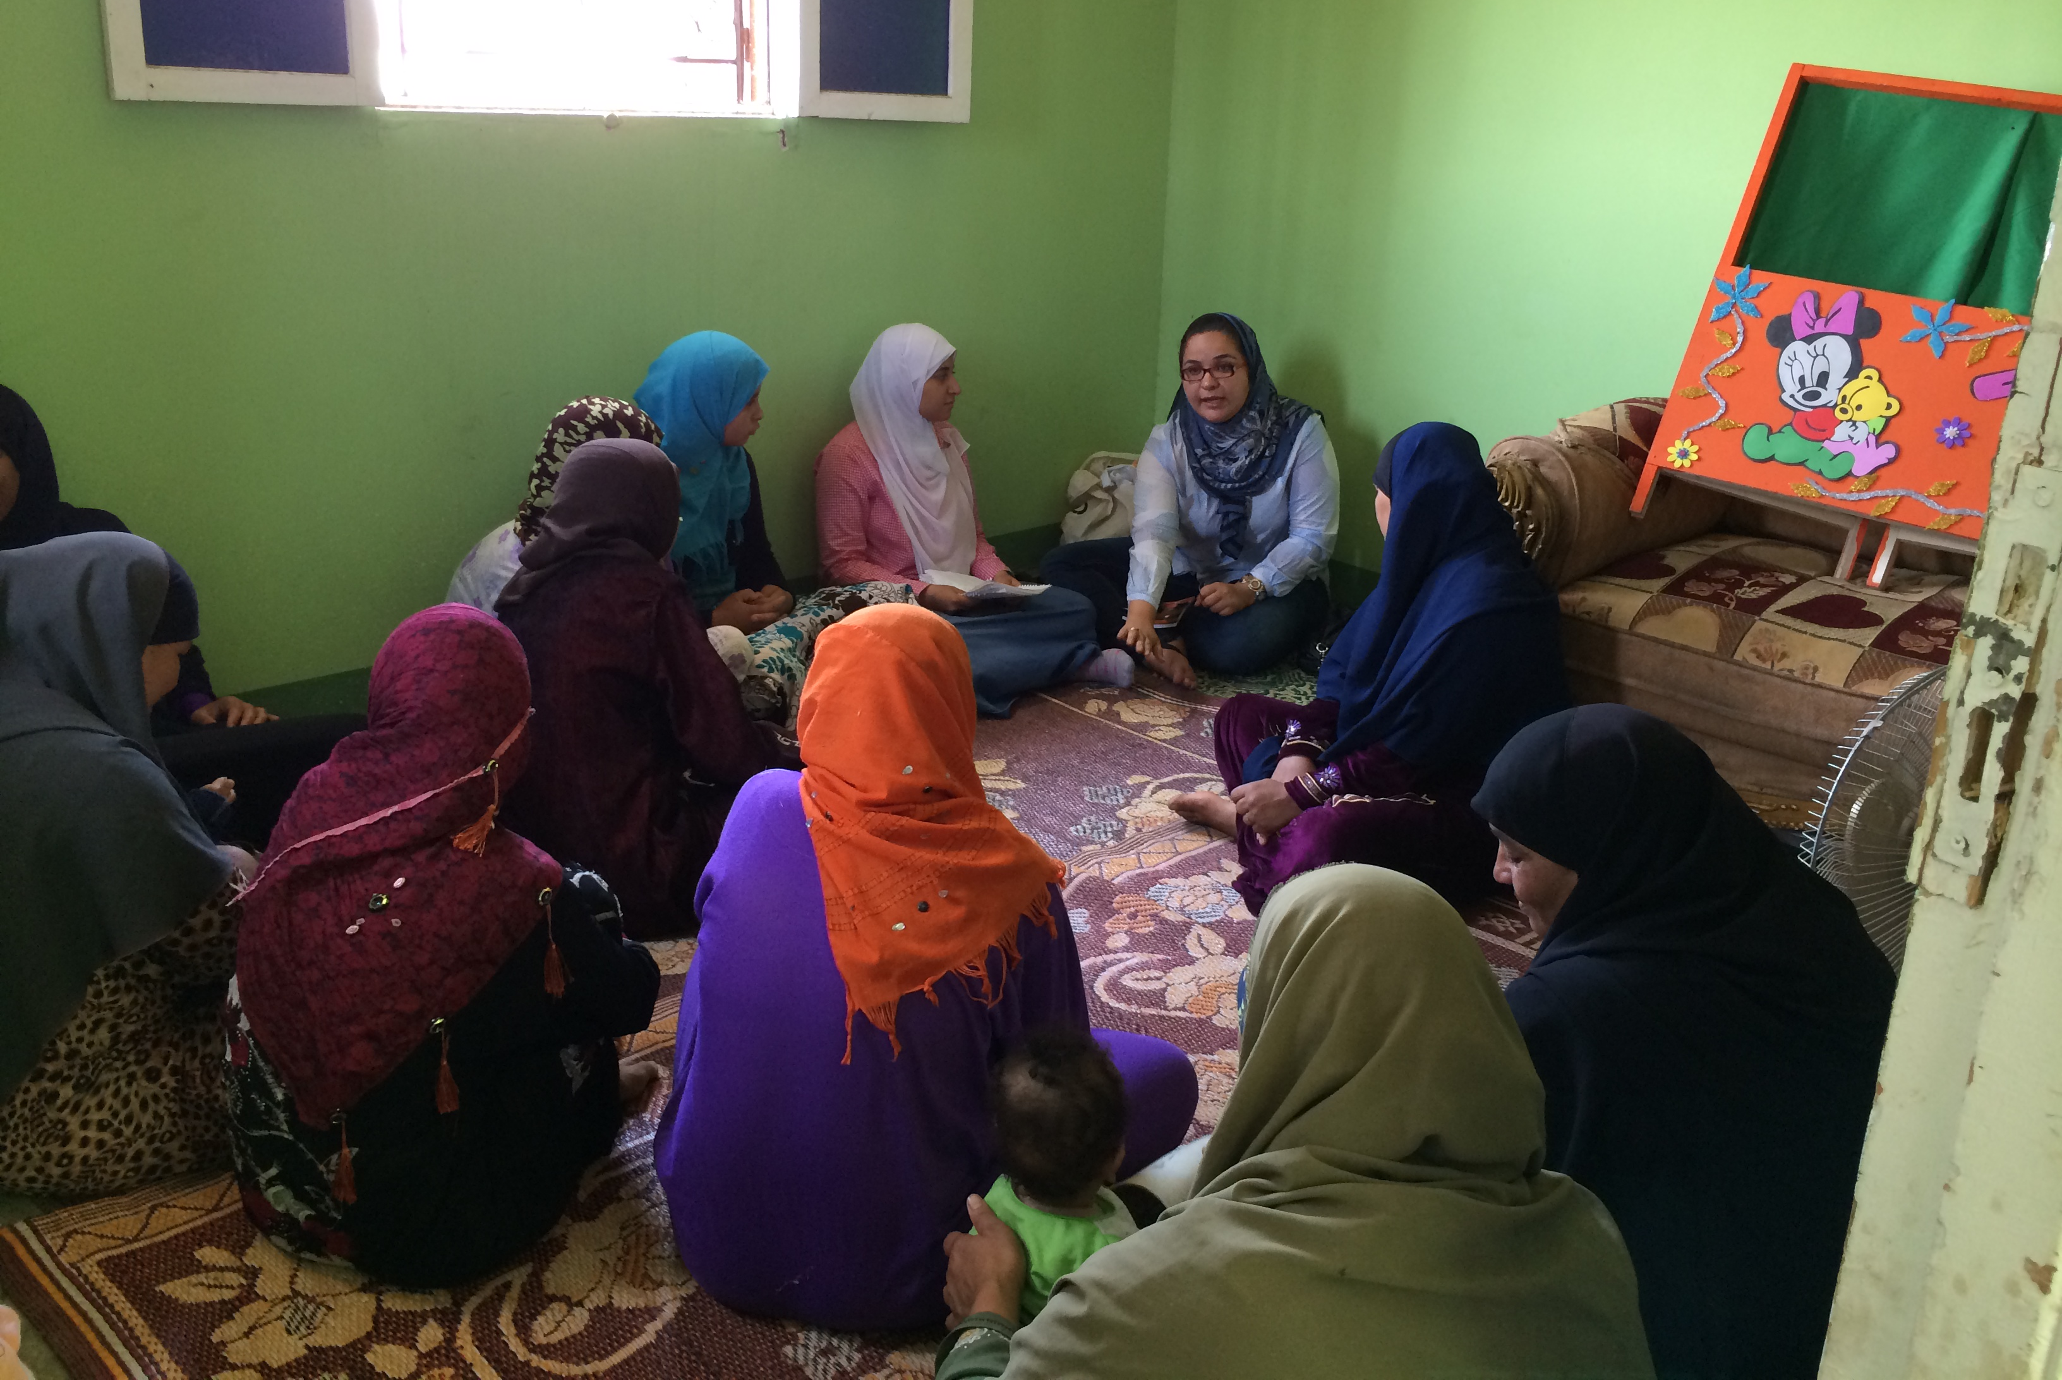
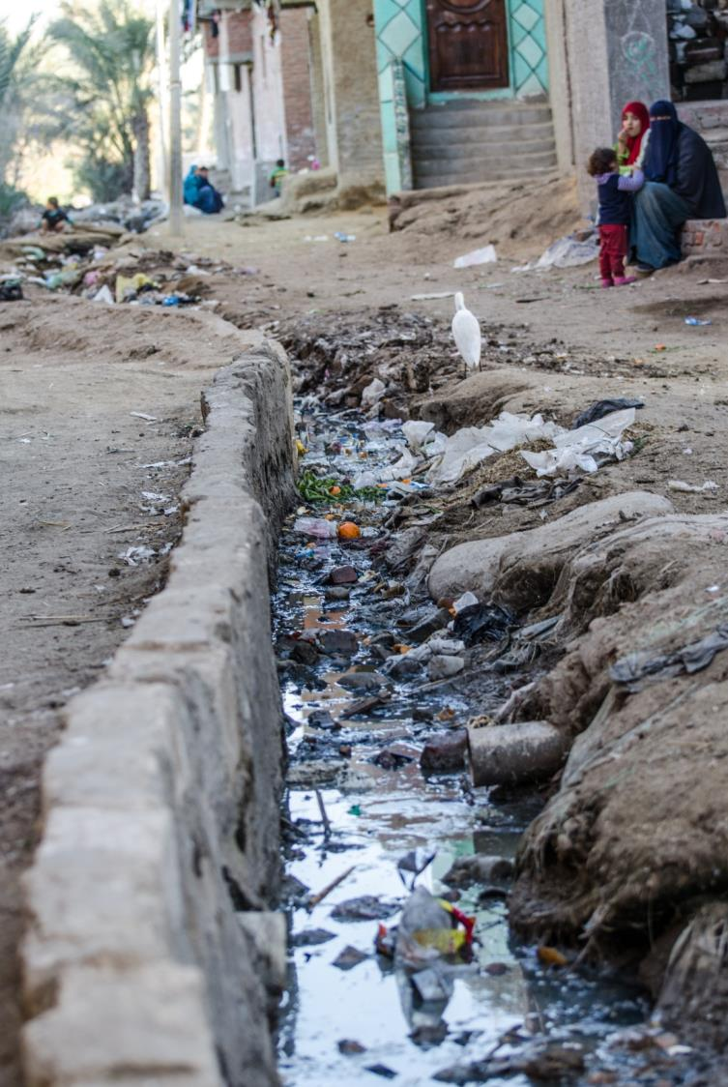
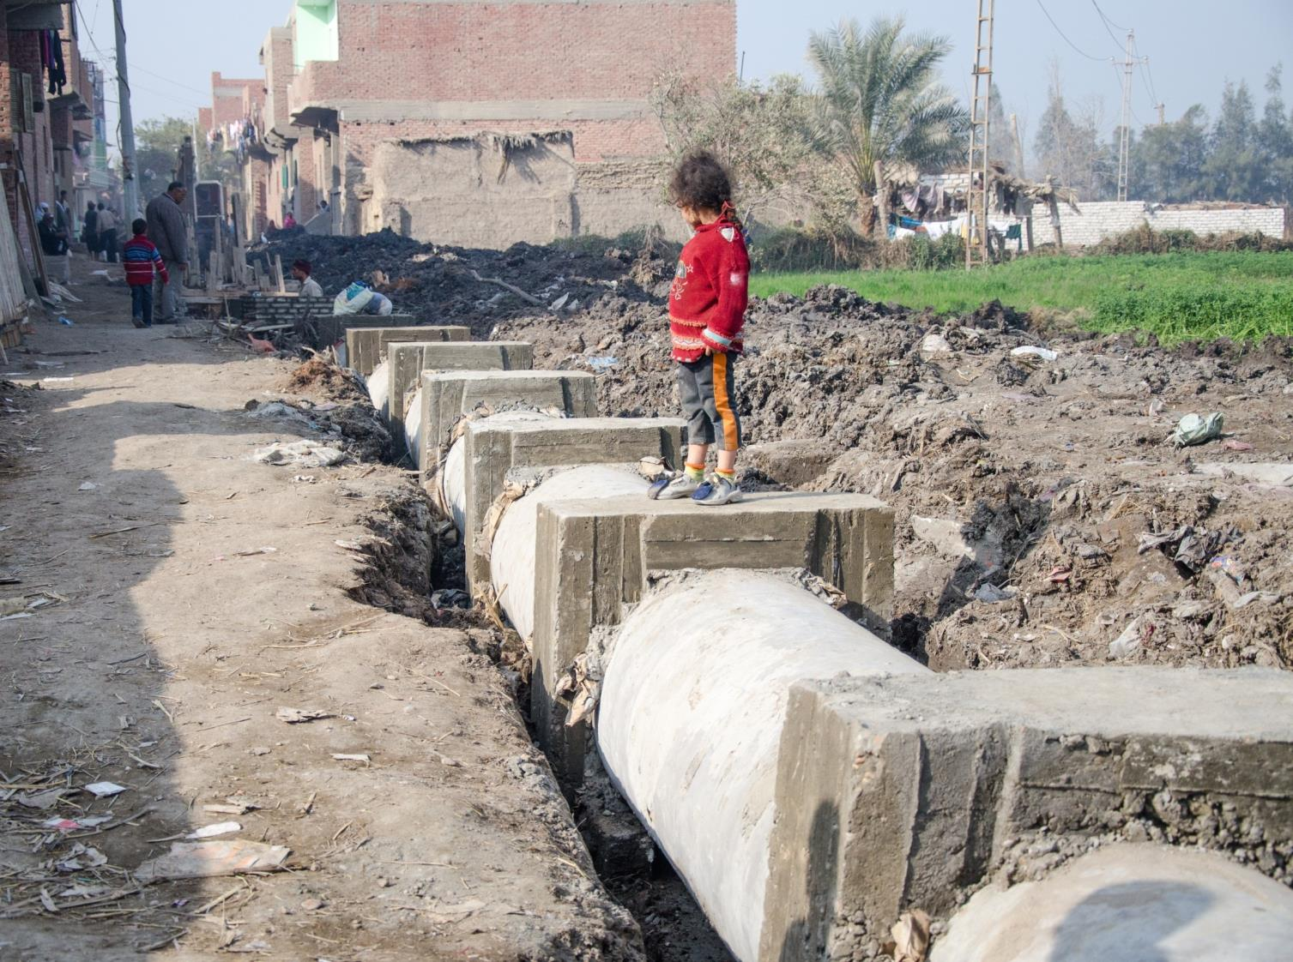
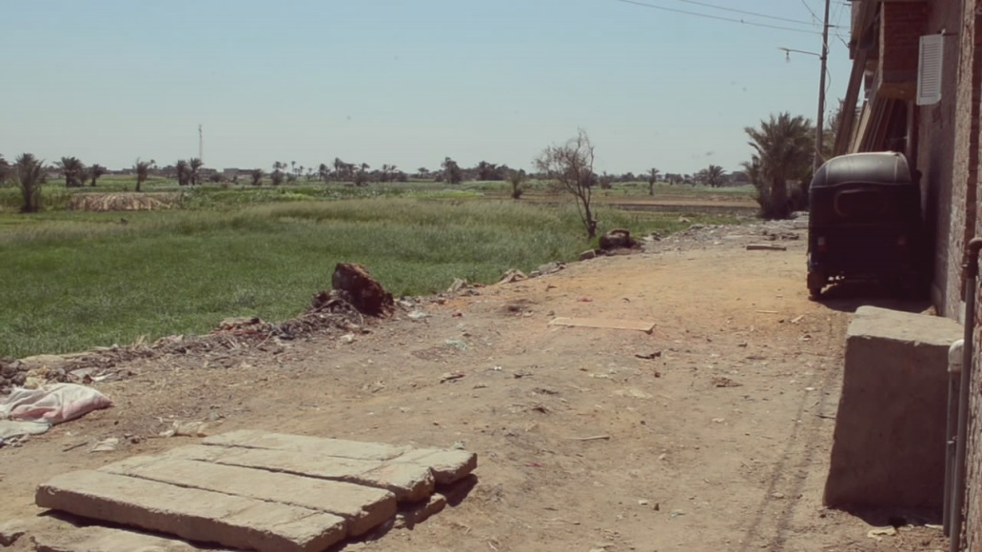
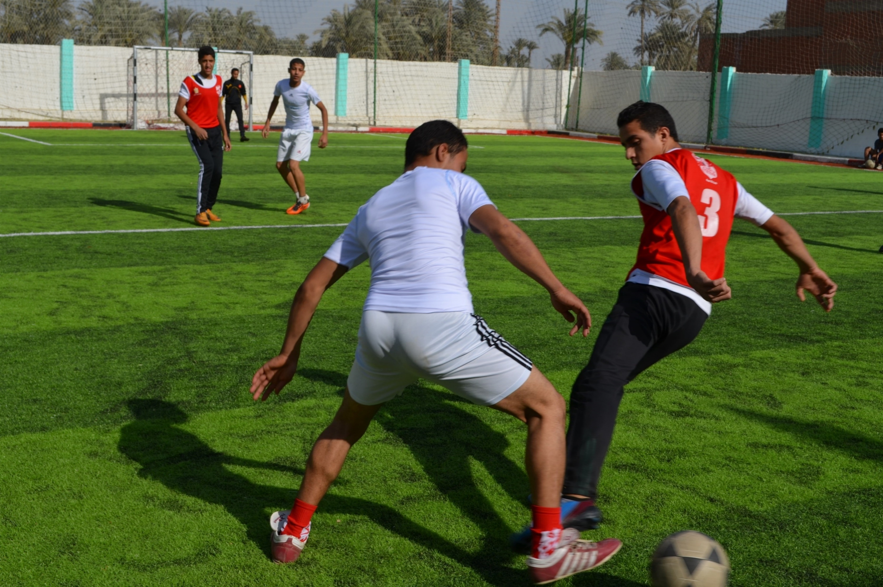
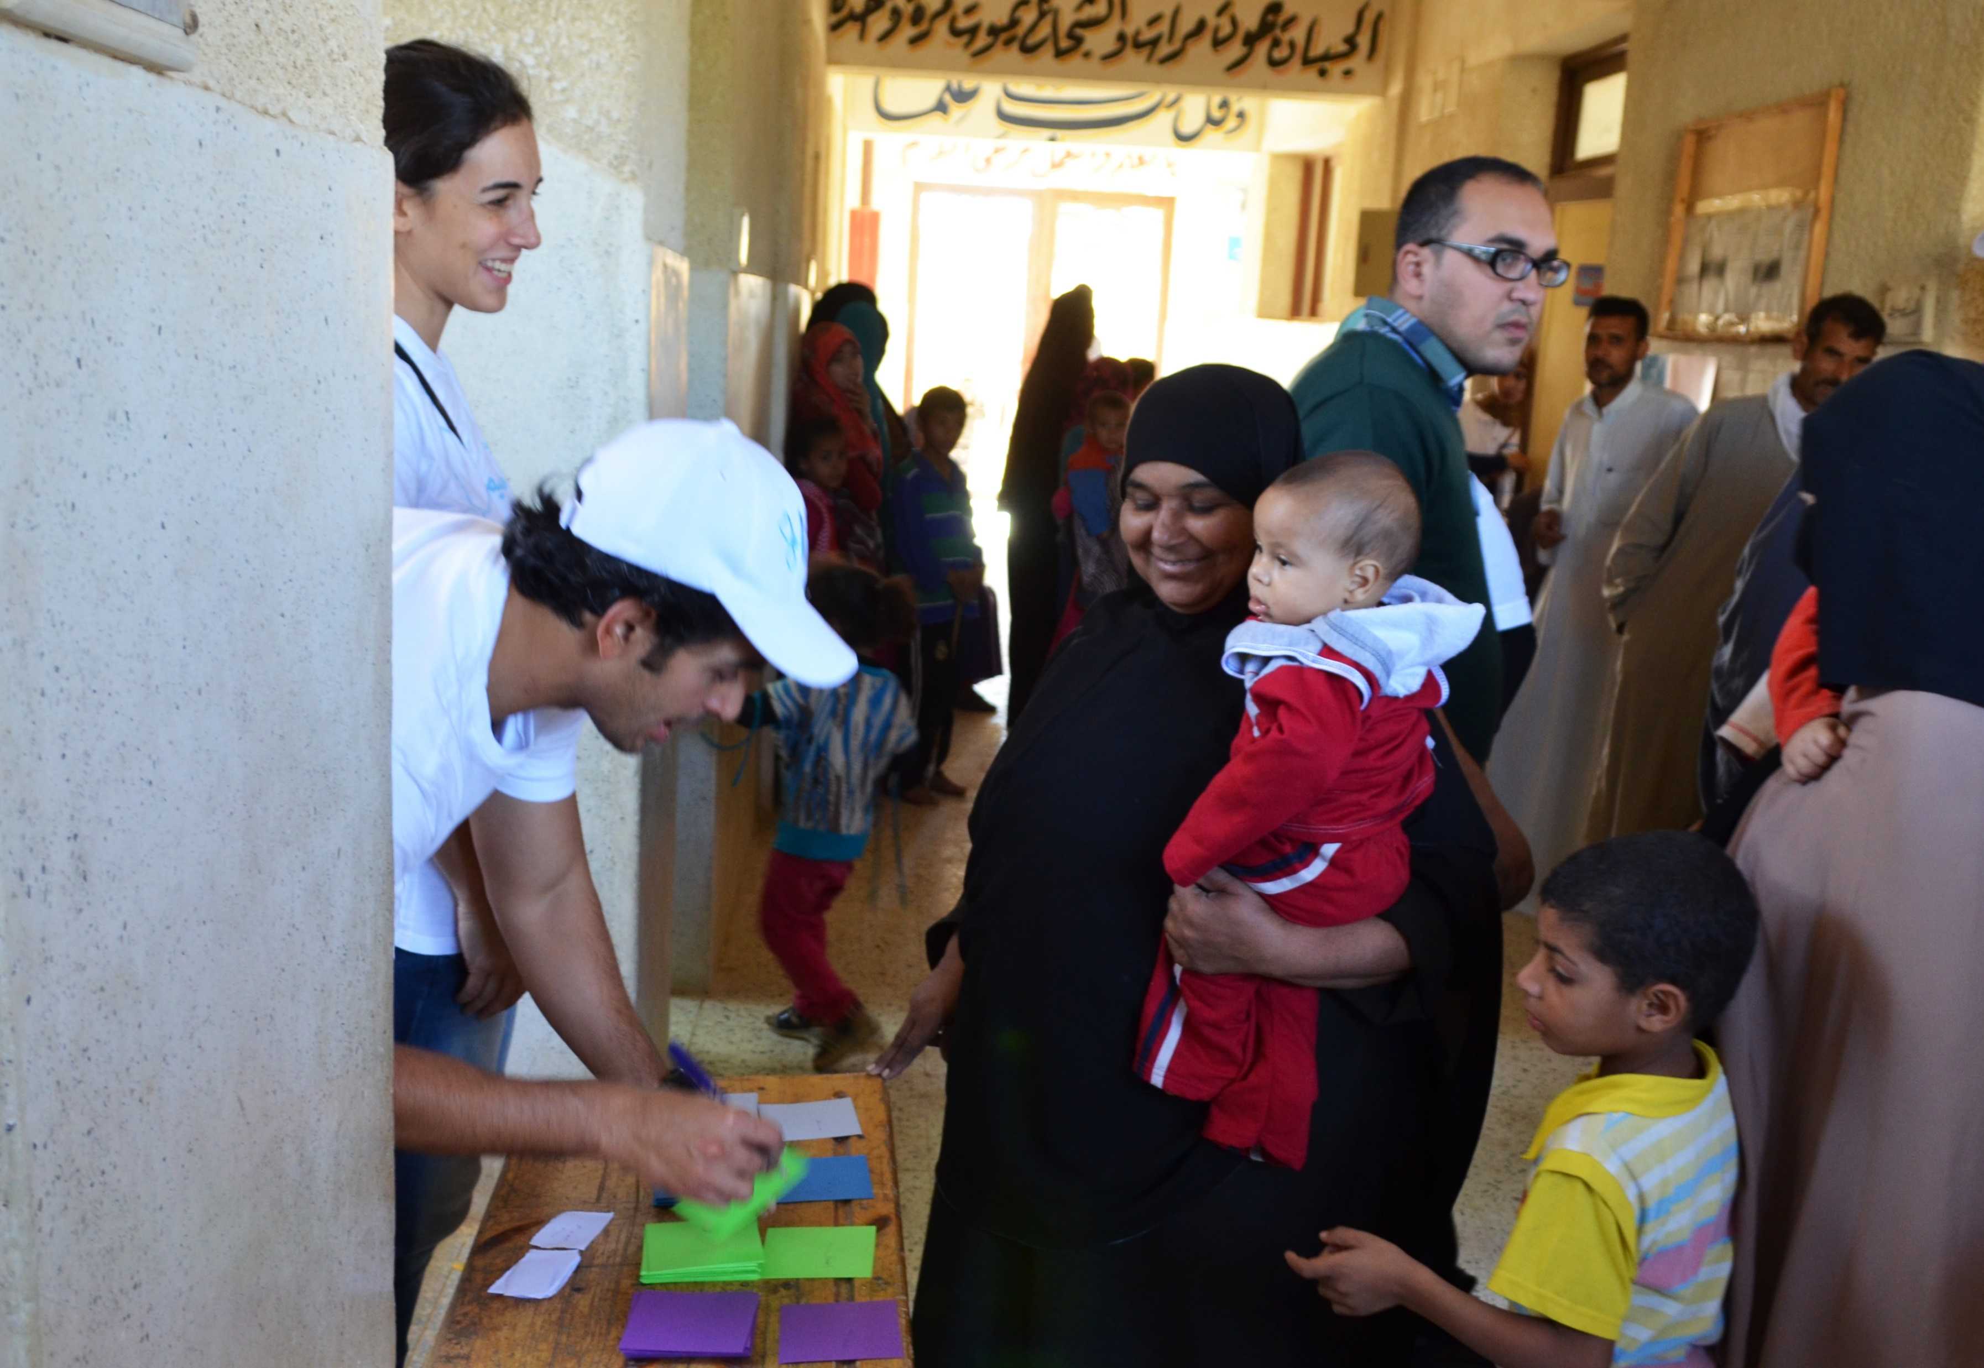
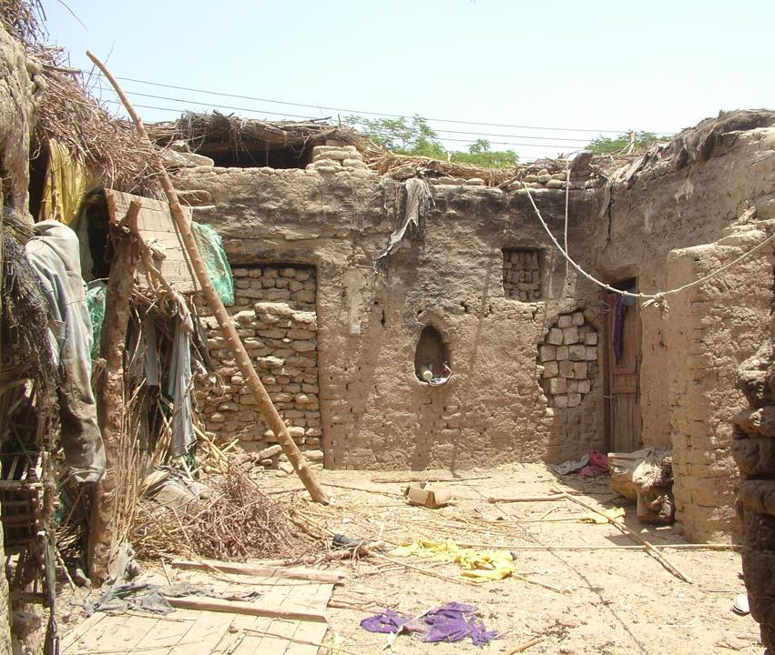
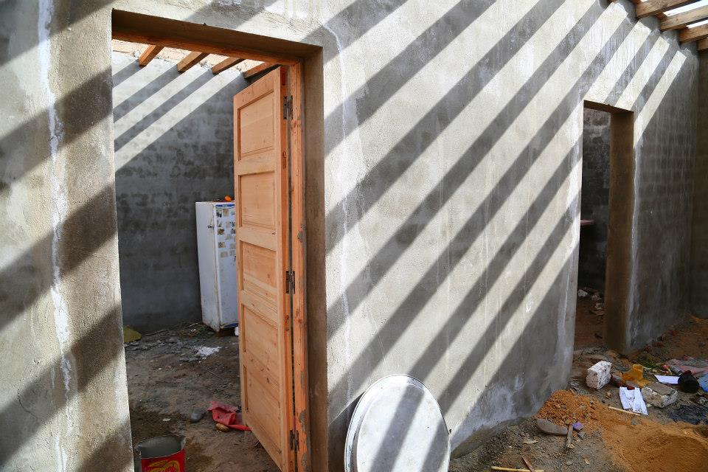
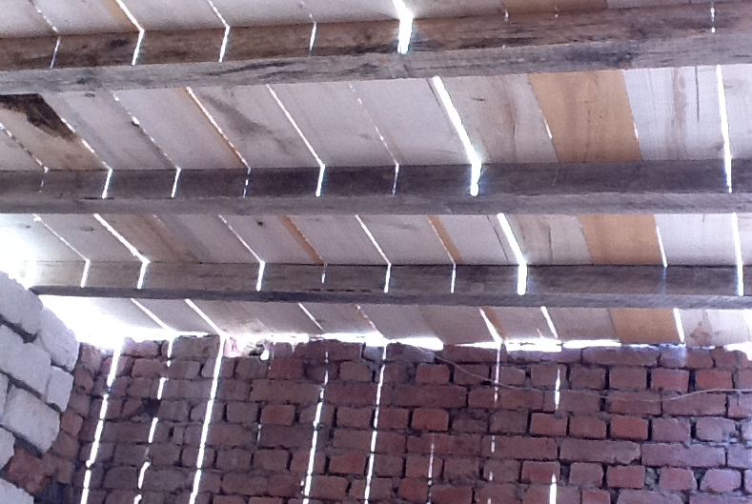
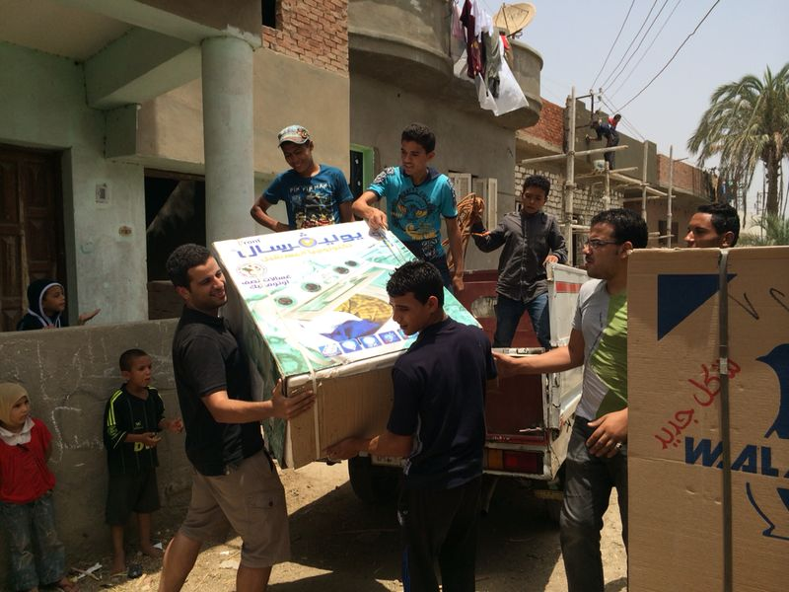
Human Development- Awareness
‘Benbny Hayah’ Building Lives
Physical Interventions
Human Development- Sports and Medical Convoys
Handouts

Slide 4
Rural development: Government and NGOs
A Dignified House
Houses
Sewage
Water
2011
2017
2007
The Revolution
2012
2019
Geographical targeting -The Poorest 1000 villages
NGO-led Village Development
Dignified Living
Notes:
Since 2007 and despite the changes that happened to the Egyptian community and politics the programmes seem to identical, regardless of the fact that poverty is in the rise. This discourse of development has been locked in by all involved stakeholders. we need to understand how it works thus the problems and how it can be improved.

Slide 5
Why?
This research investigates the nature of NGO-led village development in rural Egypt. Aiming to comprehend the processes, actors, interventions and effects. In addition to presenting the various perceptions of the government, the NGOs and the people of the development.
There is a need to understand the system and process
Inadequate literature about NGO-led development in Egypt
The available literature is quantitative and produced by foreigners
Physical interventions are prioritized over Human development interventions.
The Intended Beneficiaries perspective is not highlighted

Slide 6
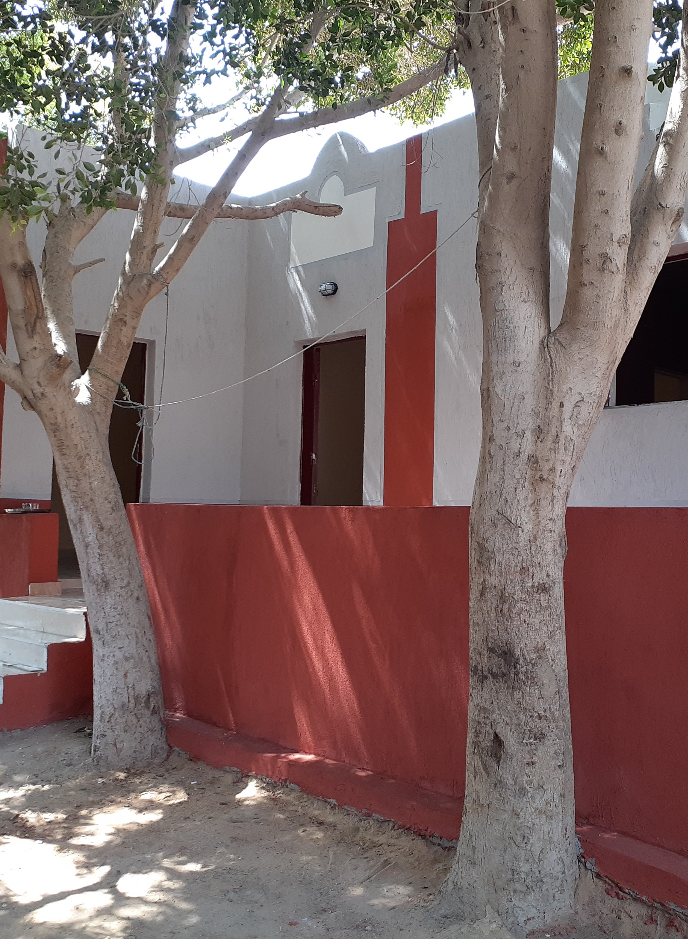
Case study
Fayoum, Benisuif, Sohag and Alminya Governorates
3 NGOs and 1 voluntary group
45 plus in-depth interviews (Governmental officials, NGO managers & field workers, CSO directors and Villagers)

Slide 7
Findings

Slide 8
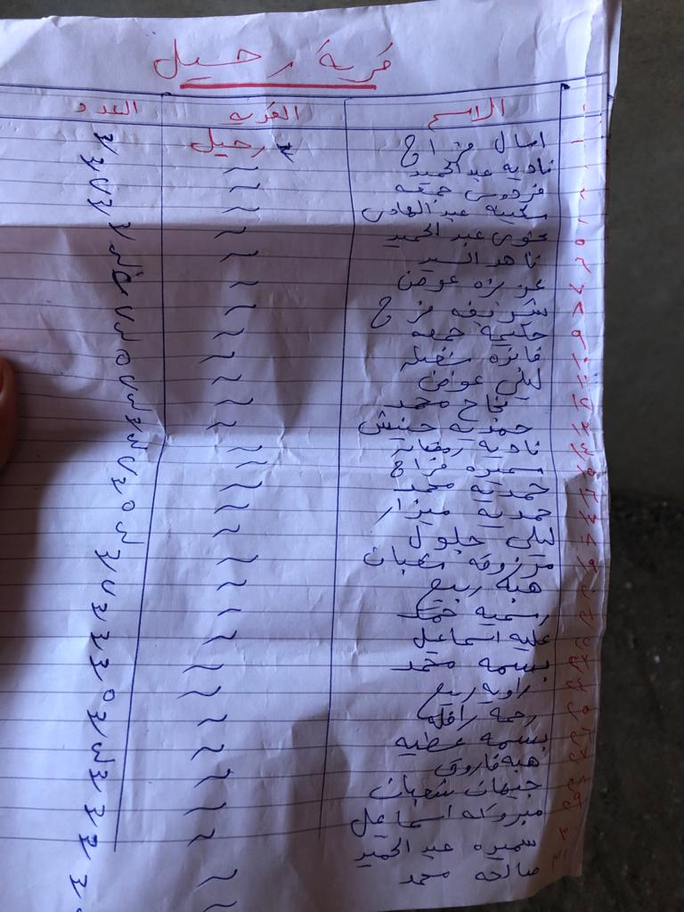
The Aid chain
The Government
NGO
NGO fieldworker
Intermediaries/ village representatives
The Intended beneficiaries
Chain C- Volunteer Donor
Chain A - Government
Chain B - NGO

Slide 9
Rural livelihoods and Priorities
Education
Work
House
Marriage
Health
Donor preferences
Intermediaries
NGO-Donor preferences
Beneficiary
Depends on the status
Government
Specialties
House, work, marriage, health then education.
Basic needs
NGO
Infrastructure, Houses, service buildings

Slide 10
Roles & Perceptions
Planner
Executor
Facilitator
Receiver
Government
Providing the basics for a human life (shelter, water and sewage)
NGO
Helping the Government
Intermediaries
Doing good, helping people (personal gains and status)
Beneficiary
On the receiving end.
Attaining their goals (helping people)
“They are all very decent, God bless them with everything….. success and safety …may god reward them” Nagla 42

Slide 11
Identifying barriers to participation and inclusion
Aid limitations
The impact of an authoritarian state on development decisions
The role of culture and religion in shaping the actors’ motivations, perception of themselves and their roles in the aid chain
Intermediaries
Beneficiary
(Najam,2000)
Notes:
What are the imbedded barriers that we usually do not account for ?

Slide 12
The Discourse –A continuation
Government
Legitimacy
Quantitative reporting
The know how is available
matches the global requirements
NGO
They have the know how
The discourse matches the donors needs (aligned with the government)
Intermediaries
They believe so much in what they do
They try to give feedback but it’s a top-down chain
Beneficiaries
Feel unworthy
Don’t want the aid to stop
They feel they should be thankful and content to what god sent
Government
Goal setting
Protocols
Large NGOs- Government Funded Projects NGO Project
Experience
Discourse of Development
Framework
Isomorphism
Small Independent NGO Project
Framework
Interventions
Practices
Beneficiaries
Complementary Discourses

Slide 13
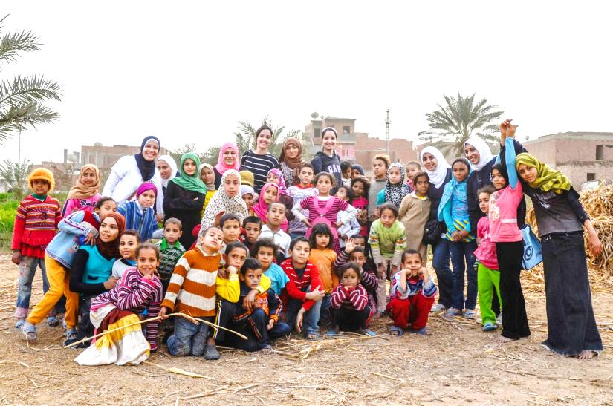
Thank you

